Slide 1
“A Lean Journey”
THIRLBY CLINIC, P.L.C. - TRAVERSE CITY, MI

Slide 2
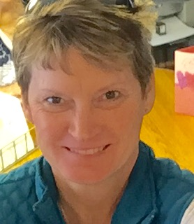
Deb Schepperly
Care Coordinator
Medical Assistant for 12 years at Thirlby Clinic, PLC
The last 6 years led the transition from paper charts to an electronic medical record.
Integral part of developing pay for performance in the Traverse City area.
Currently Care Coordinator

Slide 3
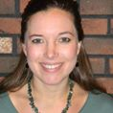
Jamie Schichtel, CCM, CMA(AAMA)
Practice Administrator
Manager of Neurology office for 12 years. Implemented LEAN Process improvement prior to champion class.
Started the LEAN champion course still working for Neurology.
Changed positions for career growth and experience offered at Thirlby Clinic, PLC.

Slide 4
Marie Jannausch-Hooper RN, BSN
Marie is the Executive Director for Northern Physicians Organization and Northern Michigan Health Network.
She is a graduate of the University of Michigan and has 35 plus years working as a registered nurse in several different capacities including performance improvement, case management, infection control/prevention and as staff nurse.
Marie is currently serving on the Michigan State Medical Society Executive Council and participating on the IHI (Institute for Healthcare Improvement) Leadership Alliance.

Slide 5
A LEAN JOURNEY
It is a journey and our journey started in the Fall of 2012.
Northern Physicians Organization, a physicians organization with 530 members began by using the Hoshin Strategy and Deployment method for our strategic plan

Slide 6
NPO’s Mission
Provide healthcare leadership through a Northern Michigan, physician led organization.
NPO’s Vision
NPO will be the model by which physician led, patient centric, accountable care demonstrates the value of a patient/physician partnership.

Slide 7
To that end….
To support those closest to the patient, NPO needed to bring LEAN to the practices.

Slide 8
The Thirlby Clinic Journey

Slide 9
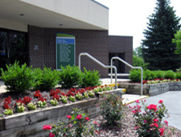
Thirlby Clinic, PLC
Internal Medicine Office
9 Full Time Physicians
25 Team Members
16,000+ patients
Full Time Lab
5 Lab Staff - draw patients from several medical clinics in the area

Slide 10
WHY GET LEAN?
Healthcare reimbursements over the last 5 years have decreased
No longer the pay for service health care environment. The system is now pay for performance.
The new healthcare model requires we prove we are providing the services and producing the outcomes expected by the payors
Patients are expected to ‘participate’ in their healthcare or pay higher premiums
Employees are expected to do more in the same amount of time

Slide 11
THIRLBY CLINIC GOALS
CUSTOMER SATISFACTION
EFFICIENCY
UTILIZATION OF RESOURCES
INCREASE PROFITS
TEAMWORK
SO...OUR JOURNEY BEGINS
THIRLBY CLINIC IMPROVEMENT PROJECT

Slide 12
DEVELOP A PLAN
PATIENT SATISFACTION
DECREASE PATIENT WAIT TIMES IN WAITING ROOMS
INCREASE “TIME” WITH THE PATIENT AND PHYSICIAN
LET’S GO TO THE “GEMBA”
YOU KNOW, WHERE THE WORK IS DONE

Slide 13
CURRENT STATE VALUE STREAM MAP- FLOW

Slide 14
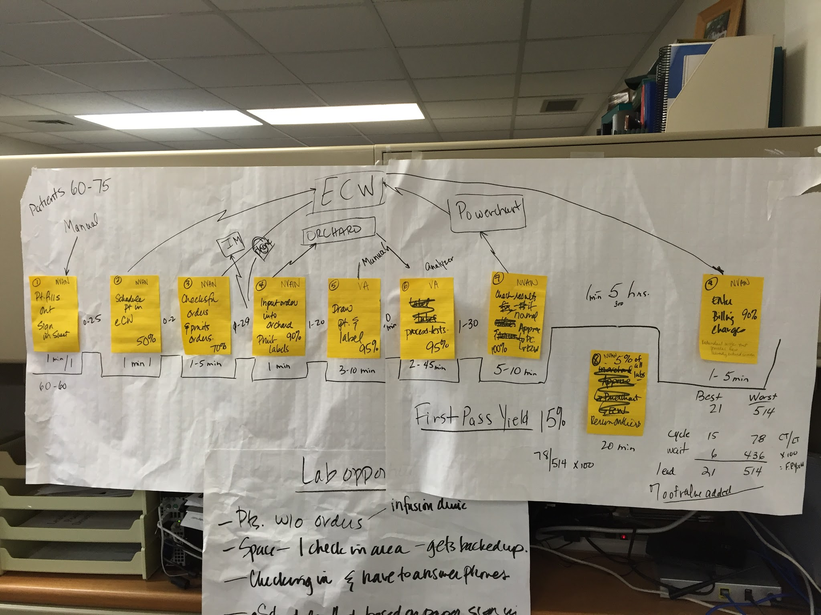
CURRENT STATE VALUE STREAM MAP
Lab flow

Slide 15
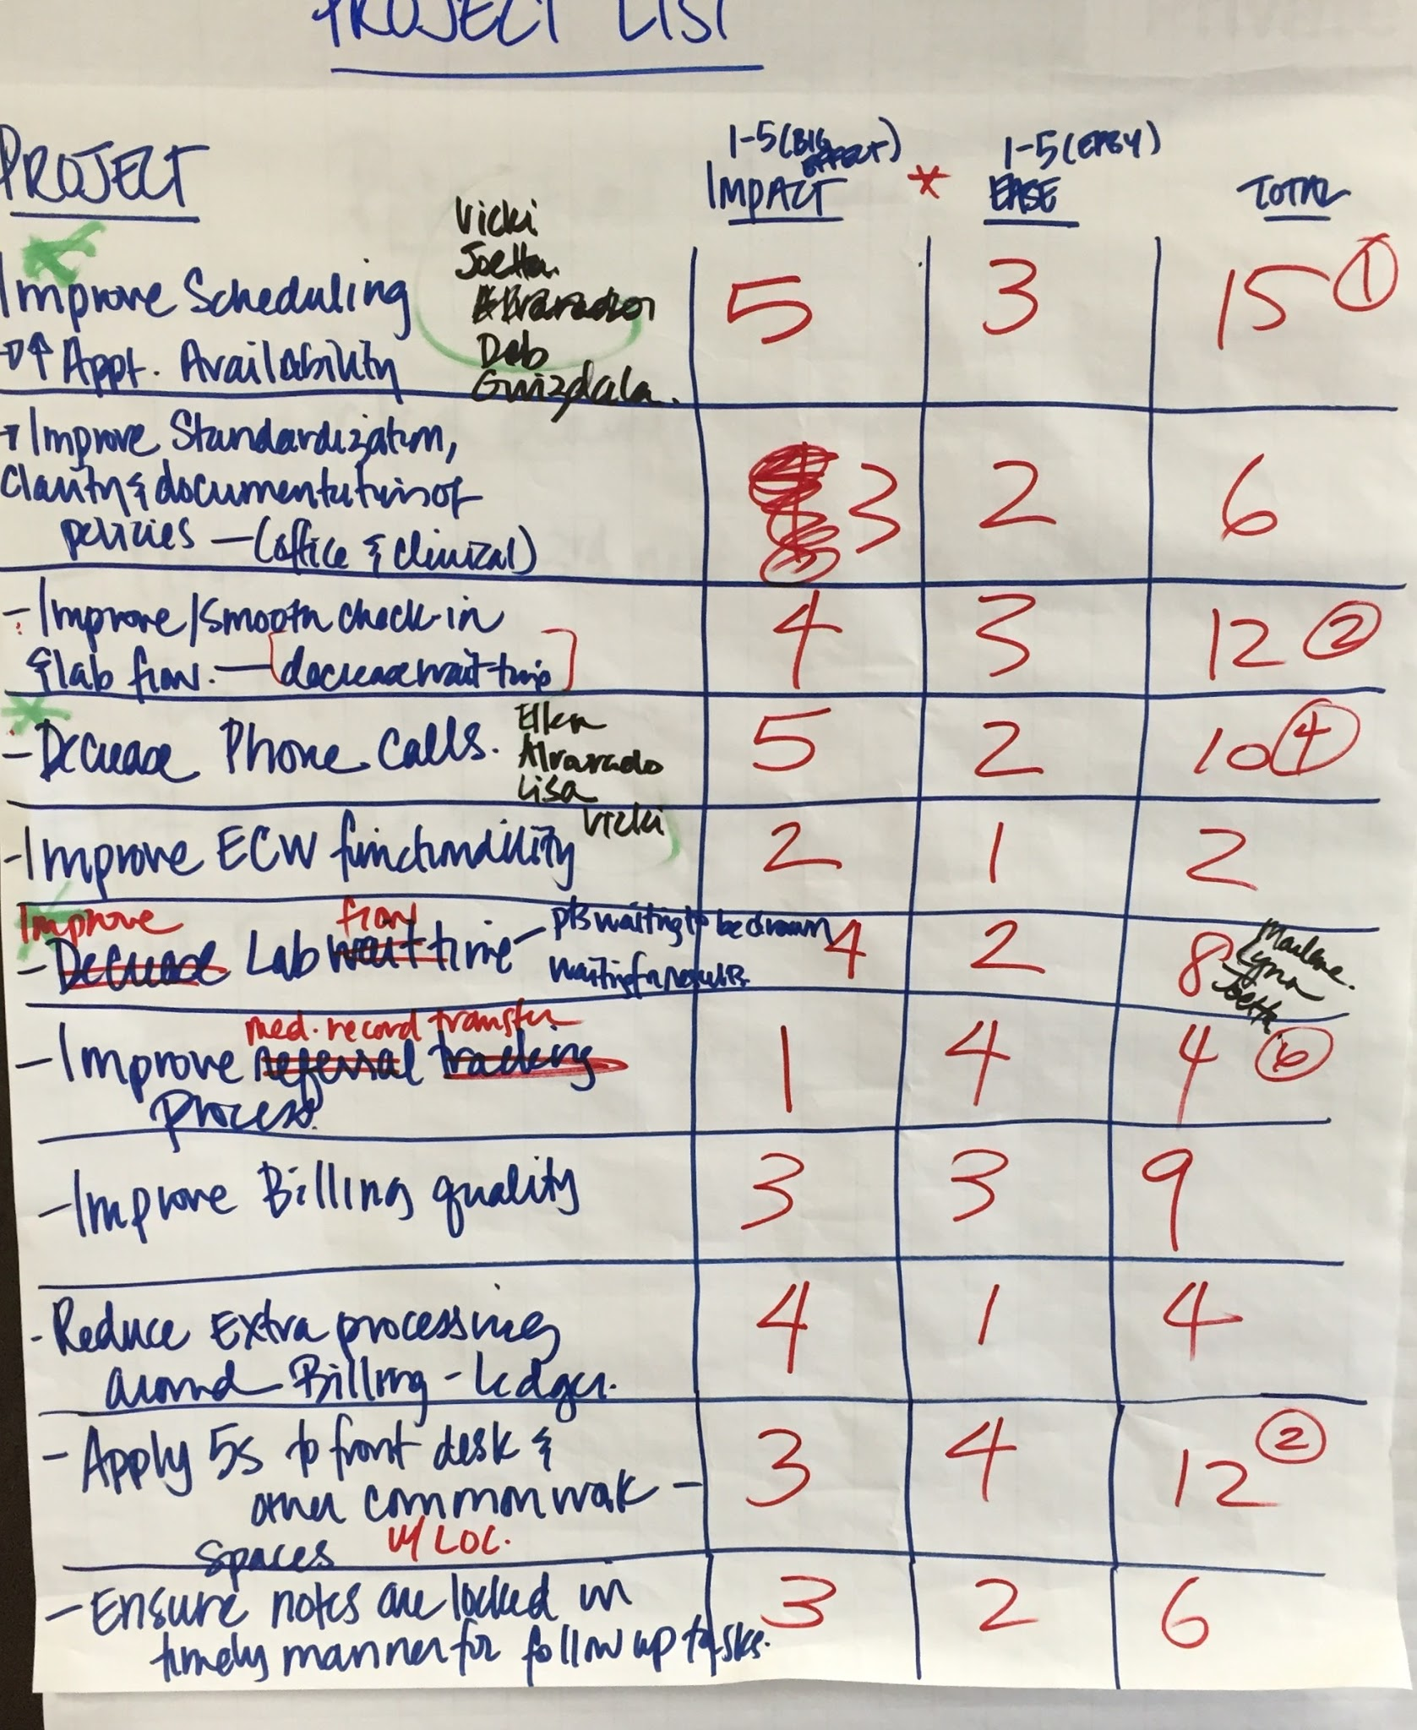
PROJECT BOARD
APPOINTMENT AVAILABILITY
PATIENT WAIT TIME
DECREASE REFILL PHONE CALLS
5S FRONT DESK AND CLINICAL
IMPROVE CHECK IN FLOW

Slide 16
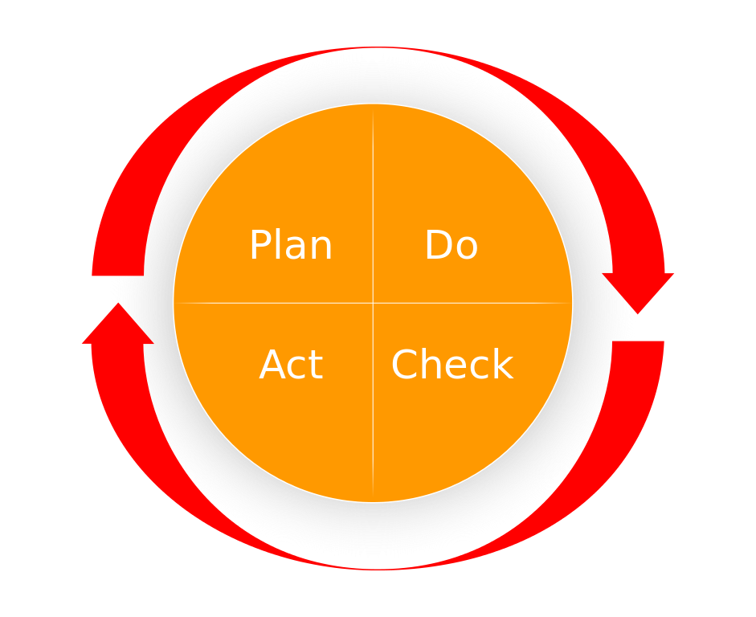
OPPORTUNITIES WITH METRICS
INCREASE AVAILABILITY OF PATIENT APPOINTMENTS
DECREASE PHONE CALLS FOR LAB RESULTS TO PATIENTS
DECREASE PHONE CALLS FOR PATIENTS NEEDING REFILLS
DECREASE INCOMING DOCUMENTS

Slide 17
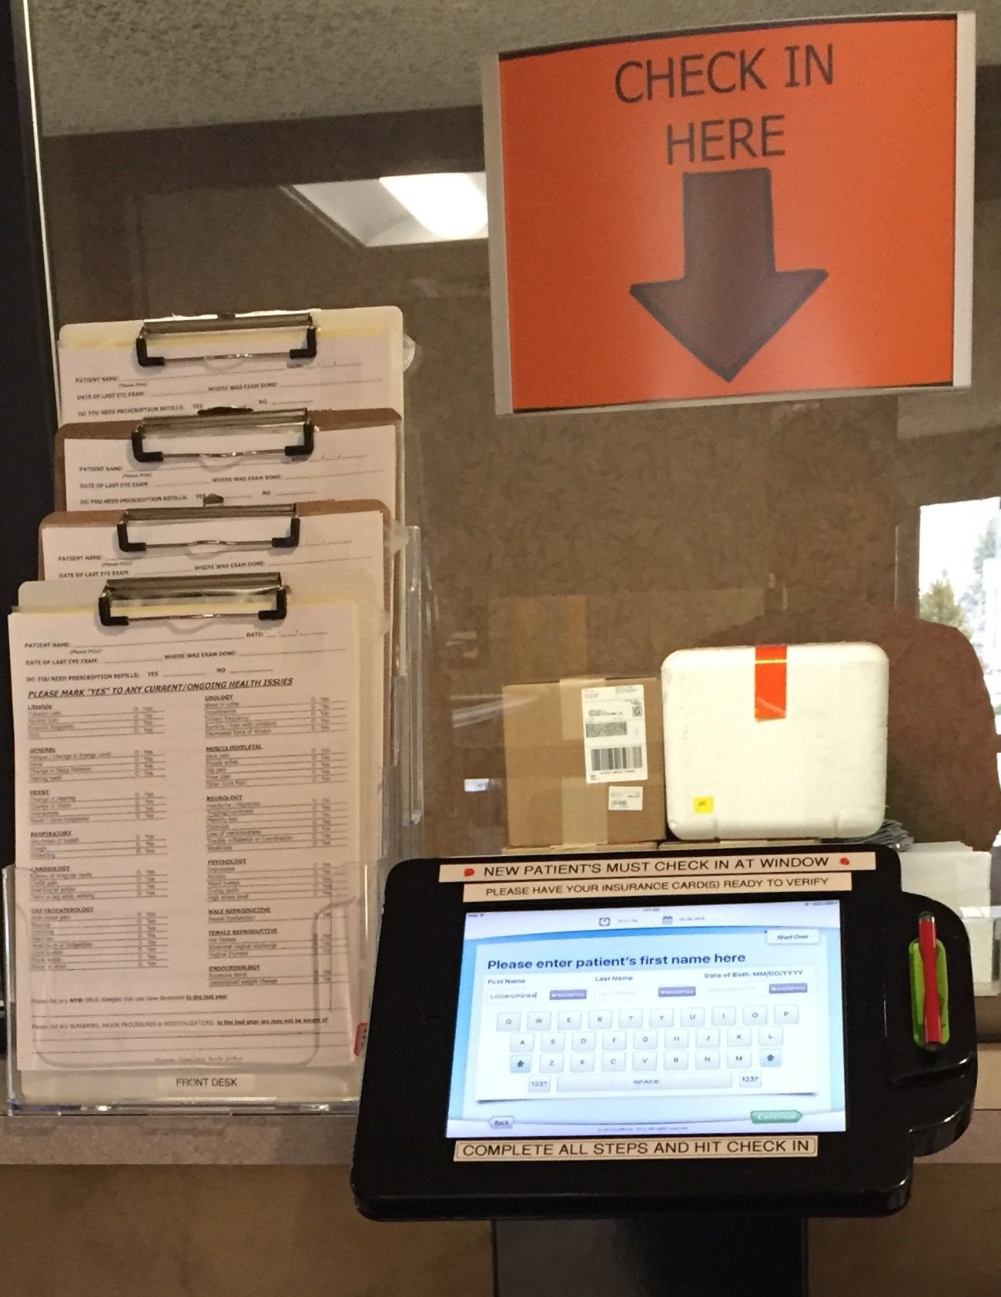
PATIENT SELF CHECK IN
ADDED 2 SELF STANDING KIOSKS FOR
SELF CHECK IN
ALL PHYSICIANS ADDED 2-4 “SAME DAY”
APPOINTMENT SLOTS
PATIENTS LOVE BOTH OF THESE IDEAS

Slide 18
STANDARD WORK PROCESSES CREATED
CHECK IN
CHECK OUT
DISCHARGE OF CARE
OBITUARIES
SENDING YEARLY PHYSICAL REMINDERS
HOMECARE NURSE CALLS
PATIENTS WITH NO LAB ORDERS
LAB WORK BEFORE PHYSICALS

Slide 19
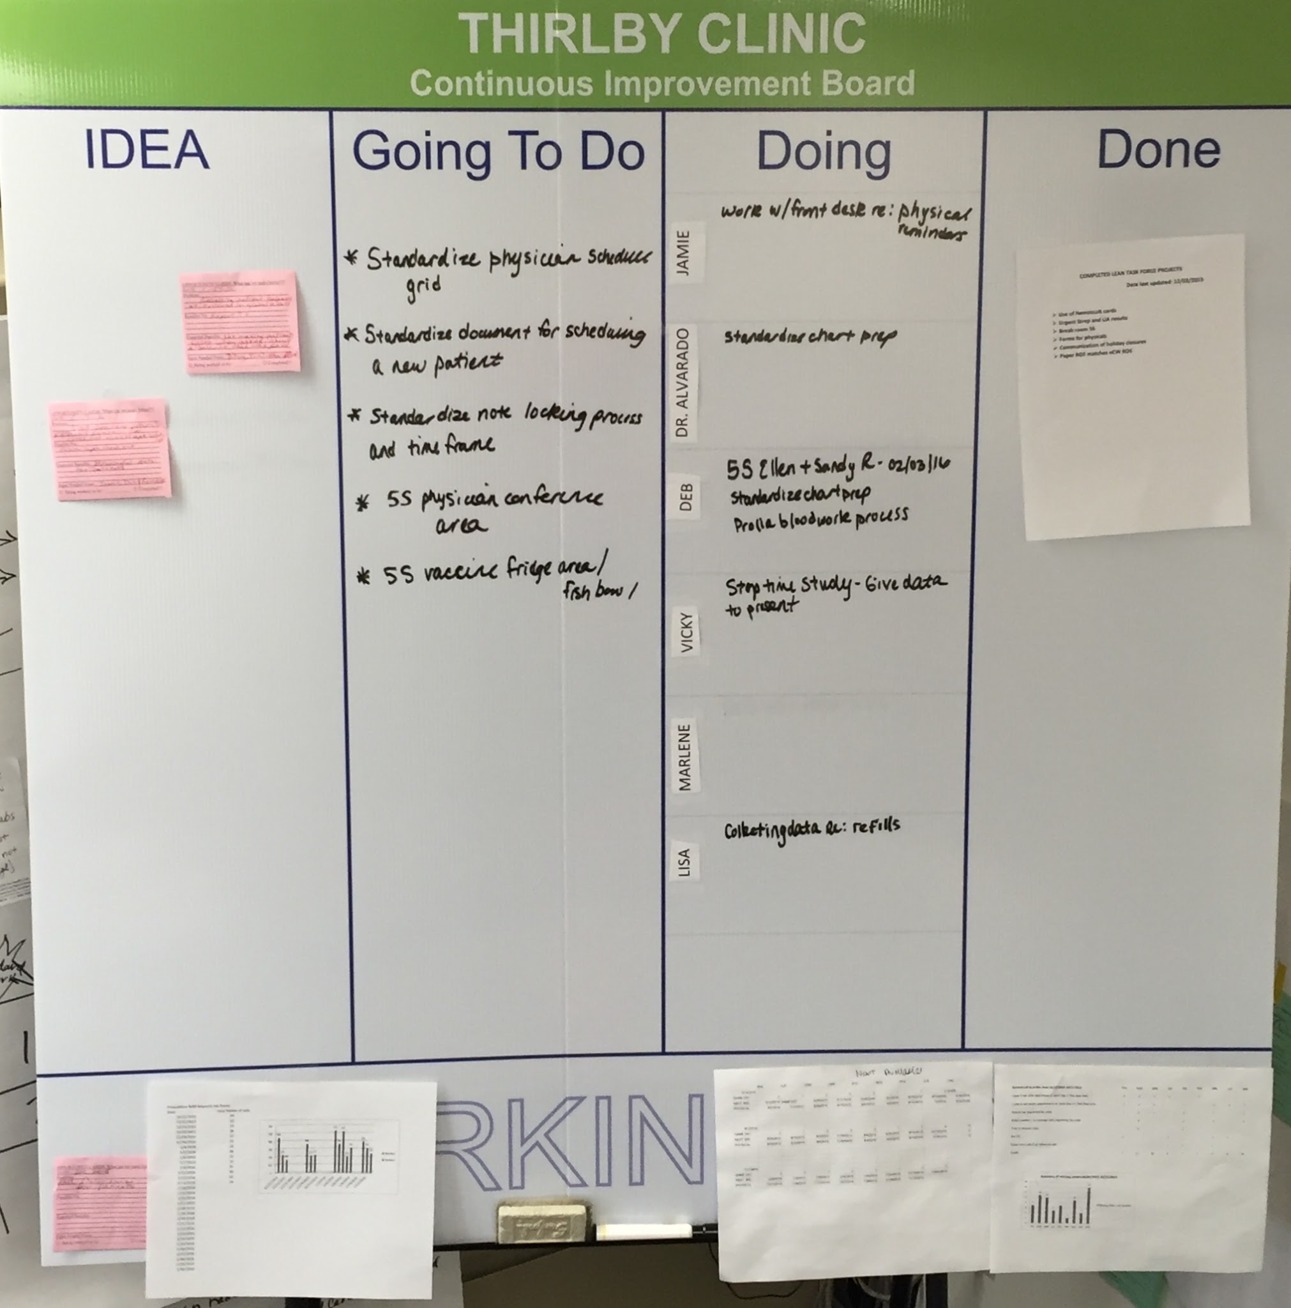
VISUAL MANAGEMENT BOARD

Slide 20
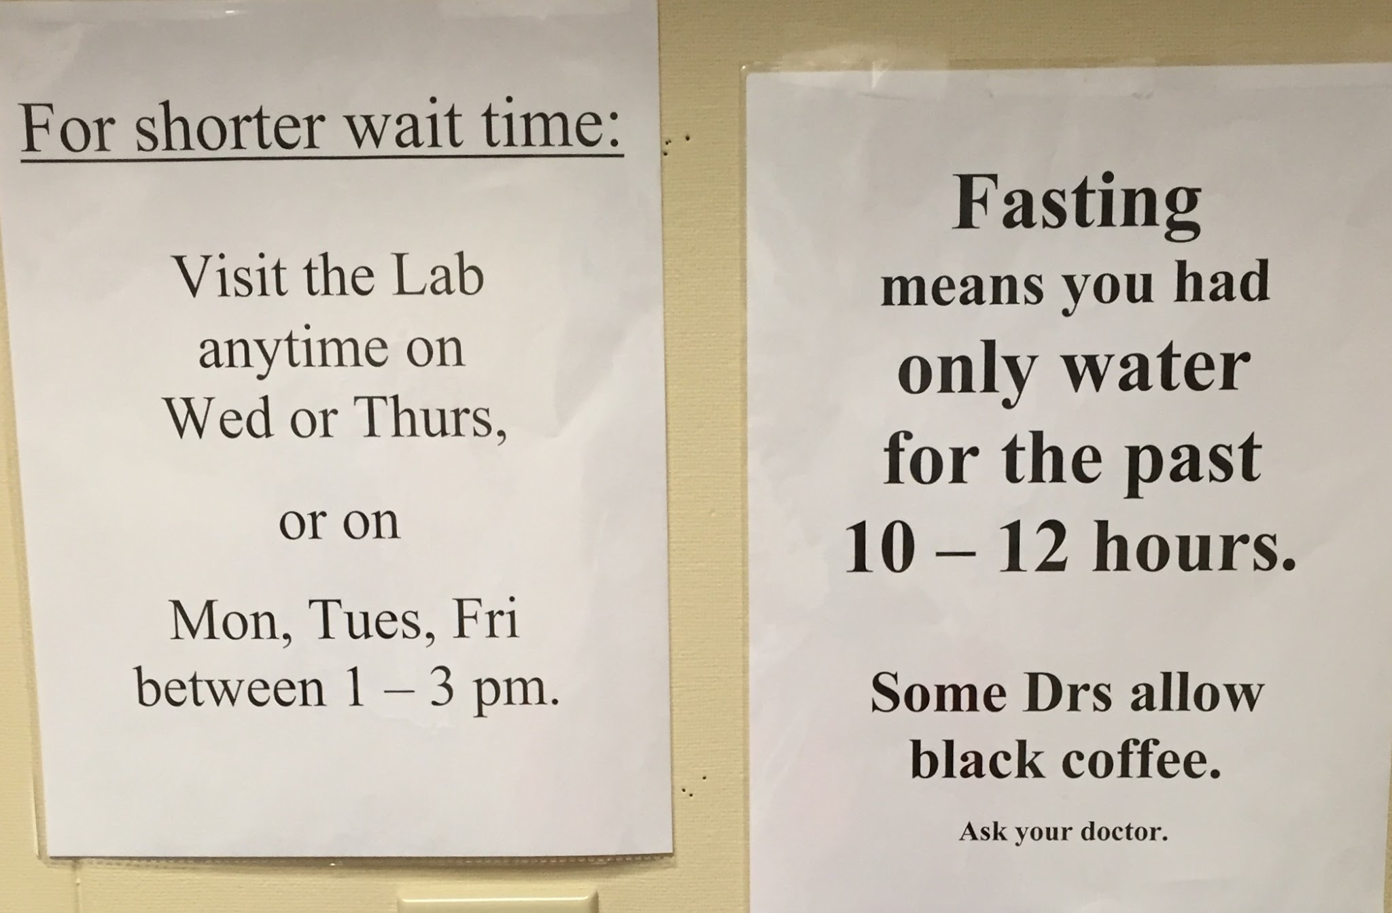
VISUAL MANAGEMENT FOR THE LAB

Slide 21
5S - GET IT TOGETHER
SORT
SET IN ORDER
SHINE
STANDARDIZE
SUSTAIN

Slide 22
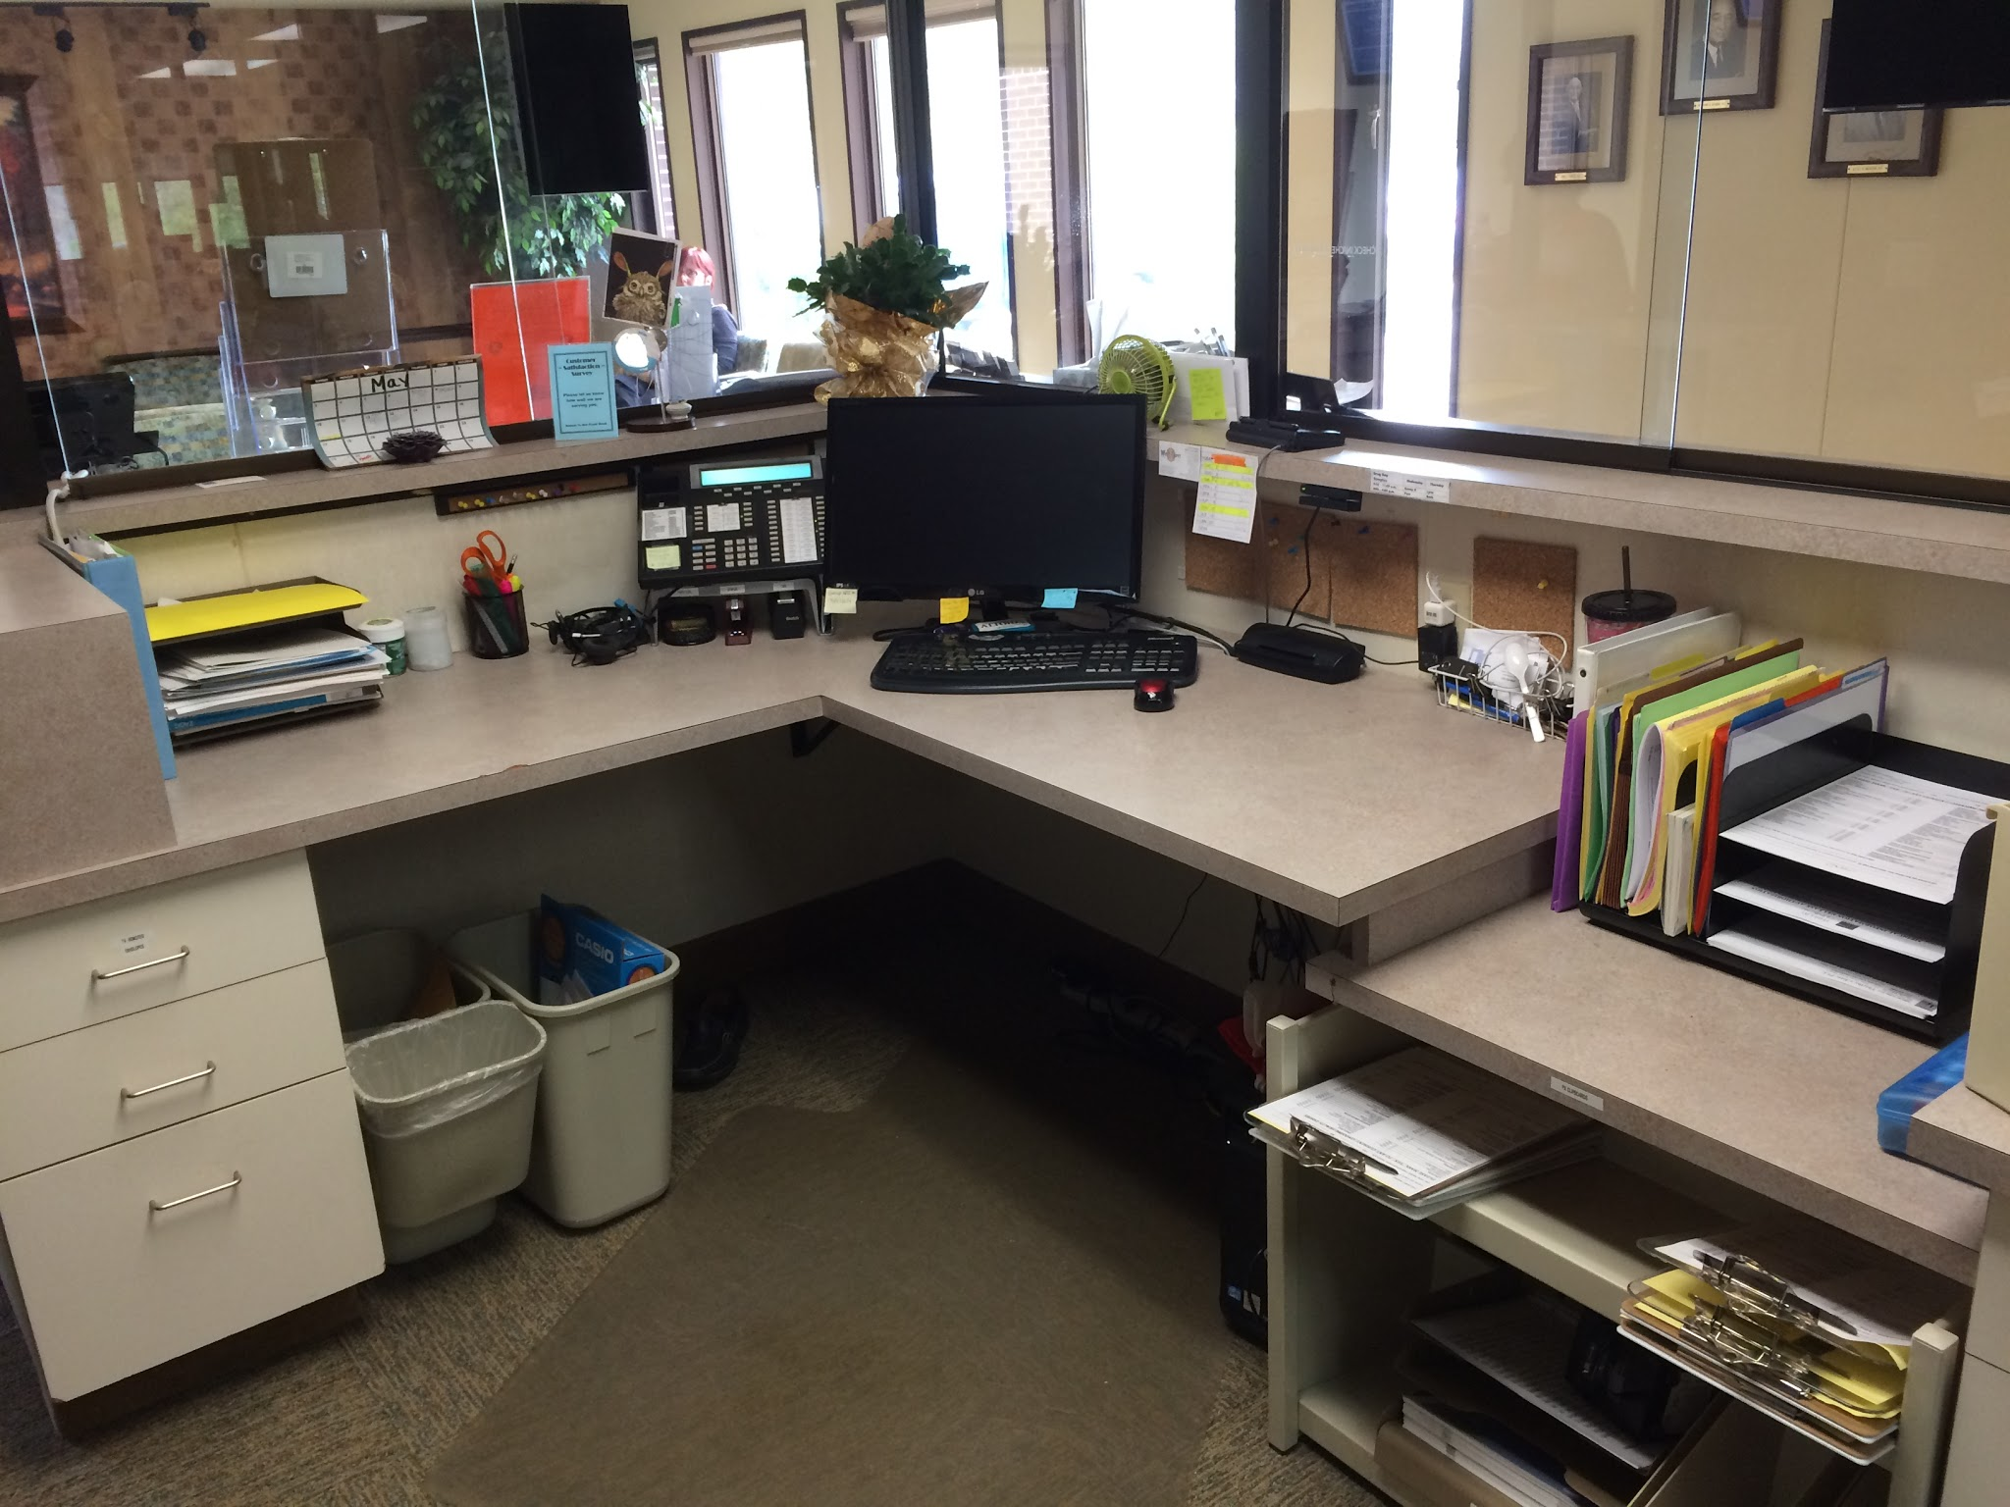
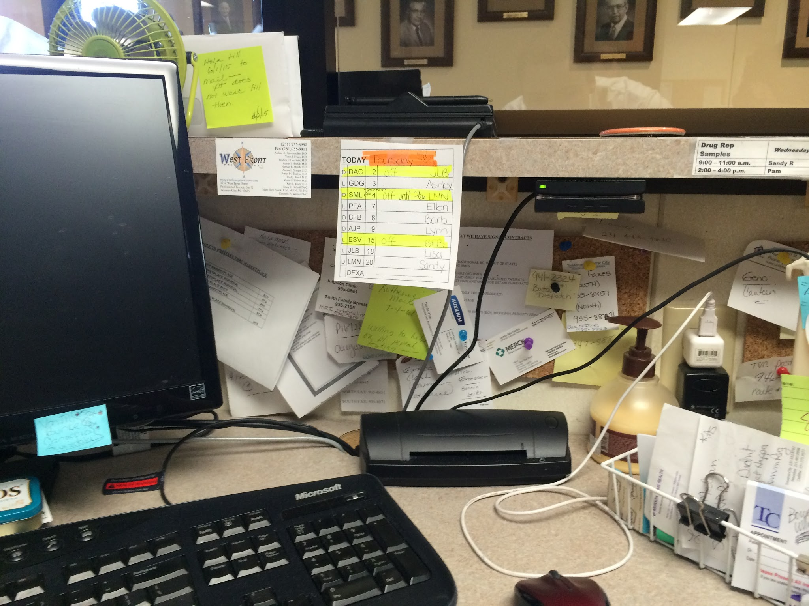
GET ORGANIZED!!
BEFORE
AFTER

Slide 23
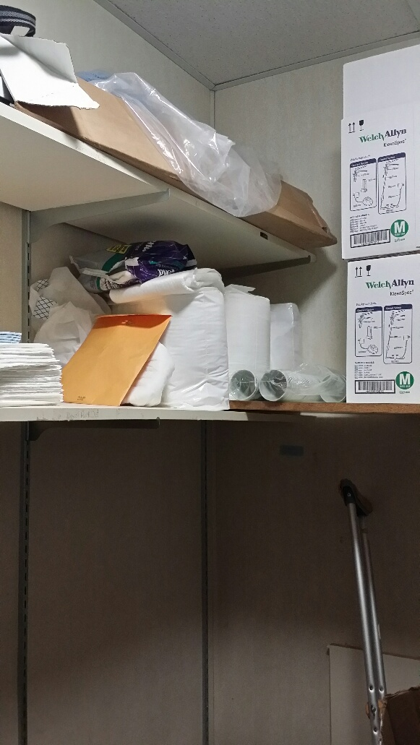
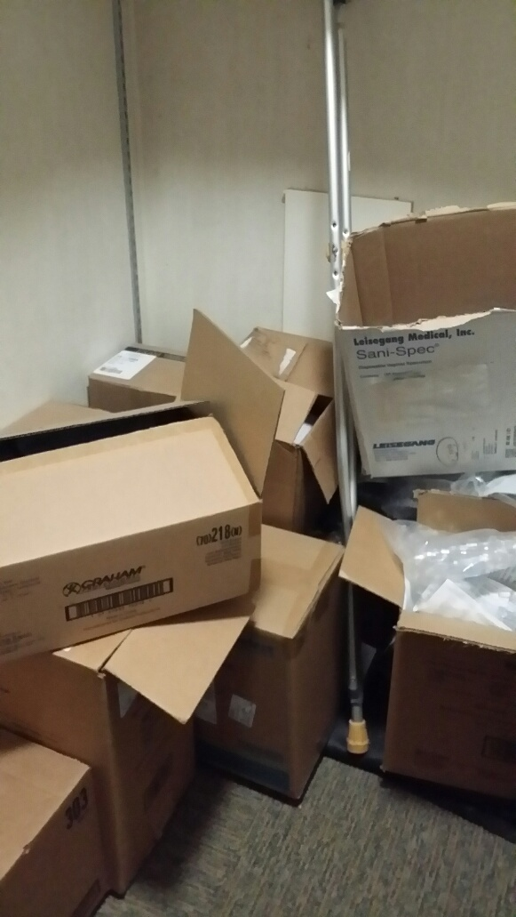
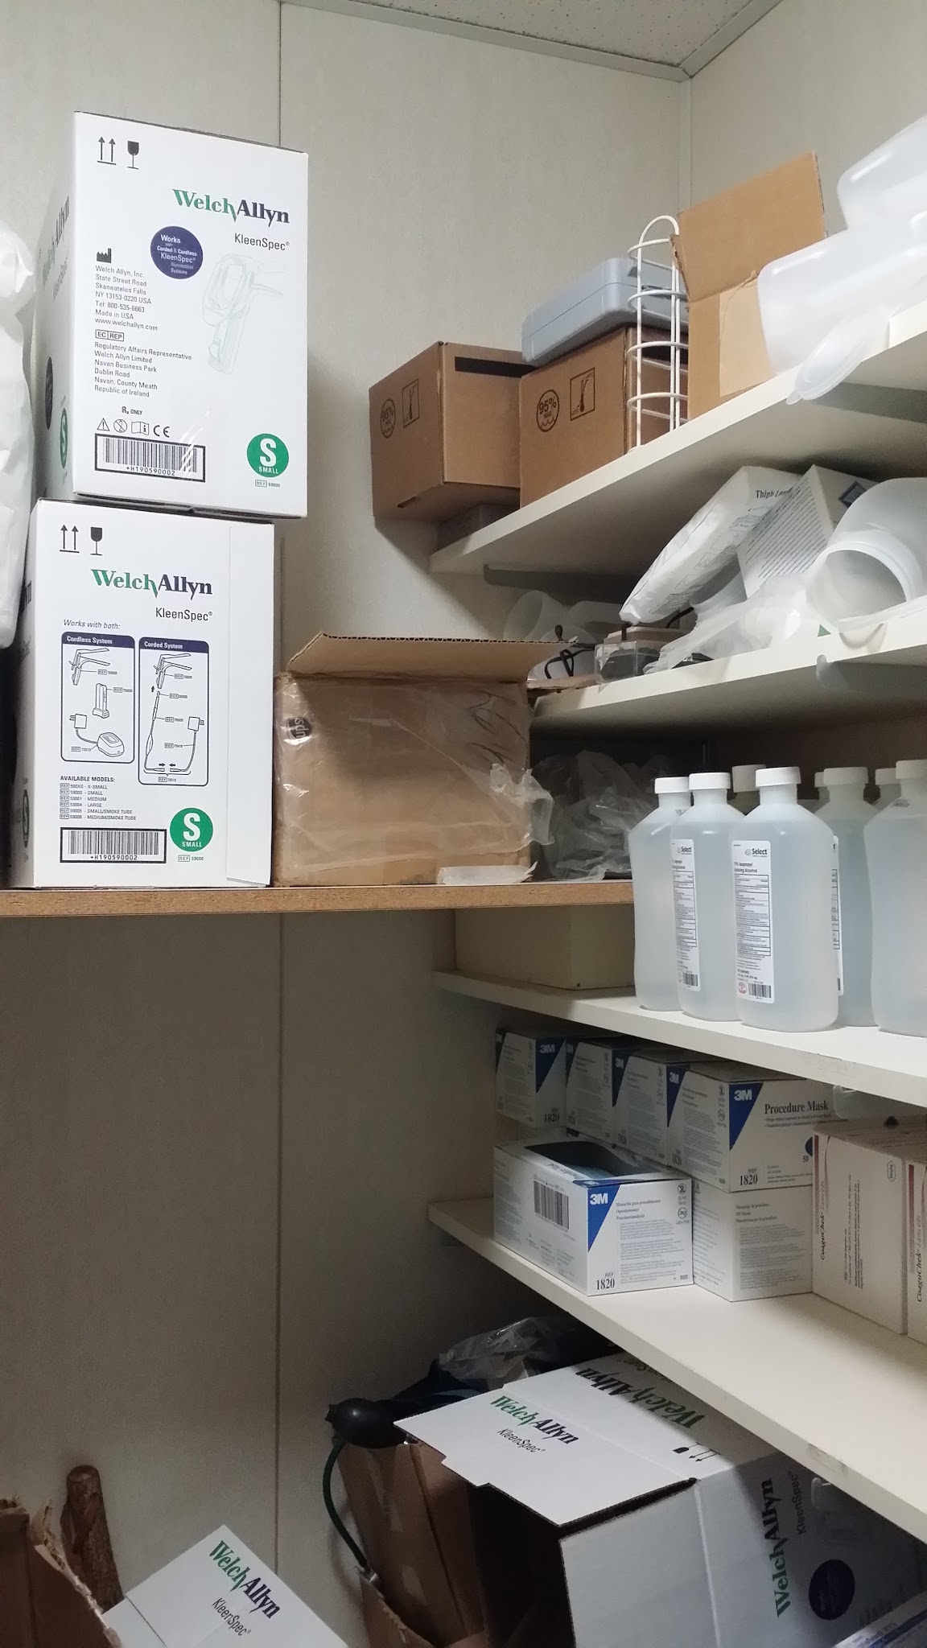
BEFORE

Slide 24
CLOSET - AFTER

Slide 25
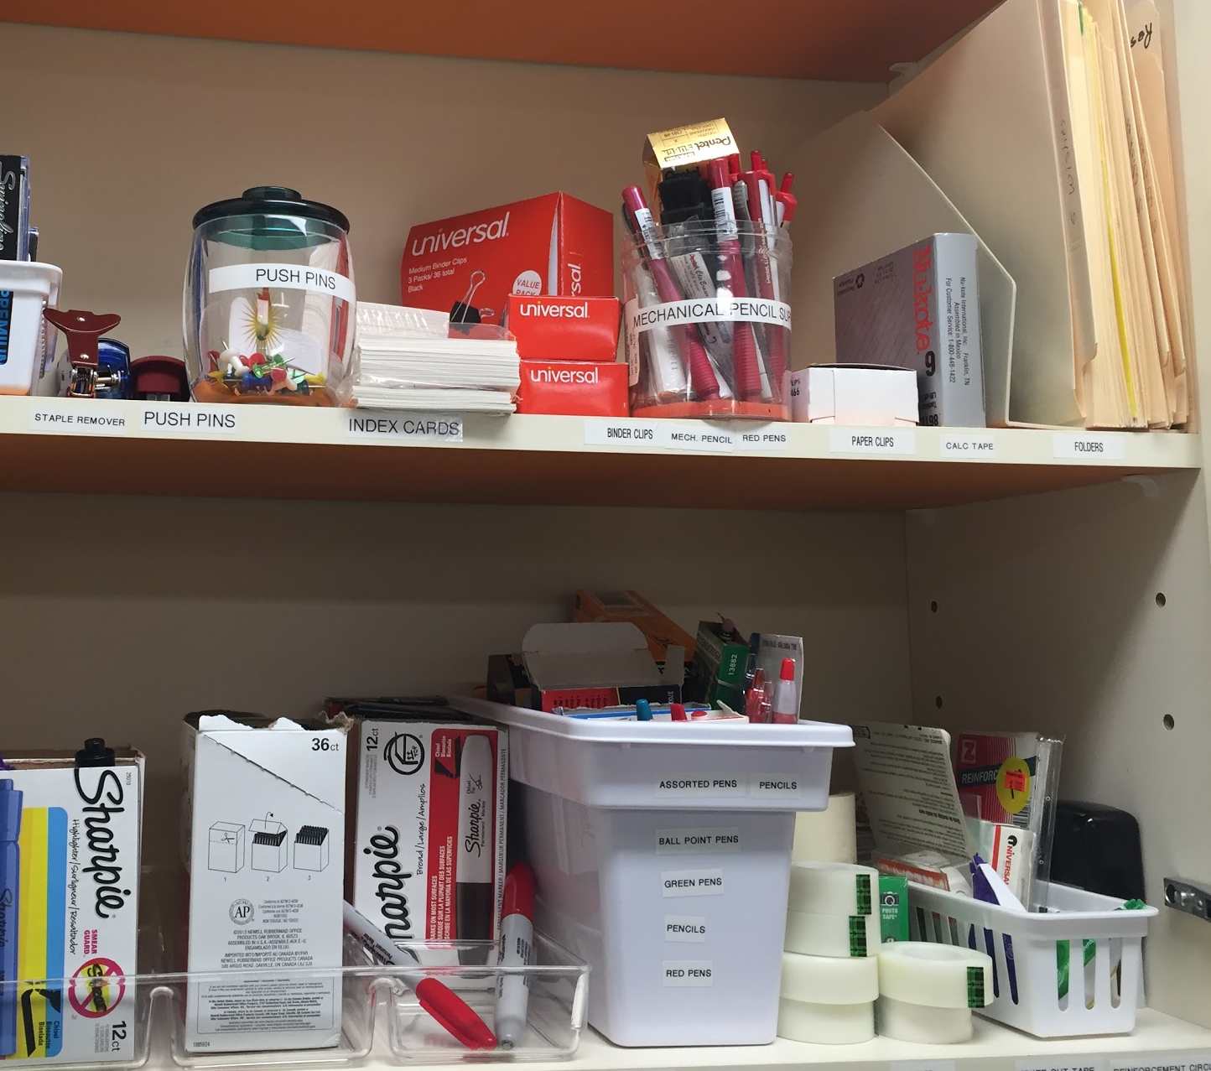
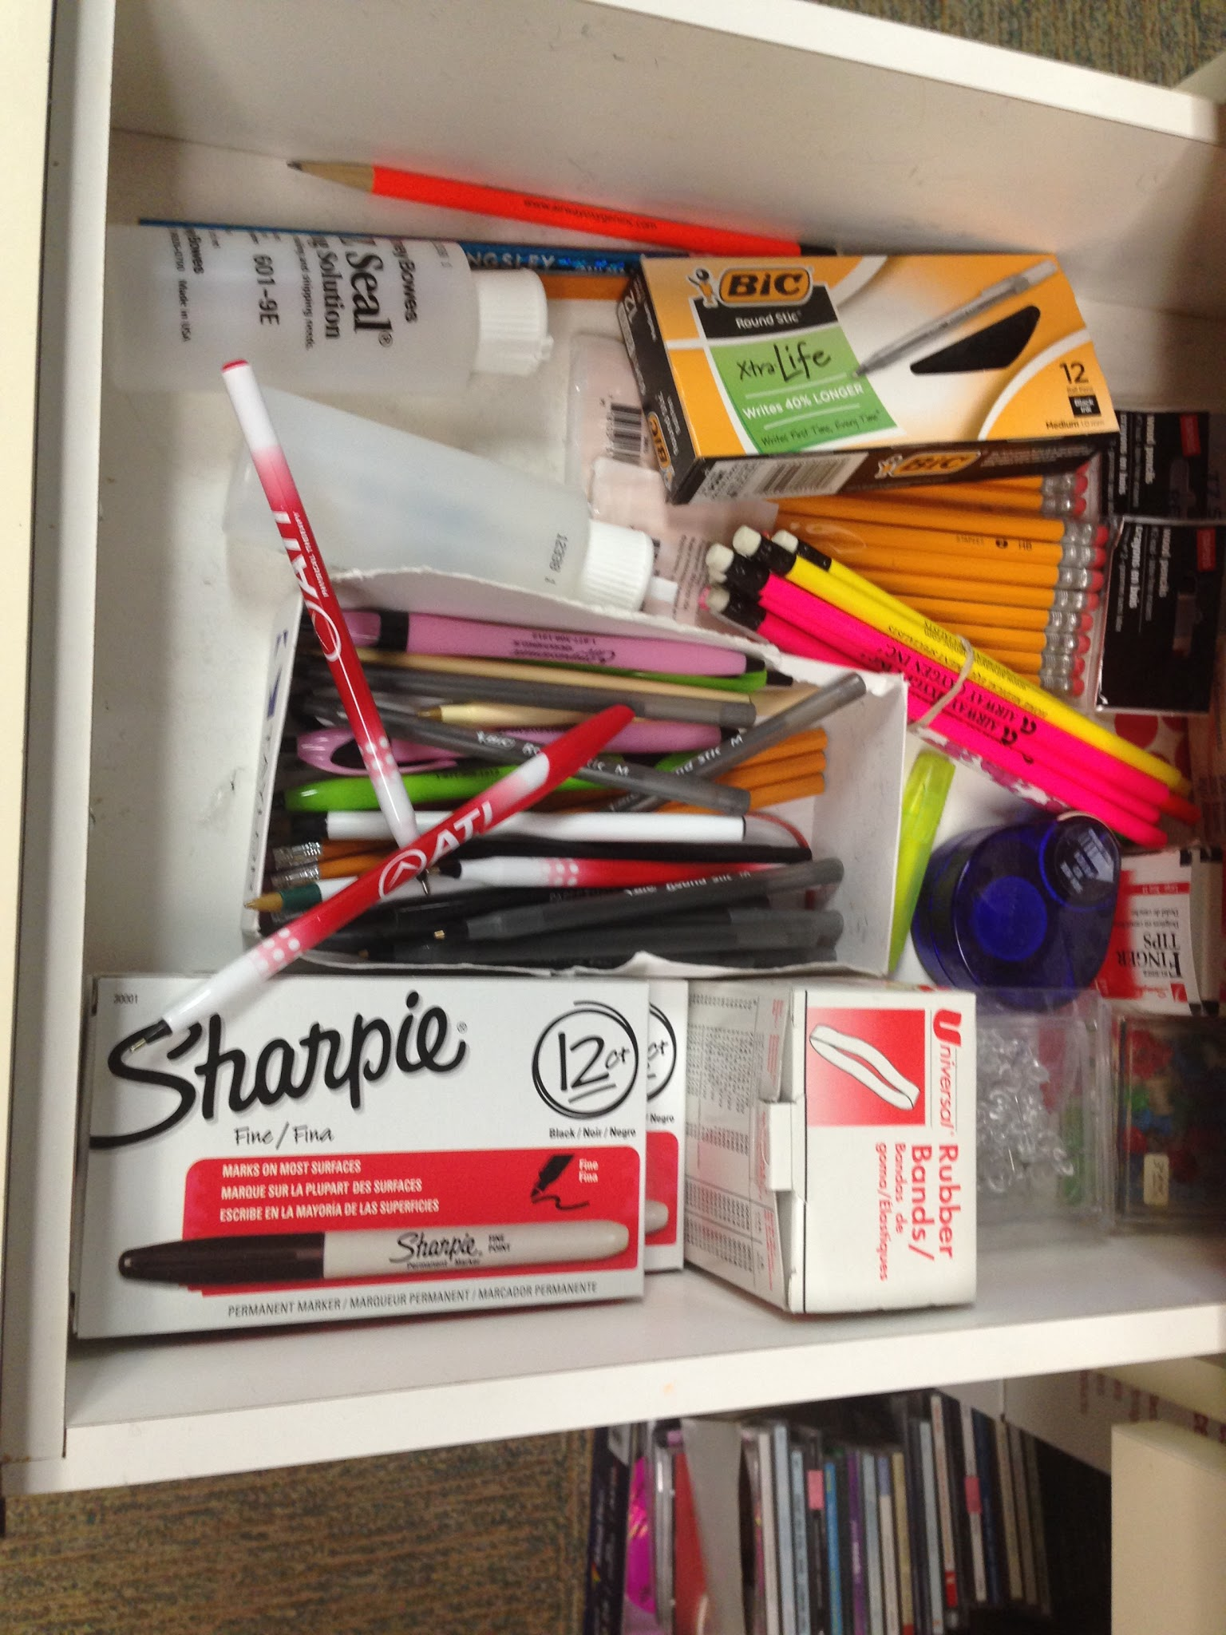
BEFORE
AFTER

Slide 26
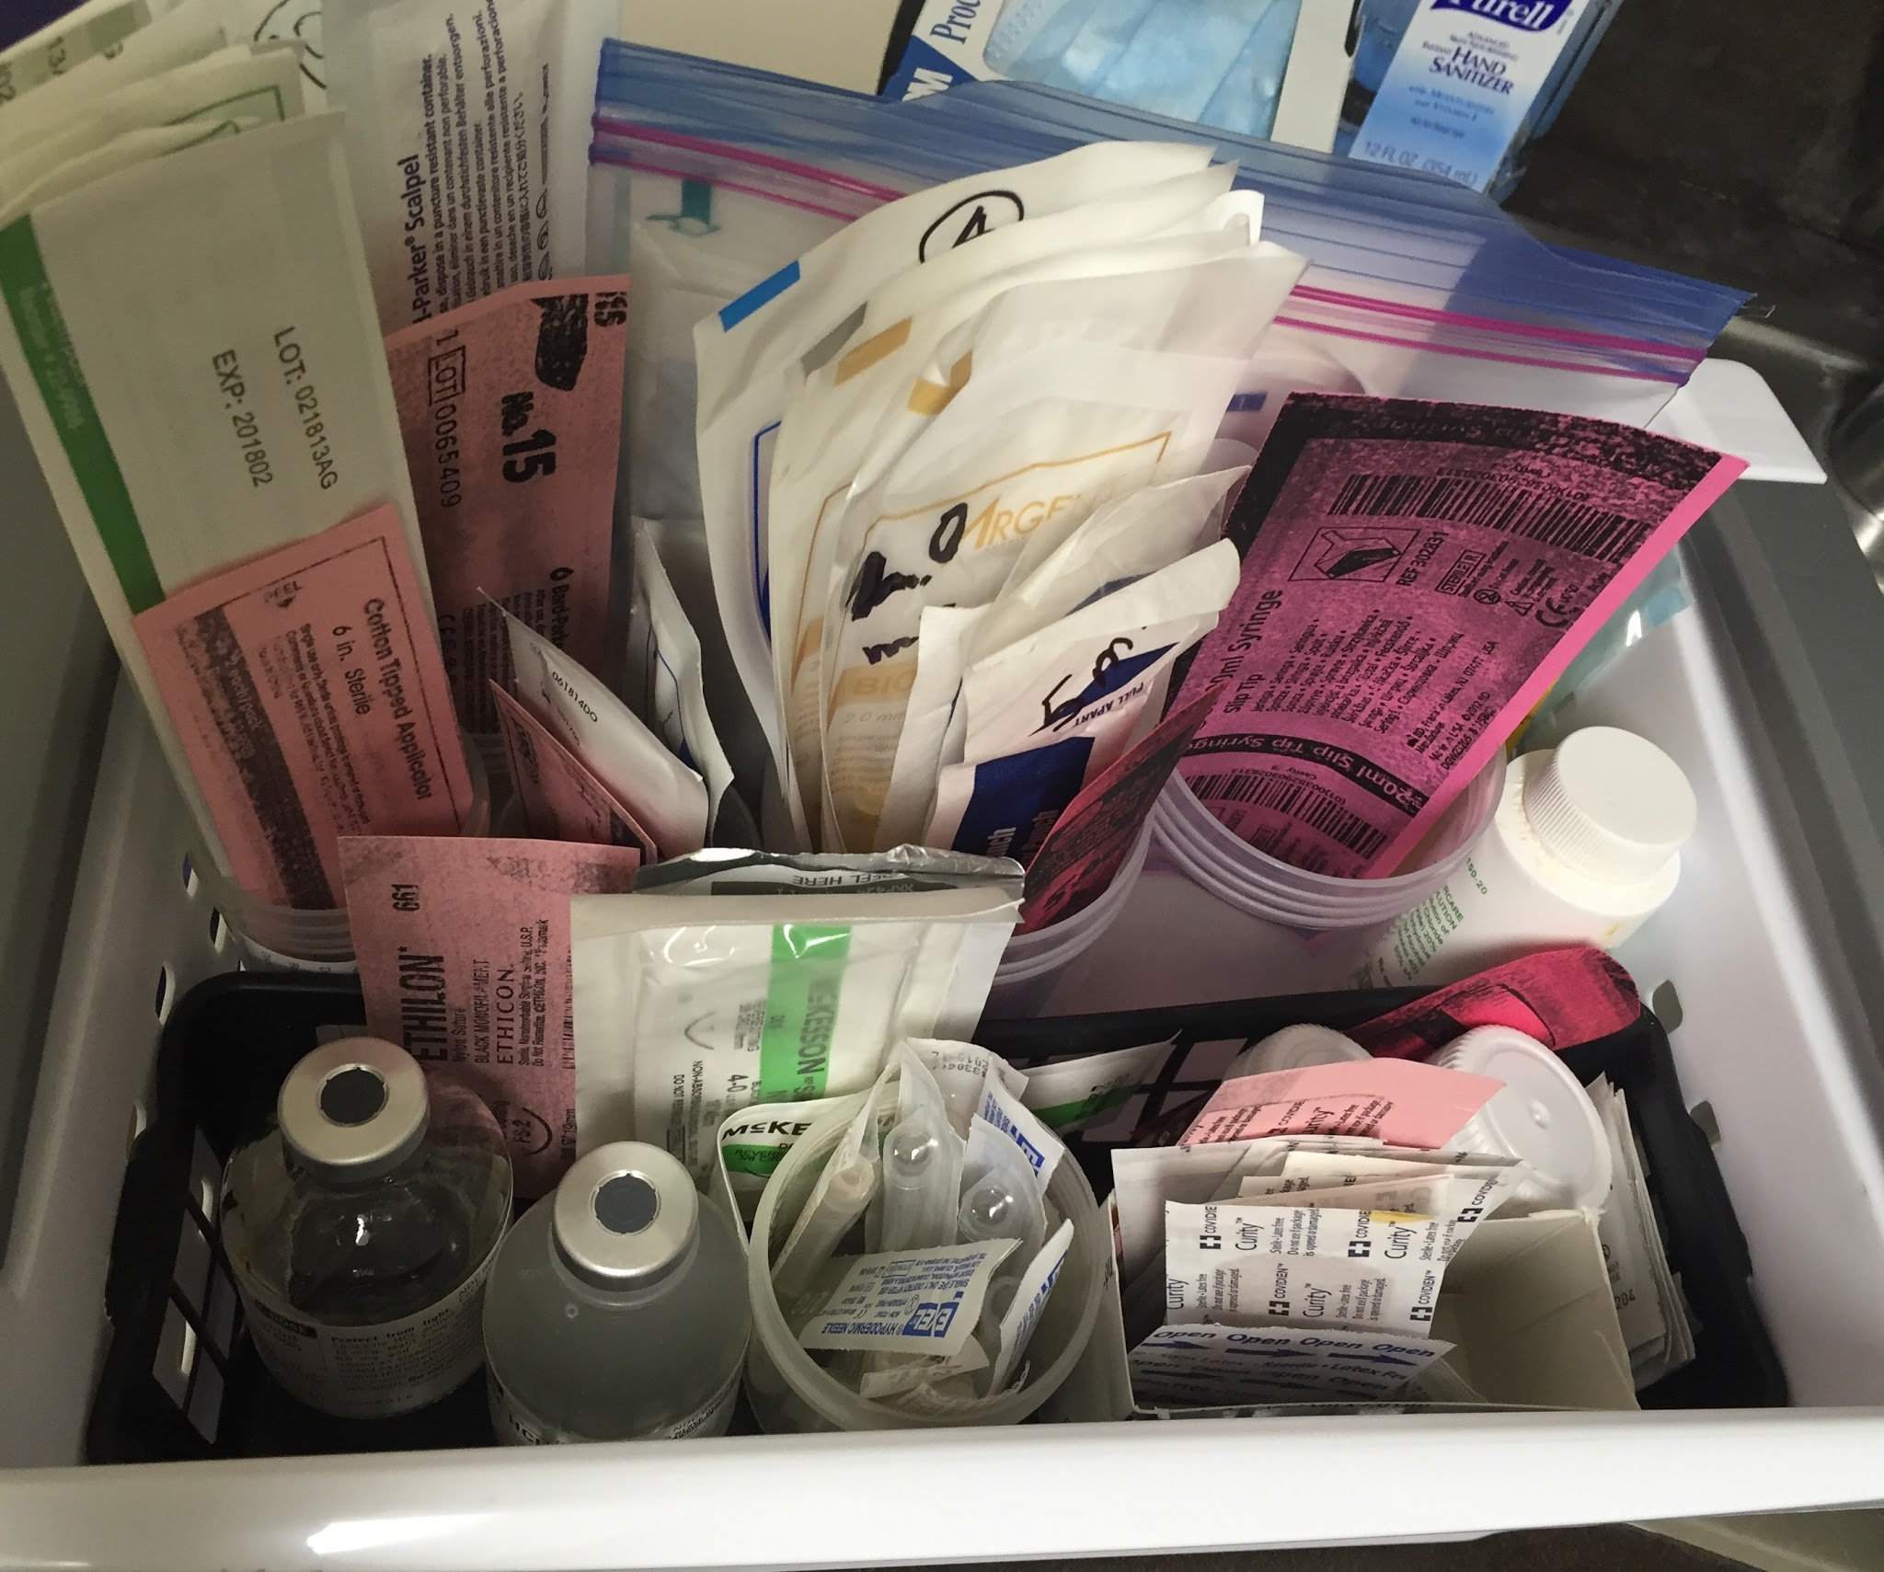
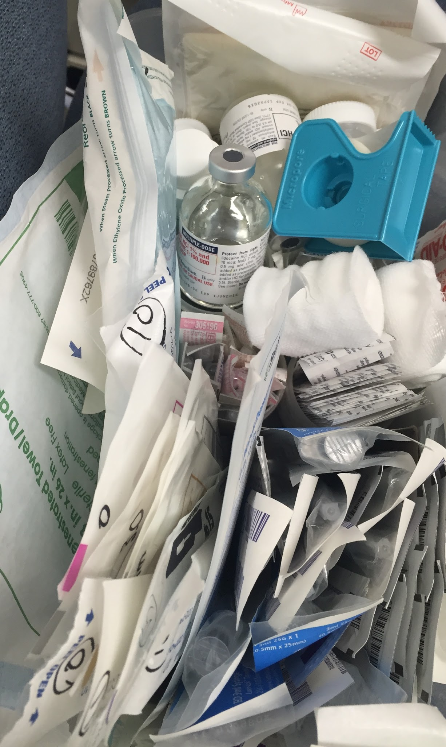
OVERPRODUCTION? 5S!!
BEFORE
AFTER

Slide 27
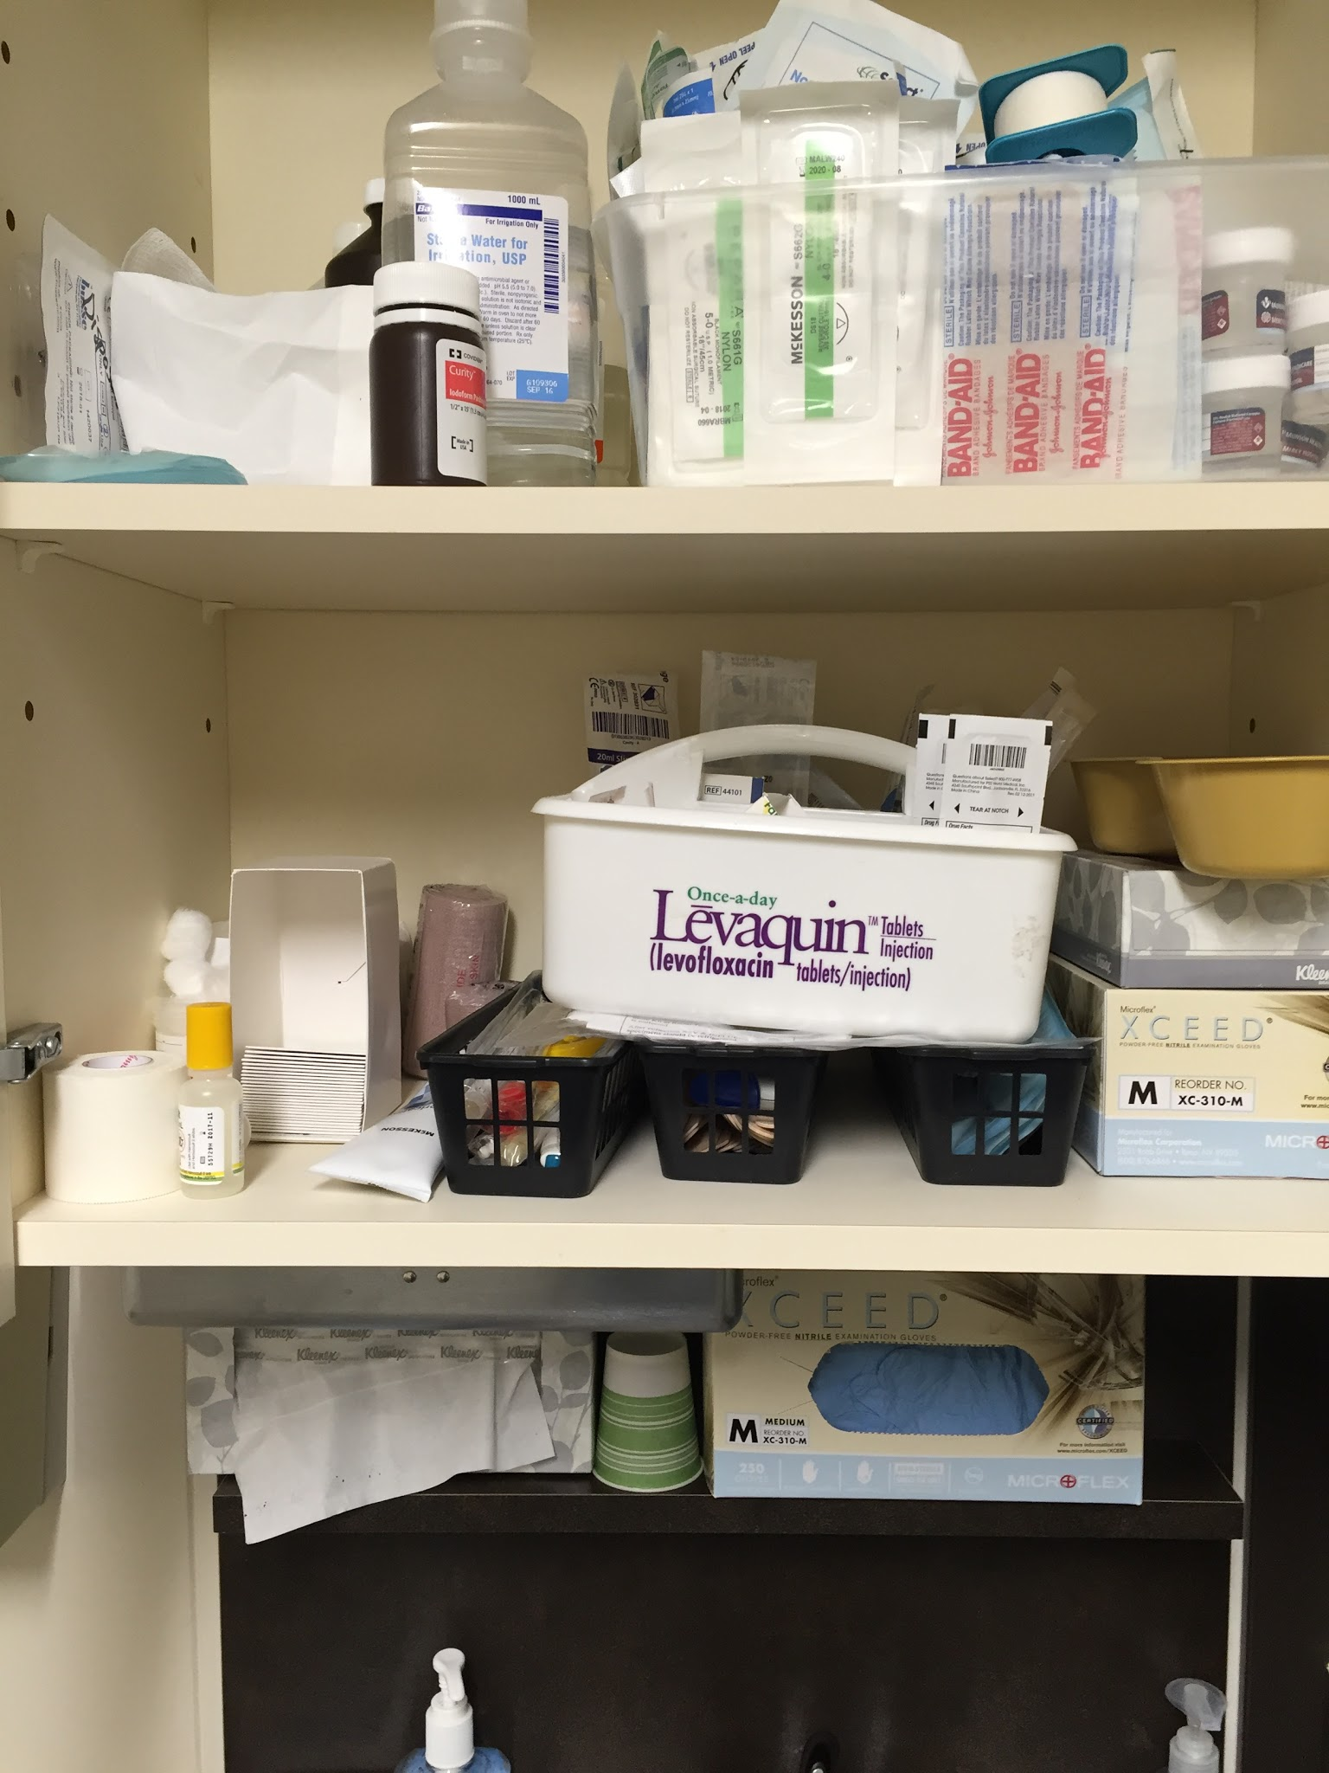
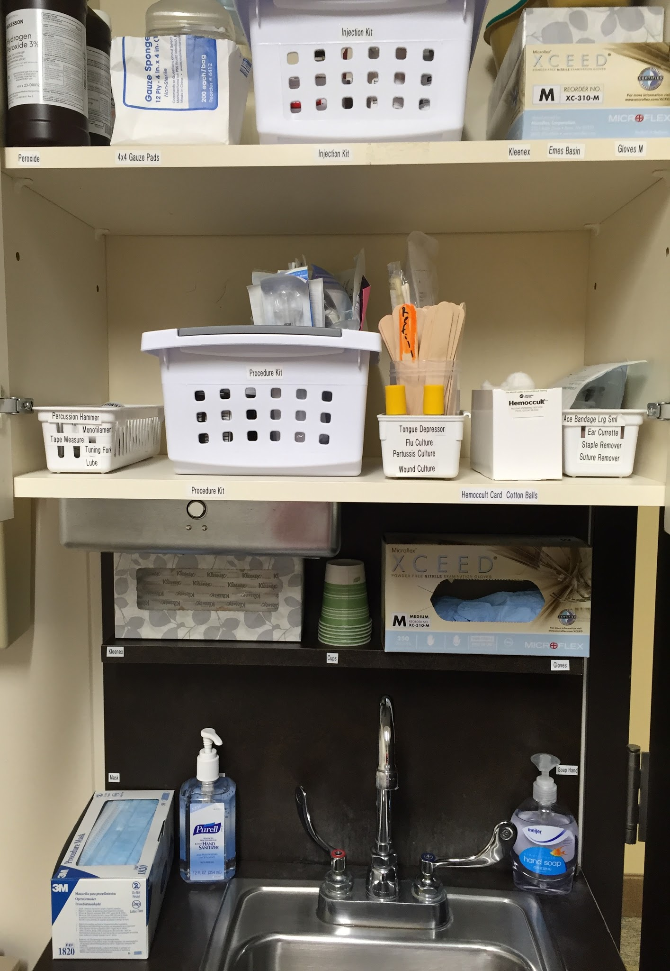
AFTER
BEFORE

Slide 28
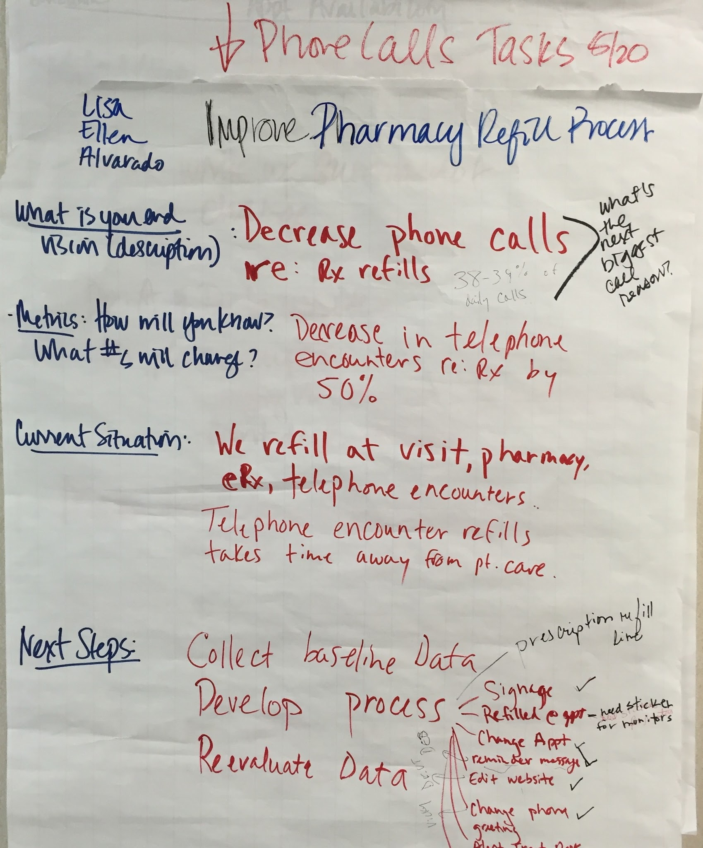
FLOW PROBLEM
REFILL REQUESTS FROM PATIENTS
OUTSIDE OF AN APPOINTMENT,
REFILLS ARE REQUESTED BY PHONE,
ELECTRONICALLY, VIA PHARMACY
OR THE PATIENT PORTAL.

Slide 29
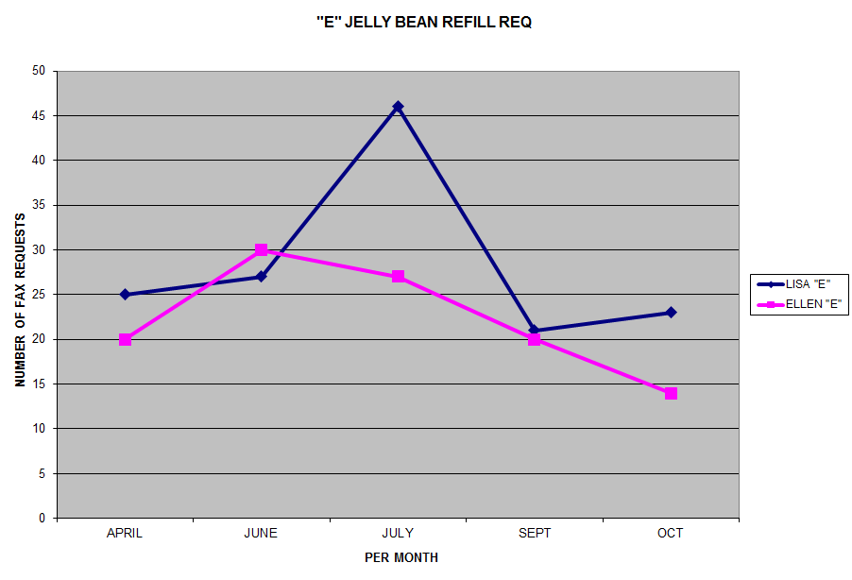
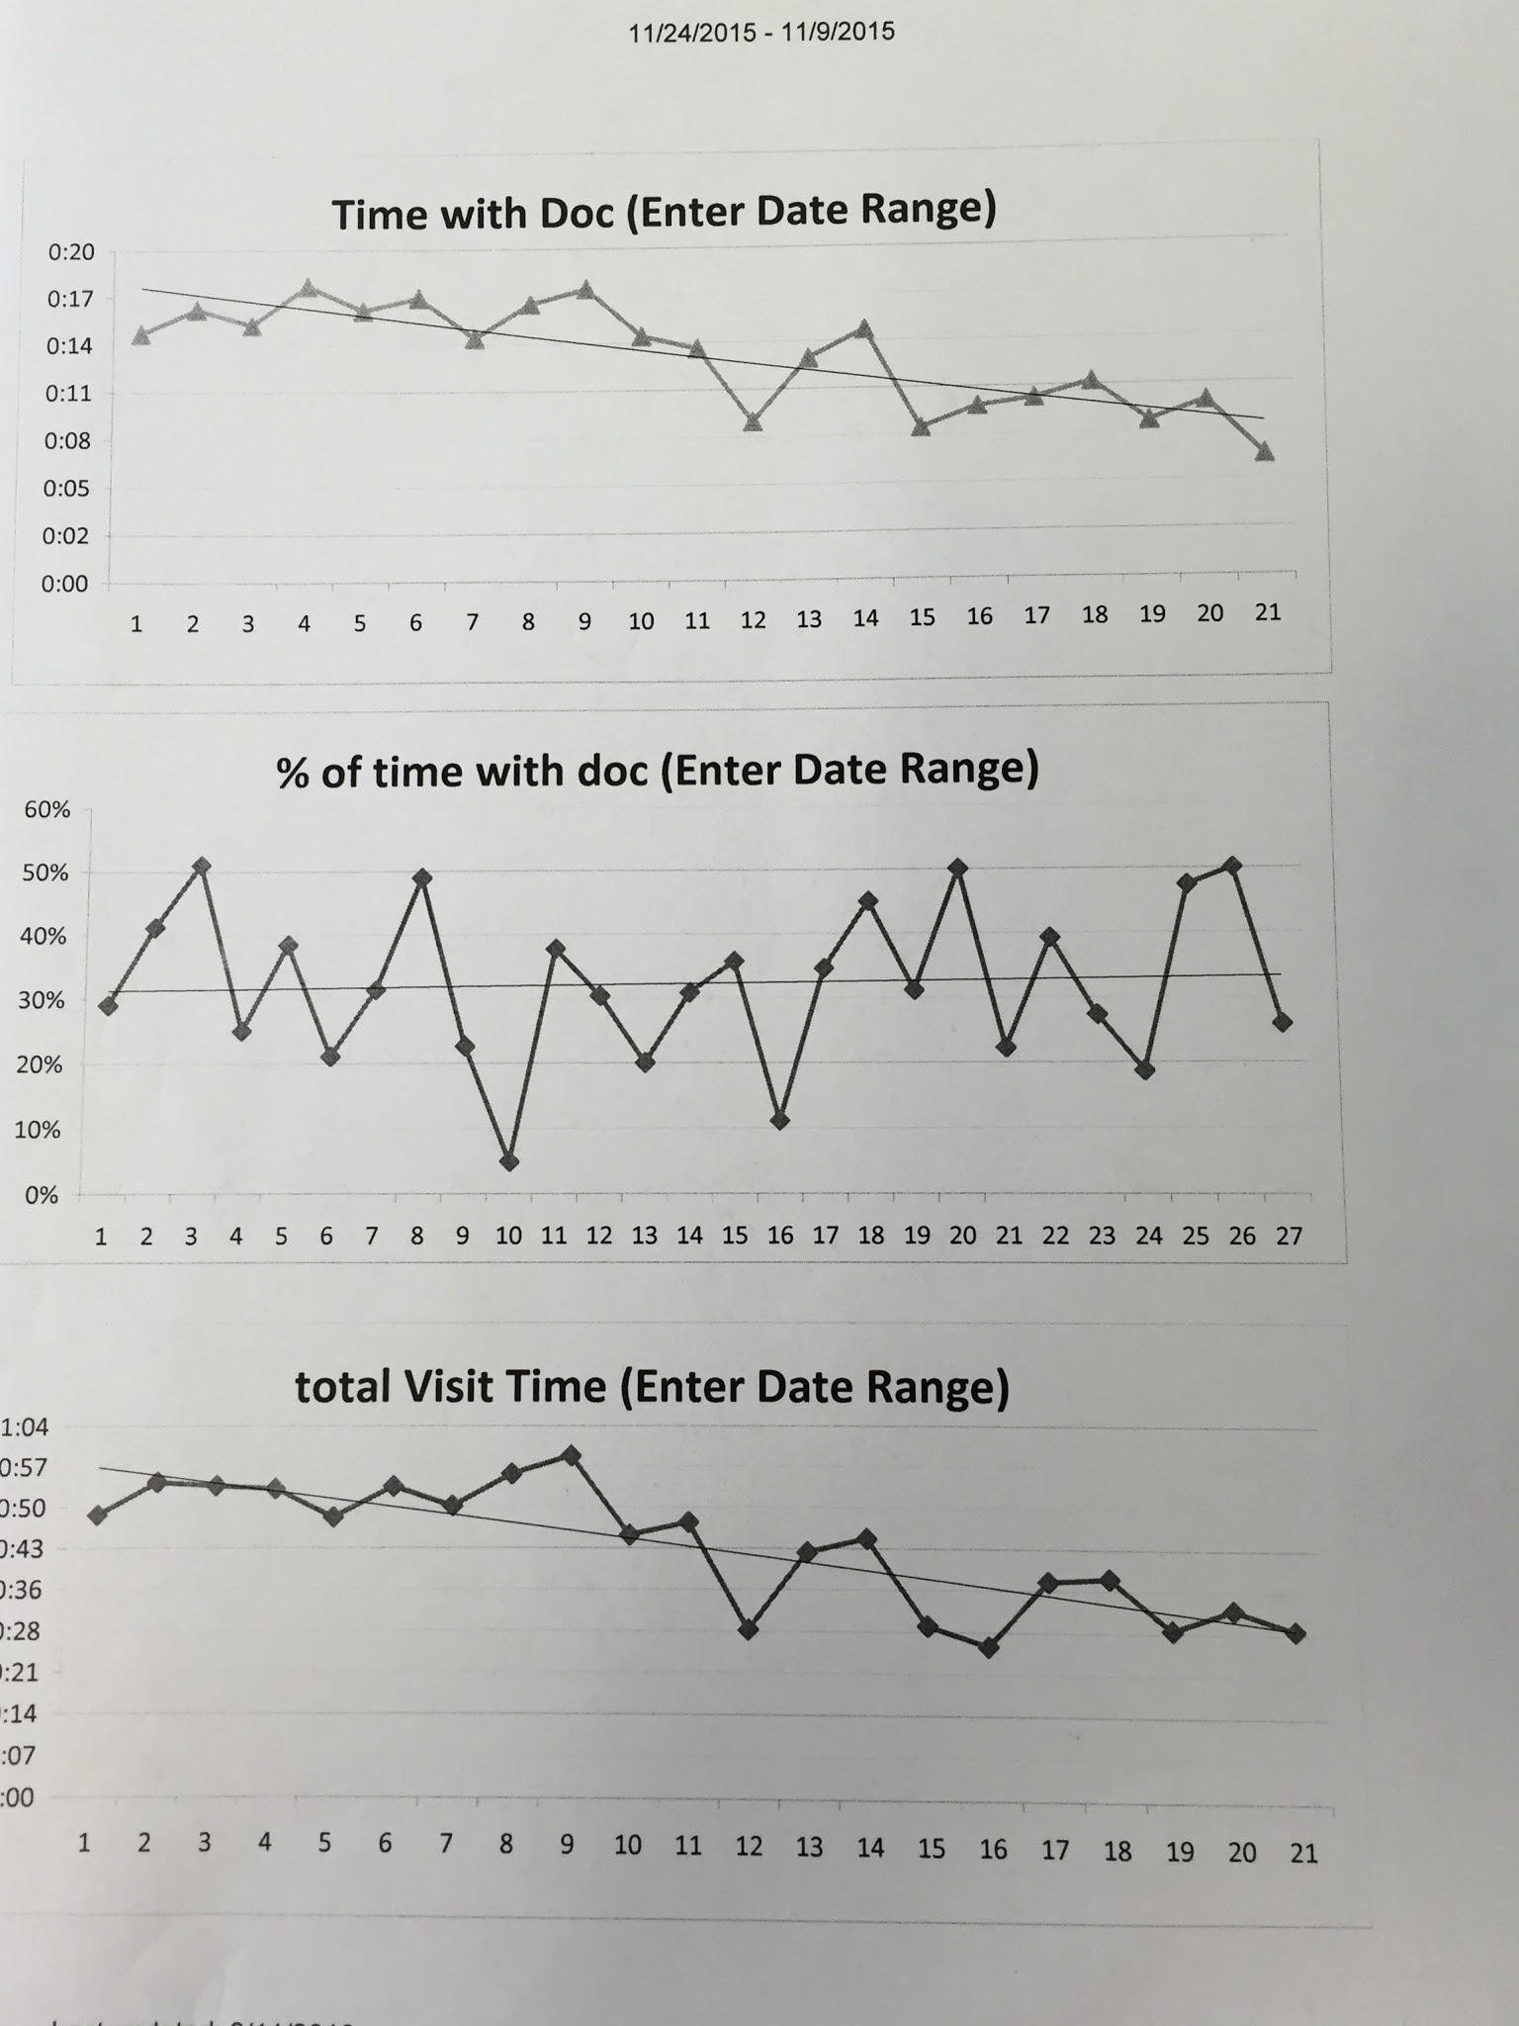
TIME STUDY AND PHONE CALLS - RESULTS

Slide 30
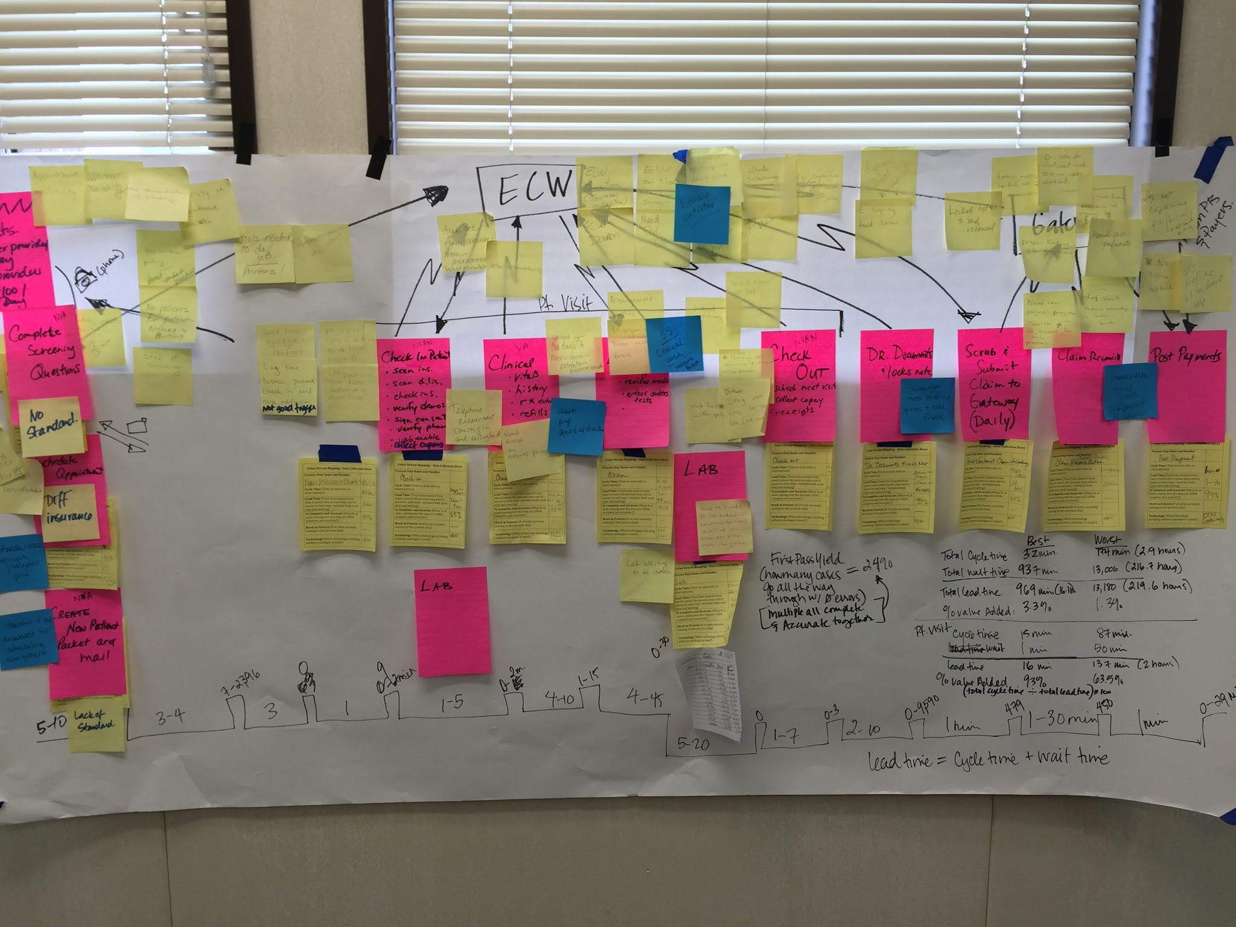
PICTURE OF FUTURE STATE MAP
PINK IS ORIGINAL PROCESS, BLUE ARE UPCOMING CHANGES TO PROCESS

Slide 31
FUTURE STATE MAP
IN PROCESS - CONTINUE PROJECTS TO IMPLEMENT
STANDARDIZE DOCUMENTS FOR SCHEDULING
STANDARDIZE PHYSICIAN PREFERENCE GRID
STANDARDIZE CHART PREP
5S CLINICAL AREA AND VACCINE REFRIGERATOR
STANDARDIZE NOTE LOCKING PROCESS

Slide 32
JOURNEY CONTINUES
THIRLBY CLINIC
**CAMARADERIE
**LEADERSHIP
**EMPOWERED
**OWNERSHIP
LEADS TO EFFICIENCY - SAVES MONEY - SAVES TIME

Slide 33
THE FUTURE THIRLBY CLINIC:
LEADERS IN EFFICIENCY
- SAVES MONEY
- SAVES TIME
WHICH =
MORE TIME FOR PATIENTS
MORE TIME WITH PATIENTS
PATIENT SATISFACTION
GREAT CUSTOMER SERVICE
HAPPY EMPLOYEES
POSITIVE WORKPLACE

Slide 34
Final Comments
Triple Aim/ Quadruple Aim
Patient Experience
Lower cost of Healthcare
Improve Outcomes
Support the Community of Providers

Slide 35
Thank you for your attention!

Slide 36
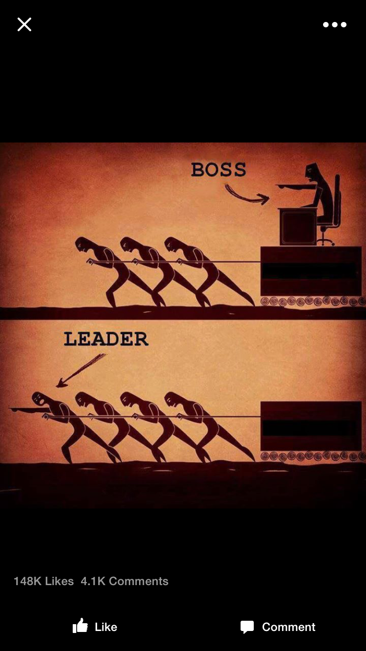
Thank you to our sponsors!
Northern Physicians Organization (NPO)
Heather Fraizer, PhD- Northwestern Michigan College
LEAN Champion businesses
LEAN Champion teammates
Thirlby Clinic for the opportunity to become the new standard in healthcare

