Slide 1
Basic Continuous Improvement
8 Simple Steps to Organizational Improvement & Employee Engagement
Michigan Lean Consortium
August 4, 2016
Caitlyn Theisen

Slide 2
Agenda
Introduction
Definition and Purpose
CI Process in Eight Steps
Tracking and End Result Development
Summary

Slide 3
Introduction
This continuous improvement system takes a step by step approach based on proven methods
  Grounded in the scientific method
Continuous Improvement is both a mindset and a tool
Opportunities for continuous improvement are all around, everyday
Take your learning here and apply it to your area of influence

Slide 4
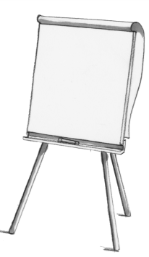
Exercise
On your own, identify 2-3 improvement opportunities within your area of influence
  Describe each problem in one to two sentences
Timing: 3 minutes
Then, in teams of 4-5 people…
Task: Decide as a team on an improvement opportunity to work through during this session
Timing: 5 minutes

Slide 5



What is Continuous Improvement?
Method of making small, incremental improvements to contribute to increased competitiveness, productivity, teamwork, employee engagement, and reduced costs
It’s a series of asking, “How can we optimize the current process?”
Improved Process
Improvement
Improvement
Improvement
Increased Competitiveness
Process

Slide 6
What is Continuous Improvement?
“Continuous Improvement is the on-going effort to improve products, services and processes by making small, incremental improvements within a business. It is based on the belief that these incremental changes will add up to major improvements over time…”
http://www.processexcellencenetwork.com/innovation/articles/continuous-improvement-4-factors-that-make-a-conti
It is one tool in the lean toolbox, useful because of its flexibility and ability to drive rapid, noticeable improvements

Slide 7

Why Do CI?
Generates specific, incremental, and sustainable improvements
Develops an organizational capability for continuous improvement
  Harnessing every brain not just every pair of hands
Changes the culture toward a continuous improvement mindset
“A lean operation without Continuous Improvement capability won’t stay lean for long. It will be unable to adapt to changing customer demands and cost and quality pressures.”
  -Journey to Lean by John Drew, Blair McCallum, Stefan Roggenhofer

Slide 8
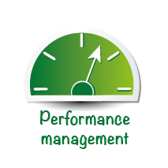





Continuous Improvement Mindset
Thinking
&
Behavior
Shift thinking in order to see the issue more deeply
Set measureable objectives to optimize process and cost
The more visual a process, the easier to identify status and problems
Together ask, “How can the process be improved?”
Identify non value-adding work (waste) to optimize the process
Get input and feedback
Notes:
In the LEAN simulation you have already made a continuous improvement
In 3 rounds the production process was so optimized that the urgent customer order could be done.
There you have already applied important elements:
Teamwork, the problem was solved in the group
A moderator cared ​​for an open communication
The improvement was conducted on the basis of numbers, facts, figures and sketches and drawings
What is continuous improvement ?
CIP is a mindset in which the improvements take place in small steps, however, contribute to increase the competitiveness
And opportunities and potential surrounds us every day, everywhere
With our WILD Global LEAN improvement program, we use a proven method.
To start the journey of continuous improvement, this context must be understood and taken on the responsibilities
With a coach you will learn to see your first KVPs, then perform with him and later participate independently in the process
This training is the basis for the LEAN operator training and we expect that you actively participate to implement it
A point is to develop your ability to live this process as a model/example
This is just as important as to develop the skills of his team and staff to achieve success.
Respect for the participants is a fundamental value of your activities.

Slide 9
CI Mindsets Lead to a CI Culture
Actively Shape Change
Dedicated Team Member
Positive Attitude
Positive Influence
Helpful Tip:
Be an example of the behavior and attitude you wish to cultivate in others
Take Responsibility
Communication

Slide 10
Creating a CI Culture
CI mindsets lead to CI culture
No improvement initiative will last without being sustained by an improvement culture
Motivation comes not from carrots or sticks, but from helping employees get in touch with their abilities and potential
Psychological benefits
  Positive peer pressure
  We are more amenable to change when we are part of the change process
Embrace fun! Implement games and celebrations to reward hard work

Slide 11
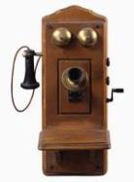






Proven Success of CI in Industry

Slide 12
Proven Success of CI in Kalamazoo
*OEE: measure of process throughput

Slide 13
Prerequisites
To develop a robust, sustainable improvement program, management support is essential:
  To ensure improvements occur “…management support for people’s time, access to required data, and permission to change things [must be] granted.”
  -Product Development Value Stream Mapping Manual, Hugh L. McManus, MIT 2005
What can you do if you don’t have management support?
  ‘Go until you get a red light’
  Use data (measurements) to prove effectiveness; argue facts, not feelings
  Start small; focus on your immediate area of influence
  Small pockets of improvement are better than none
  “If no one’s in charge, I guess you are.” –Penny Weller, Kalamazoo TED Talk on Continuous Improvement

Slide 14
What Makes a Good CI Program?
Driven from the bottom but supported from the top
  “Improvement work must be done through people, rather than to people.” -Journey to Lean by John Drew, Blair McCallum, Stefan Roggenhofer
CI is not a management activity!
  “How many employees live every day as though it were yesterday, doing the same things, experiencing the same frustrations, and getting the same results? It is precisely because they experience them day after day that people at the front line know the problems – and more often than not, have good ideas for solving them.” “…One organization had a slogan that said ‘Everyone in this company has two jobs: to do their job and to improve their job.’” -Journey to Lean by John Drew, Blair McCallum, Stefan Roggenhofer
  Management can then focus on developing and motivating their people, instead of solving their problems for them
Improvement becomes part of the work, not additional to the work

Slide 15
Stages of a CI Program
Begin, Build, Embed
Begin:
  “primary need is to demonstrate change” (proof of concept)
  Start small; focus on one or two specific areas or issues
  Begin establishing infrastructure required to maintain the program
  External consultants often used at this stage
  Helpful to have one or two lean experts and two to three change agents
  Focus on designing the program, training and coaching, and developing technical knowledge
  -Journey to Lean by John Drew, Blair McCallum, Stefan Roggenhofer

Slide 16
Stages of a CI Program
Build:
  Companies often stall in this stage because the CI infrastructure is in adequate
  Focus is broadened
  Change agents become experts who now train the next group of agents; as internal support grows and strengthens, the need for outside support is reduced
  -Journey to Lean by John Drew, Blair McCallum, Stefan Roggenhofer

Slide 17

Stages of a CI Program
Embed:
  Every value stream has undergone lean transformation
  CI becomes the norm
  Rather than being pushed upon them, coaching is “pulled by line operators and managers who request it to help them meet targets”
  -Journey to Lean by John Drew, Blair McCallum, Stefan Roggenhofer

Slide 18
The CI Process
CI Process involves building a team and following eight well-defined steps
  Steps designed to standardize work and improve operational efficiency
Because the steps are based on the scientific method, following the steps leads to improvements EVERY TIME
Notes:
Following the CI steps transform Marvin from a mild mannered mint leaf to the unstoppable Mighty Marven, the Infinite Improver!

Slide 19
Collecting CIs
When considering a process or area for improvement, ask:
  How many people does this specific process affect?
  How much time do people spend working within the constraints of the current process?
  What would we gain if we spent time working to improve this process? (Gains should be measurable, as in dollars, hours or other value metrics that are quantifiable.)
  What other teams / processes would be impacted by changes to the current process, and how? Would those impacts serve as impediments? Is the amount of effort justified by the anticipated value of forming a new process?
  -http://leankit.com/learn/kanban/continuous-improvement/
Notes:
Collect CIs to charge the Wasteblaster 3000

Slide 20

Collecting CIs
Process deviations
Key performance indicators (KPIs)
Customer complaints
Deviations from specifications/standards
Downtimes
Rework
Employee ideas and suggestions
Deviations
Prioritization
Downtime
Rework
Helpful Tip:
Prioritize based on corporate strategy and goals

Slide 21
Building a Team
  Why teamwork?
  Best practice
  To develop an organizational capability for continuous improvement through employee engagement
  To ensure solutions are fully realized and sustainable
  Doesn’t teamwork take longer?
  “If you want to go fast, go alone. If you want to go far, go together.” – African Proverb
  The time lost in developing improvement is gained back many times over due to increased process efficiency
  It’s not time lost, but time invested

Slide 22
Leading a Team
Volunteer employees who have undergone advanced CI Leader training
Goal is to engage, not dictate
Leaders focus not on solving the problem, but leading the team through the process so they can solve the problem:
  “Never tell people HOW to do things. Tell them WHAT to do, and they will surprise you with their ingenuity.” -George S. Patton, military leader
Helpful Tip:
Remember, you are the
Process Facilitator, not the Problem Solver!

Slide 23
Team Members
How many people on a team?
Five people per team is best practice
  Smaller teams may not have fully realized solutions
  Larger teams may become bogged down in too many opinions
Who should be on the team?
CI leader
  Helps ensure process is followed
3 process experts
  Intimately understand the process and problems
‘Ringer’
  Someone with ‘no horse in the race’
  Outside perspectives lead to unexpected solutions

Slide 24
Continuous Improvement Steps
Continuous improvement leaders guide a CI team through the eight step problem solving process using the Plan-Do-Check-Act method
      Define Scope
      Define Current State
      Root Cause Analysis
      Define Future State
    Plan
    Do
    Check / Study
    Act / Adjust

Slide 25
Continuous Improvement Steps
Steps based on the scientific method
8 Step CI Process
      Define Scope
      Define Current State
      Root Cause Analysis
      Define Future State
      Plan
      Do
      Check / Study
      Act / Adjust
Scientific Method
      Ask Question
      Background Research
      Formulate Hypothesis
      Develop Testable Predictions
      Test Predictions
      Analyze Results
      Report Results

Slide 26
1. Define Scope
Narrow down the continuous improvement opportunity into a manageable size
Keep the scope within the resources of the team
    Example: don‘t attempt to implement a new building construction project in another city
Keep the boundaries within the resources of the team
    Too narrow: may limit root cause problem solving
    Too wide: will not be able to solve every problem with one solution
    Scope must be just wide enough to solve the problem and just narrow enough to focus the CI effort
    Focus is key to a successful outcome

Slide 27
2. Define Current State
What do you see now? How is the situation currently handled?
  Do this at “the place,” called the Gemba
  Don‘t take anyone‘s word for it: Go and See
  Notice the interactions of people in the area
  Spend as much time as necessary to understand the current state
Do not rush this step!
  We must first uncover the process to uncover the problems
  We must fully understand the problems before the best solution can emerge
Creating flow charts and maps help identify problem areas
Notice any waste
  “Waste is anything that adds cost but not value.” -Journey to Lean by John Drew, Blair McCallum, Stefan Roggenhofer

Slide 28
2. Define Current State: Identifying Waste
Defects
Efforts caused by rework, scrap, and incorrect information
Overproduction
Production that is more than needed or before it is needed
Waiting
Wasted time waiting for the next step in a process
Non-Utilized Talent
Underutilizing People’s talents, skills, & knowledge
Transportation
Unnecessary movements of products & materials
Inventory
Motion
Unnecessary movements by people
Extra-Processing
More work or higher quality than is required by customer
Excess products and materials not being processed

Slide 29

3. Root Cause Analysis
Problem
Solution
Root Cause
Analysis
5 Whys
Direct cause-effect drill down
Single person
Fishbone Diagram
Brainstorm possible causes
Group
Simple Issue
Complex Issue
Thinking
&
Behavior

Slide 30
3. Root Cause Analysis: Five Whys
Problem:
Orders are late going out the door.
Why?
  Product not completed on time
Why?
  Spend too much time hunting down tools
Why?
  Tools are located in various places
Why?
  Different people store tools in different places
Why?
  No standard protocol for tool storage

Slide 31
3. Root Cause Analysis: Five Whys
Do
Don’t
Parts are out of spec
Wrong tool has been used
Standard tool is damaged
Oil temperature
was too high
No temperature
standard
Parts are
out of specs
Right tool not
available
No spare tool available
Return on investment is too low to purchase spare tools
Due to global competition, product market price is too low
5 Why?
5 Why?
Corrective action easily identified
Corrective action unclear,
issue cannot be solved

Slide 32
3. Root Cause Analysis: Fishbone Diagram
Used for complex problems that likely have more than one root cause
All potential causes categorized in 6 groups:
  Machine
  Man
  Material
  Method
  Measurement
  Environment
Process experts are helpful during analysis
Helpful Tip:
If causation can’t be determined by 5 Whys, try Fishbone method –the issue may have multiple causes

Slide 33
3. Root Cause Analysis: Fishbone Diagram
Material
Machine
Measurement
Problem
Methods
Man
Environment

Slide 34
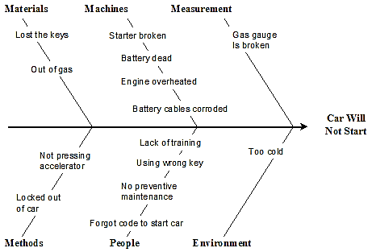
3. Root Cause Analysis: Fishbone Diagram
https://www.spcforexcel.com/knowledge/root-cause-analysis/analyzing-cause-and-effect-diagrams

Slide 35
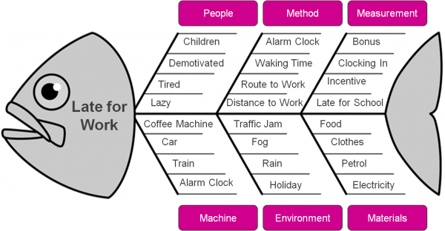
3. Root Cause Analysis: Fishbone Diagram
http://www.zarantech.com/blog/lean-six-sigma-tool-identifies-the-common-problem-of-late-coming-at-work-2/

Slide 36
Exercise
In your teams…
Timing: 10 minutes
Task: Find the root cause of chosen continuous improvement opportunity
  Use either the 5 Whys or Fishbone method
End Result: Share your results

Slide 37
4. Develop Future State
Brainstorm ideas
  What will the situation look like after the solution is implemented?
  Think about how the area would look, feel, sound, if the problem was solved
Determine any solution requirements
Use what you learned at the Gemba
Use the root cause analysis
Eliminate waste
Define measurements:
  How will you know the solution worked?
  Improvement is determined by data, not anecdotes

Slide 38
4. Develop Future State
Ask, don‘t tell!
  To build engagement, answers must come from the team, not you
  Even if the agreed upon solution isn‘t perfect, it‘s an incremental step forward
Helpful Tip:
Engagement is more important than perfection

Slide 39
5. Plan
Cultivate an implementation plan:
  What must be done to achieve the future state?
  Who is responsible?
  When will it be completed?
  What is the effect on the company when the solution is implemented?
  Is there any risk associated with this solution?
  How will you know the solution was effective?
  Is a budget required? Capital approval?
  What training will be required?

Slide 40
5. Plan
Implemement the improvement
Test the improvement
  EXPERIMENT!
  Learn
Helpful Tip:
Make it easy to follow the desired procedure

Slide 41

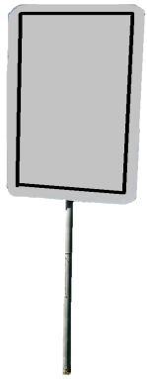



5. Plan
Make it easy to follow the desired procedure
No
Littering

Slide 42
Exercise
In your teams…
Timing: 10 minutes
Task:
  Develop the future state
  Develop the implementation plan
End Result: Share your results

Slide 43
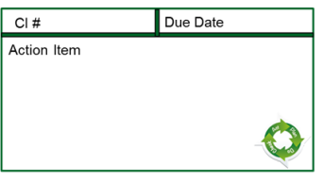
6. Do
Implement the solution
Define responsibility and timelines for implementation of the parts of the improvement
  Action Item Cards
The team should engage any affected employees at the Gemba

Slide 44
7. Check / Study
Confirm the improvement was effective
‘Check’ phase is where most Continuous Improvement efforts fail
  Was the solution effective? Did it work?
  Did the measurements improve as expected?
  Was something missed in the continuous improvement process?
  Should the Plan be adjusted?

Slide 45
8. Act / Adjust
Adjust the solution if needed
Expand the learning and improvement to other areas
Key points:
  What didn’t work?
  Could the solution have been better?
  Should another continuous improvement be initiated based on the results?
  Team identifies any opportunities to expand the improvement
  Share the improvement with the leaders in identified areas
  Start additional Continuous Improvement Projects

Slide 46
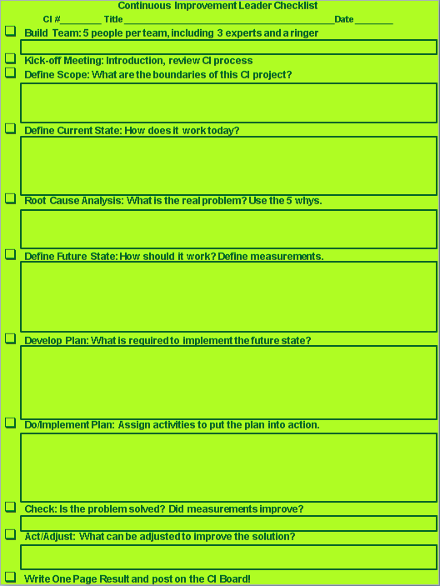
Tracking
CI leaders follow the provided checklist
Each step is defined with space to write directly on the sheet
Typically, CI leaders meet with their team an hour at a time, one to three times a week until the project is complete
CI Leaders attend a biweekly meeting to give project status updates

Slide 47
Leader Checklist
5. Develop Plan: What is required to implement the future state?
6. Do/Implement Plan: Assign activities to put the plan into action.
7. Check: Is the problem solved? Did measurements improve?
8. Act/Adjust: What can be adjusted to improve the solution?
Write One Page Result: Post it on the CI Board!
CI # Title Start Date_________
Build a Team: 5 people per team, including 3 experts and a ringer
Kick-off Meeting: Introduction, review CI process
1. Define Scope: What are the boundaries of this CI?
2. Define Current State: How does it work today?
3. Root Cause Analysis: What is the real problem? Use the 5 whys.
4. Define Future State: How should it work? Define measurements.

Slide 48
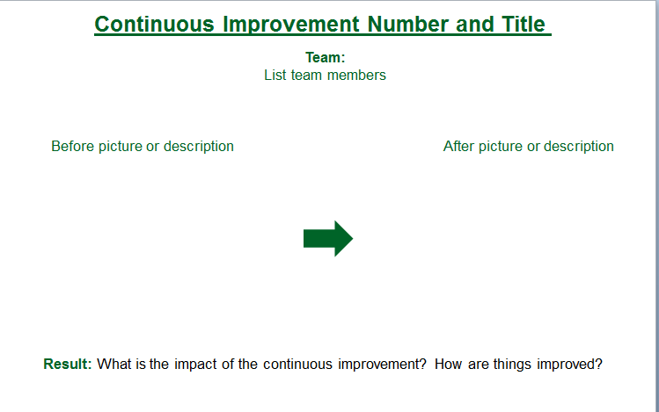
End Result Development
At the project’s end, CI Leader creates a One Page Result, including team members
Post the One Page Result on the CI Status Board

Slide 49
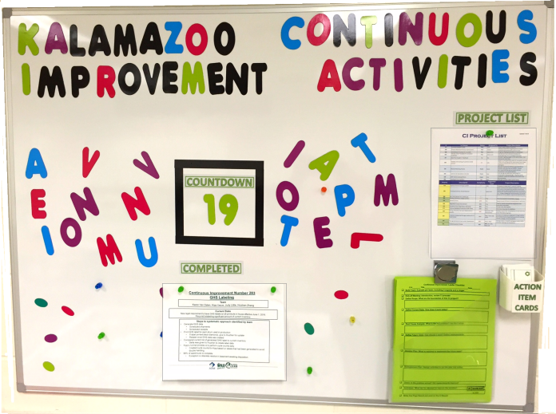
Status Board Example 1
Pending List
Countdown
Action Item Cards
One Page Results
Checklist

Slide 50




Status Board Example 2
PDCA CYCLE
Standards
CI
Lead
Date
CI
Lead
Date

Slide 51
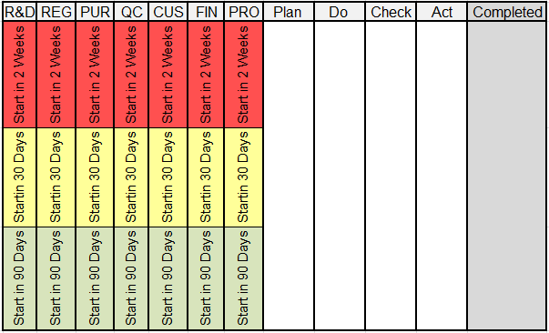
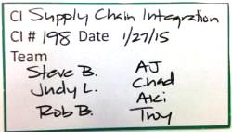
Status Board Example 3
CI projects written on magnetic card
Cards prioritized on status board based on strategy, impact, etc.
Card is moved through CI steps on Tracking Board

Slide 52
Obstacles to the CI Process
Building a robust, sustainable CI Process takes time and continued effort; the industry agrees it takes roughly 10 years for an improvement program to truly become excellent
Resistance to change:
  Complacency
    Familiar feels safer and easier
    Be patient; gaining employee engagement is a marathon, not a sprint
  Lack of knowledge
    Coaching is key
    ‘See one, do one, teach one’
    Fail forward – embrace uncertainty, use mistakes to propel you forward
    Practice makes permanent; perfect practice makes perfect

Slide 53
Obstacles to the CI Process
Resistance to change:
  Lack of Trust
    CI is not just about processes and tools, but about relationships
    Building relationships builds trust and trust is key to success
    If leaders don’t walk the talk, CI will never fully take root
  Fear
    Fear of job loss or improving oneself out of a job
      The goal of CI is not to eliminate jobs but to eliminate waste, leaving the employee with more time and mental energy to devote to problem solving and other value added activities
    Management fear of handing control to frontline workers
      “Power is gained by sharing knowledge, not hoarding it.” – Joakim Ahlstrom, author of How to Succeed with Continuous Improvement
      Use every pair of hands and every brain

Slide 54

Obstacles to the CI Process
Complainers
  Listen to the fear behind the complaint and address that
  Complainers highlight problem areas; do not discount them because often they are saying what others are thinking
  “Complaints are gifts, although you may not like how they’re wrapped.” –Penny Weller, Kalamazoo TED Talk on Continuous Improvement
  “Your most unhappy customers are your greatest source of learning.” – Bill Gates
  Don’t take it personally, but do take it seriously

Slide 55
Obstacles to the CI Process
  Team difficulties:
    B. W. Tuckman, social psychologist studying group dynamics for nearly 60 years
    Four Stages of Team Development by
      Forming
      Storming
      Norming
      Performing
    “These phases are all necessary and inevitable in order for the team to grow, to face up to challenges, to tackle problems, to find solutions, to plan work, and to deliver results.”

Slide 56
Team Stage 1: Forming
Characteristics
Team meeting
Learn about the problem
Agree on goals
Begin to tackle problem
Behaviors
Members behave independently
Self-focused mindset
Goal as a Leader
Encourage engagement and equal participation

Slide 57
Team Stage 2: Storming
Characteristics
Members grow in confidence, turbulence likely due to disagreements or personality clashes
Resolution necessary to move to next stage
New conflicts may cause cycling back to this stage
Behaviors
Voicing of opinions
Struggle to build unity
Goal as a Leader
Emphasize non-judgment, model patience
End result is a stronger, more flexible team

Slide 58
Team Stage 3: Norming
Characteristics
Resolved conflicts lead to greater team unity
Establish norms in the form of systems and procedures
Share common goal
Behaviors
Spirit of cooperation
Enthusiasm builds
Goal as a Leader
Ensure prevention of conflict does not stifle creativity

Slide 59

Team Stage 4: Performing
Characteristics
Team acts as a cohesive unit
Focus shifts to problem-solving
Dissent seen as part of creating a workable solution
Behaviors
Motivated
Share ideas openly
Decisions made as a team, not as individuals
Goal as a Leader
Unexpected challenges or new information may cause cycling through previous stages
This is expected and part of healthy team development

Slide 60
Summary
CI is the tool we use to improve processes and organization
CI process consists of 8 steps designed to standardize work
Ask, don’t tell!
Engagement and employee development is the goal; an employee-driven improvement process is always more ideal than a management-forced policy
The engine of continuous improvement is continuous learning
    Small changes are powerful
Respect both the team and the process
Follow the steps and improvements will happen

Slide 61
Keep on Improving!
Thank you for your participation.

Slide 62
Resources
Books (plus many more):
  Lean Thinking, by Jim Womack, PhD, and Daniel Jones, founders of the Lean Enterprise Institute and the Lean Enterprise Academy (UK), respectively.
  Gemba Walks, Jim Womack
  Learning to See, Value Stream Mapping concepts by John Shook and Mike Rother
  The Machine That Changed the World by James P. Womack, Daniel T. Jones, and Daniel Roos
  Toyota Kata by Mike Rother
  The Toyota Production System: Beyond Large-Scale Production by Ohno, Taiichi
Online resources are endless
  Useful webinars and reading lists on Karen Martin’s website, http://www.ksmartin.com/
Continuous improvement requires continuous learning!

