Slide 1



Slide 2
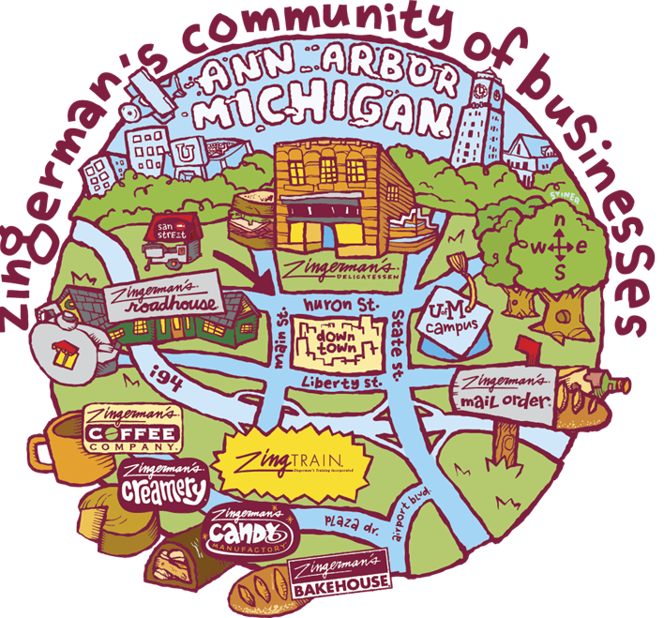
Community of 10 businesses dedicated to full flavored traditionally made artisanal foods
Sales of almost $60 million
About 700 employees
Innovative business and managing practices
Just beginning lean journey

Slide 3

Focus on
Started in 1993
Sales of almost $18 million
70 employees year round and 400 during the Christmas holiday
Using Lean for over a decade

Slide 4

Continuous improvement history at ZMO
Line redesign
HYN
(autonomic labor adjustment)
PFEP
JIT
(eliminate pre-assembly)
Takt
(paced production)
Standardized Work
Line side market consolidation
Station customization
Holiday selection and training
Back stock redesign
Sequencer logic and speed improvement
Standard takt levels
Pull (markets & routes)
Heijunka
(sequenced WO printing)
Scan to check
Cell for popular boxes & baskets (hot pod)
End of day totals
Mistake reduction
Capacity planning
2004
2016
Start of Lean journey
We’ve done a LOT!

Slide 5
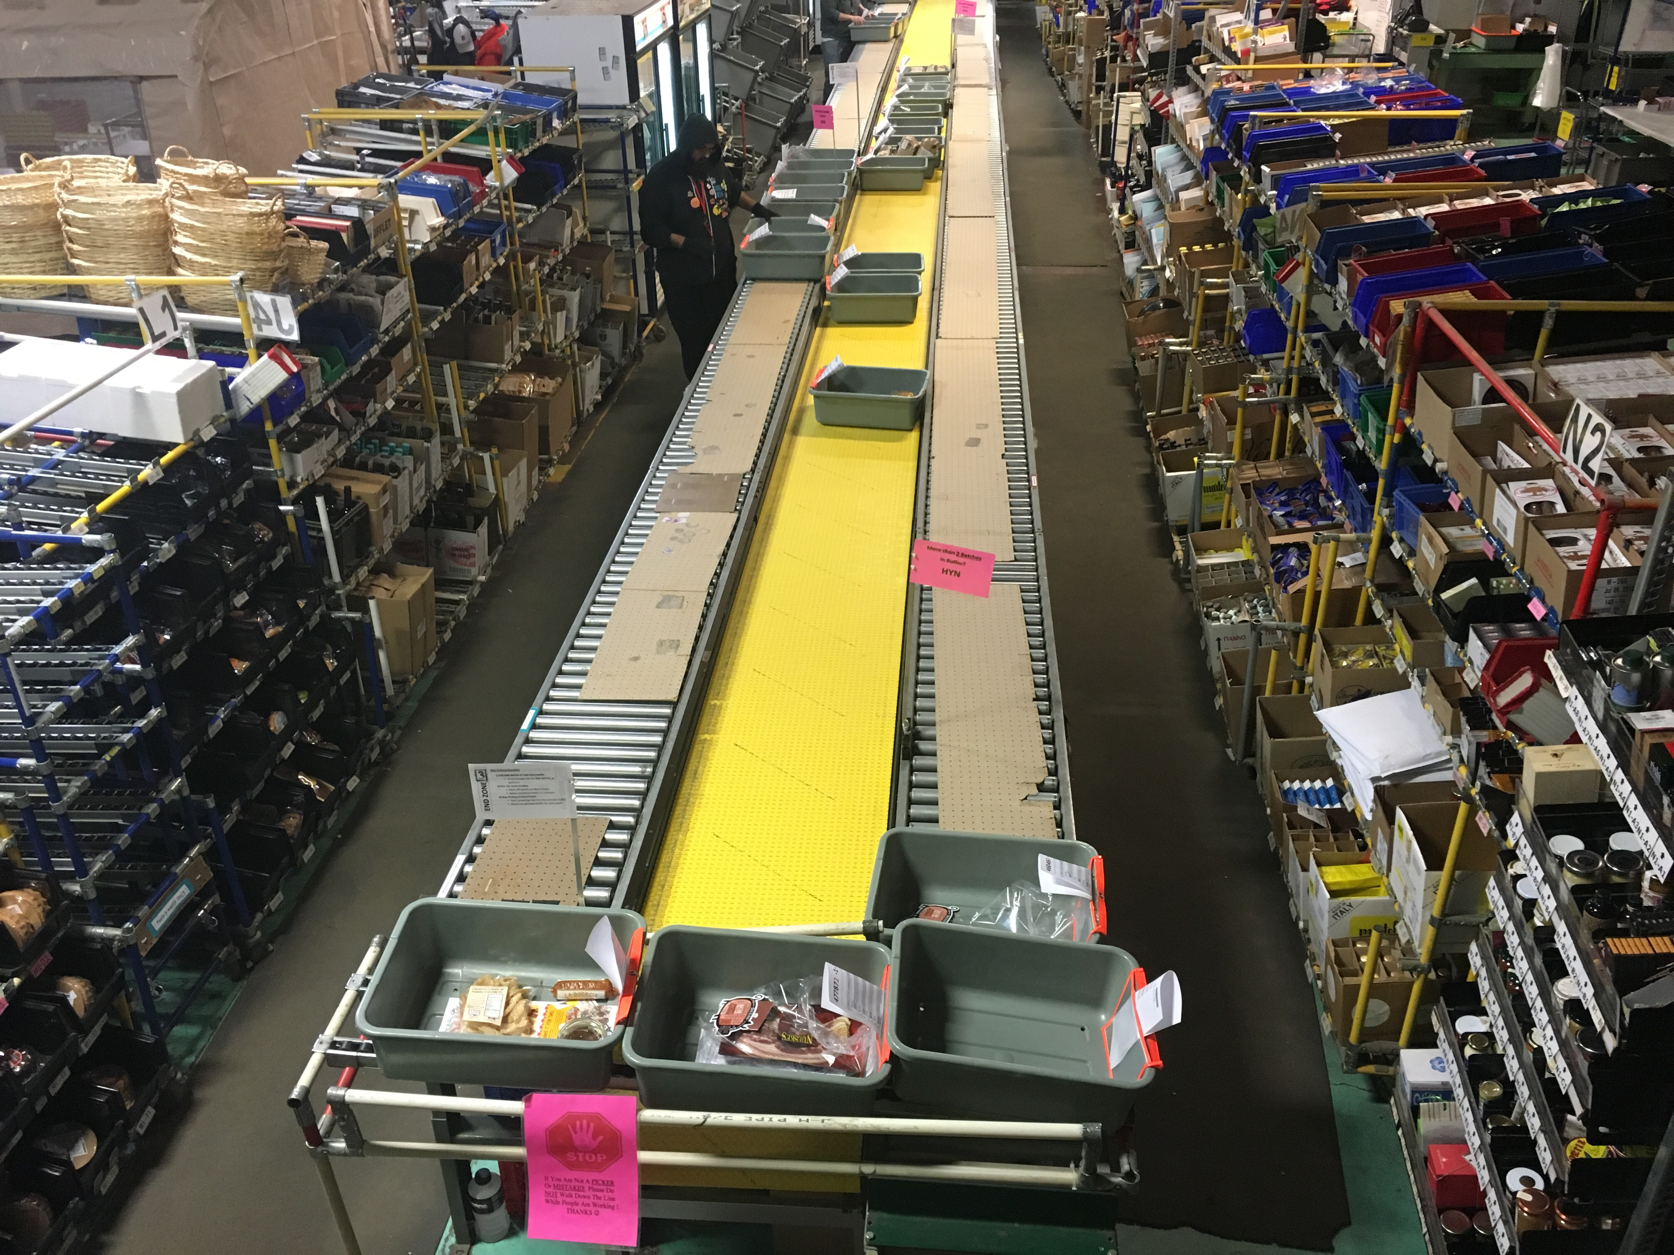
7 sec. Takt!

Slide 6
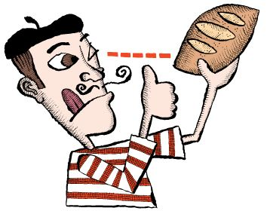
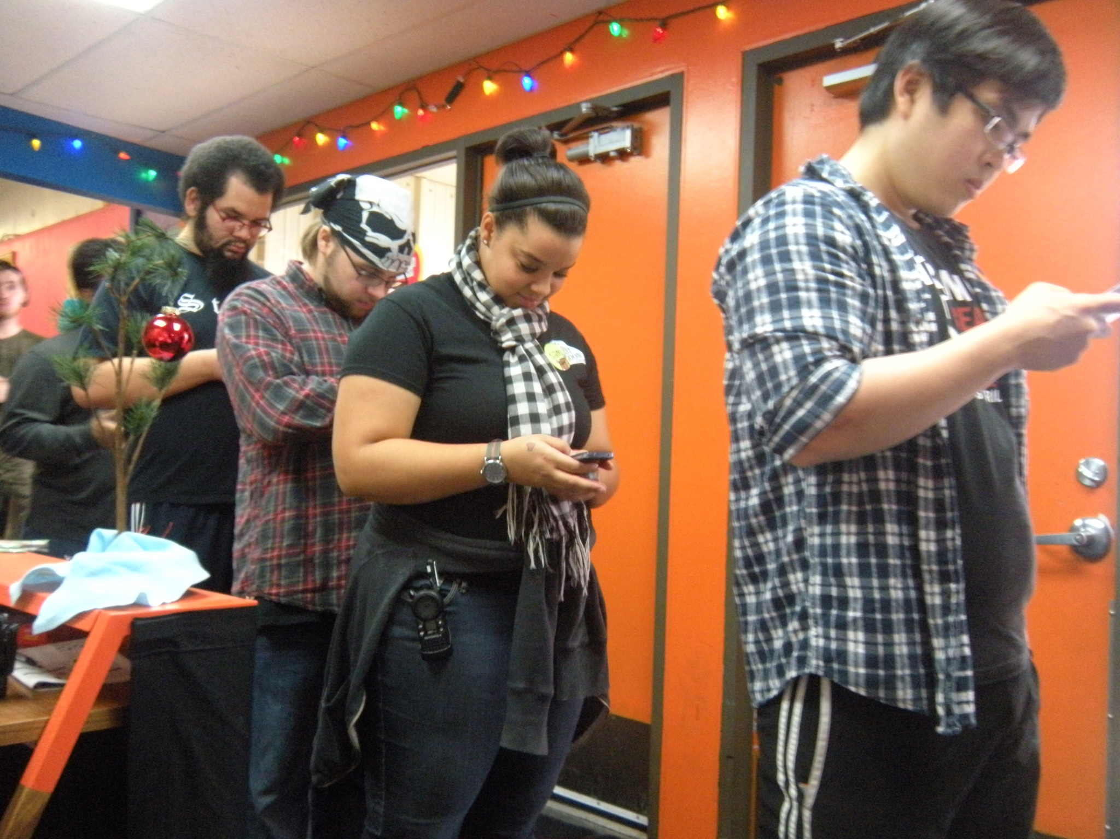
A Rare Ingredient: Involvement
PDCA
Grant based CI
TBP
2004
2015
Managers have consistently been a bottleneck for improvement.
We are tired.
3
5
Insert picture here showing group involvement
Use new process

Slide 7
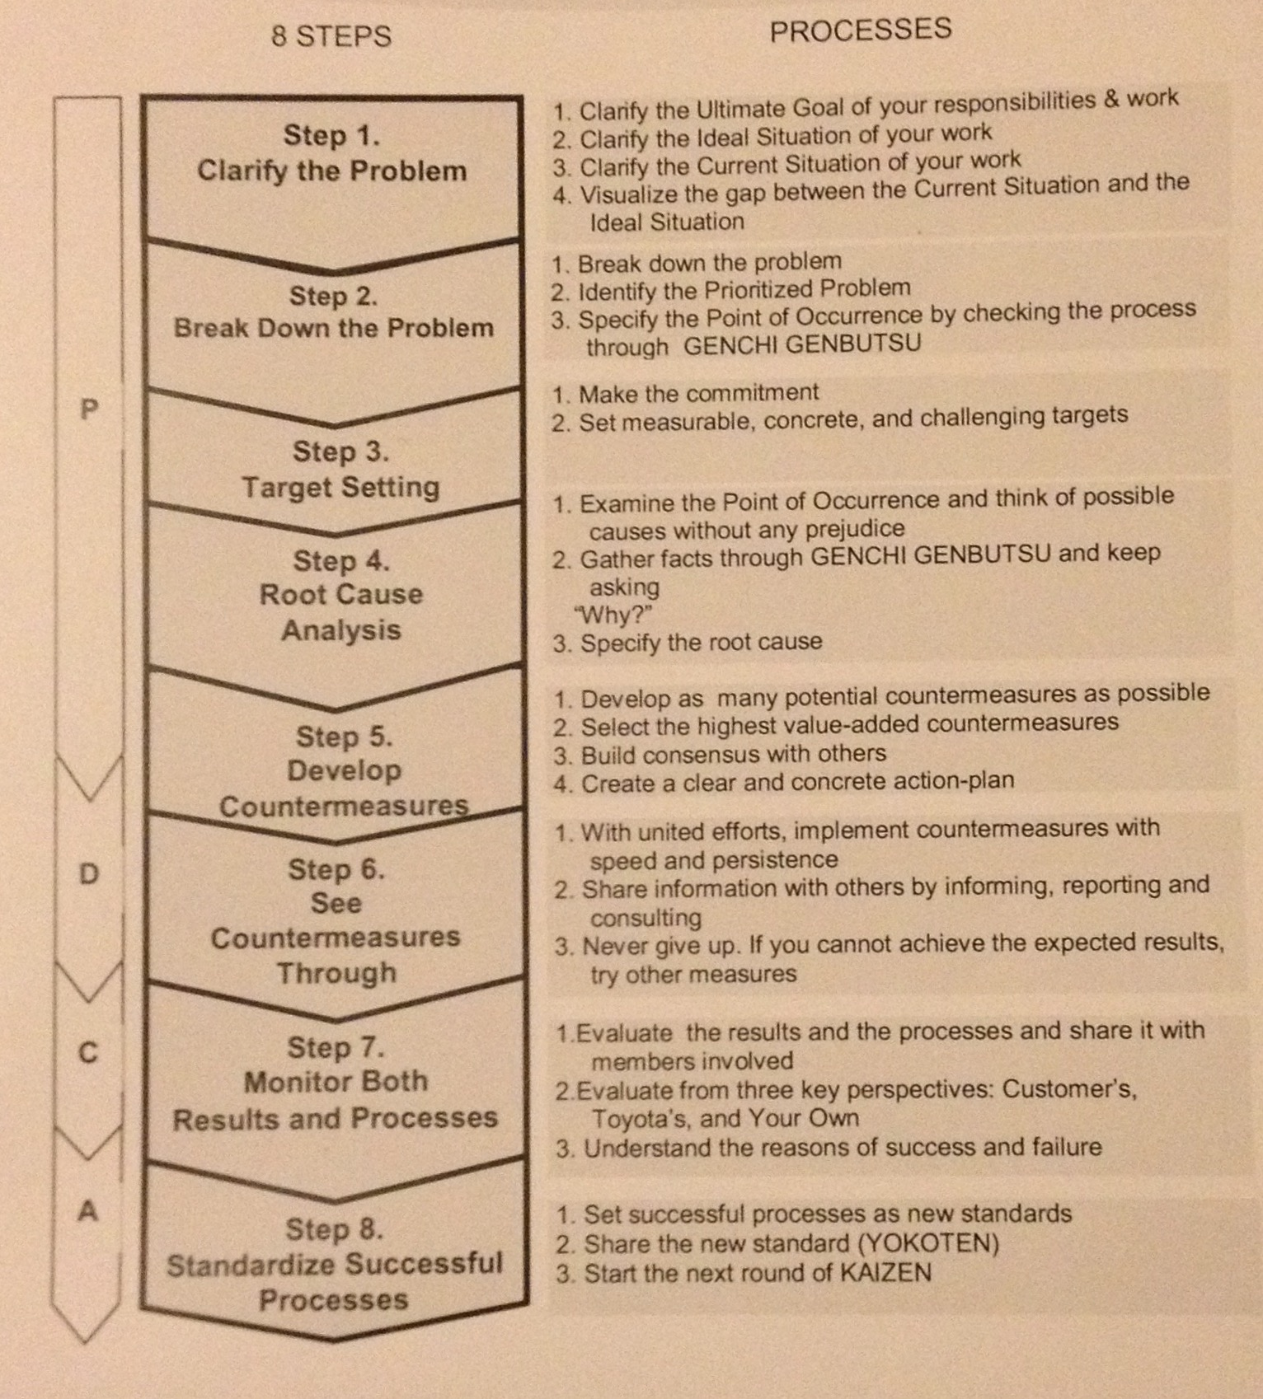
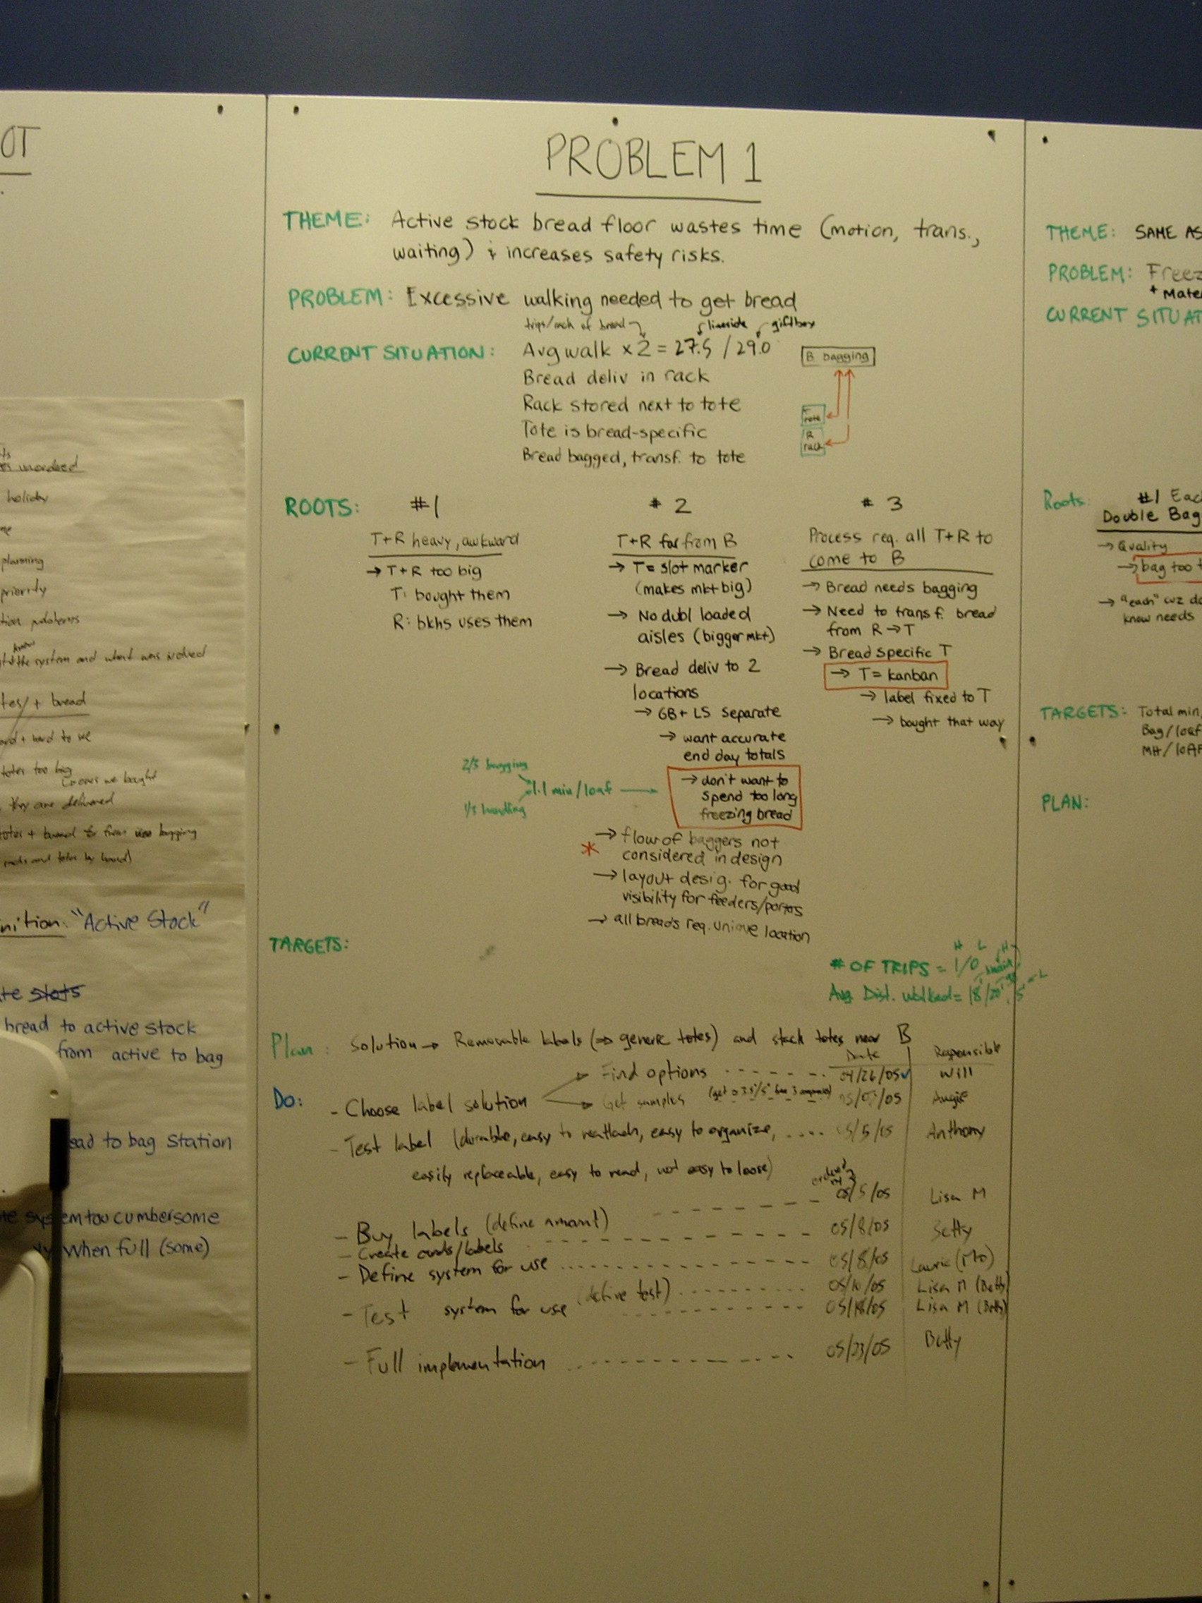
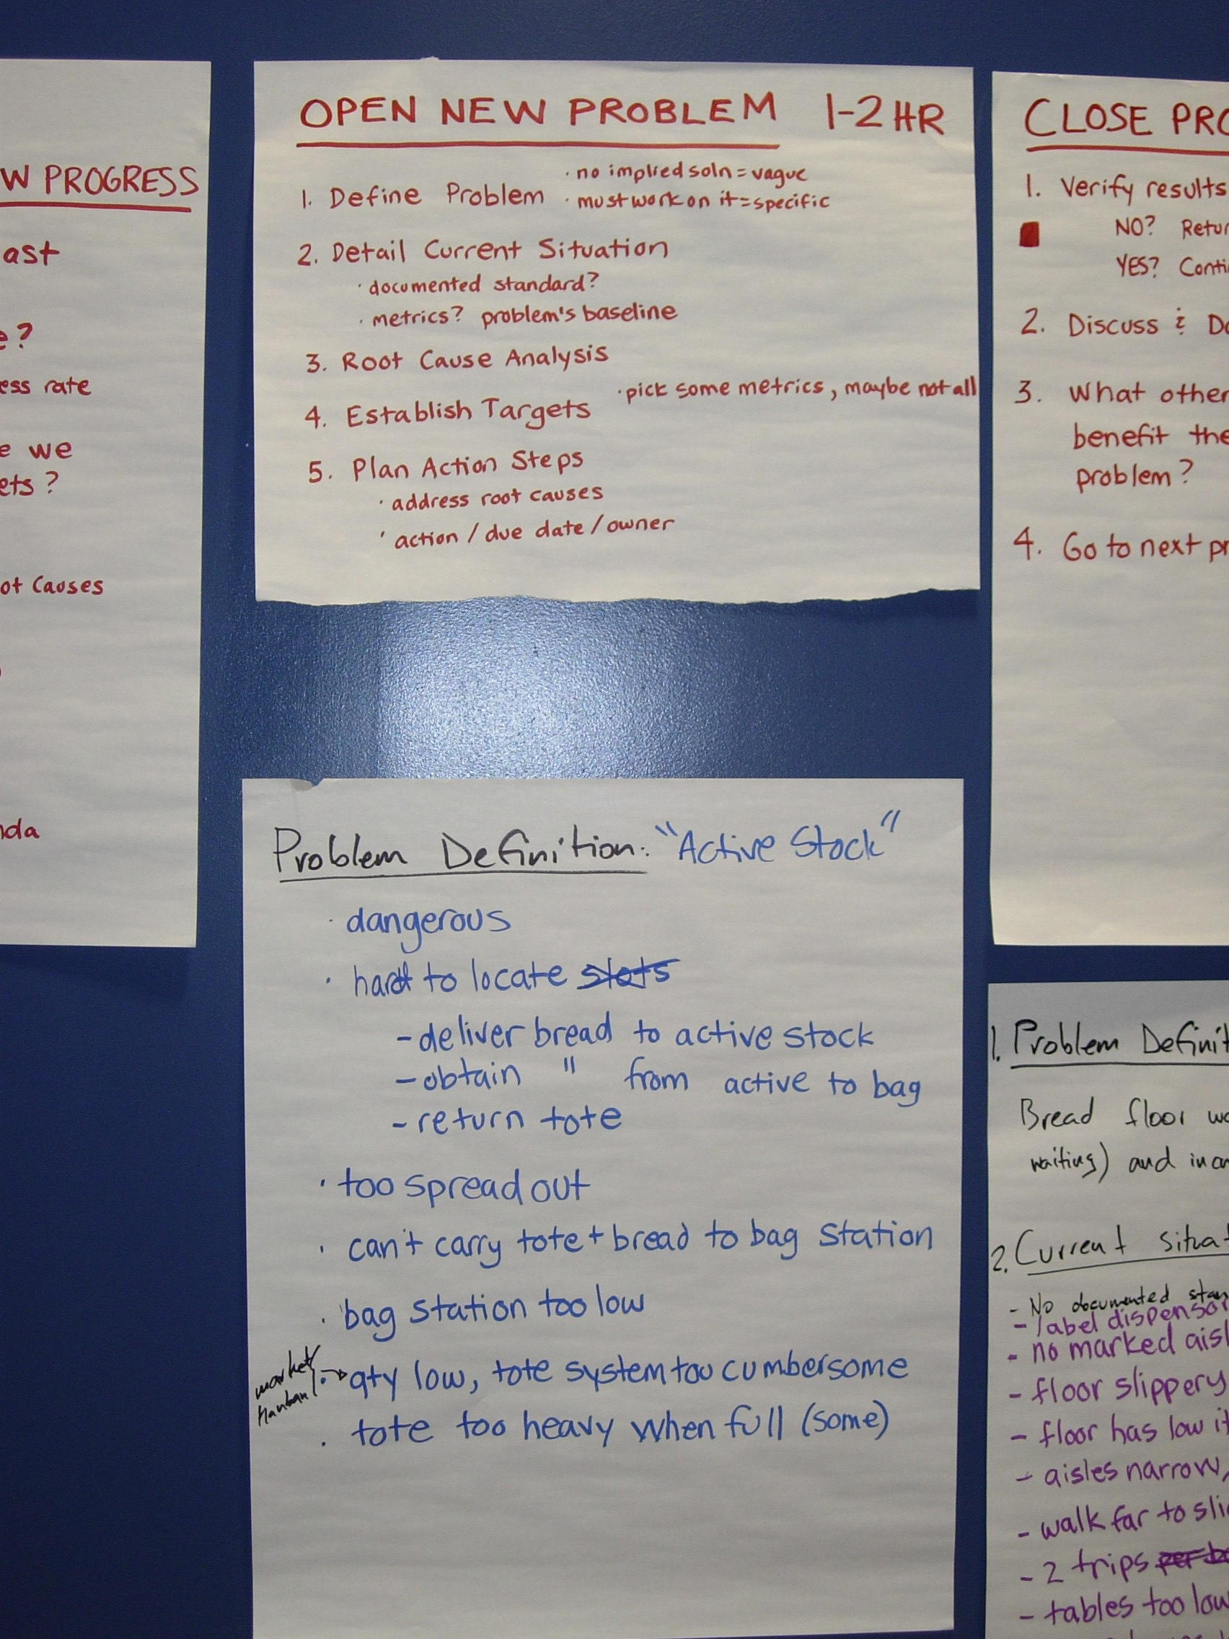
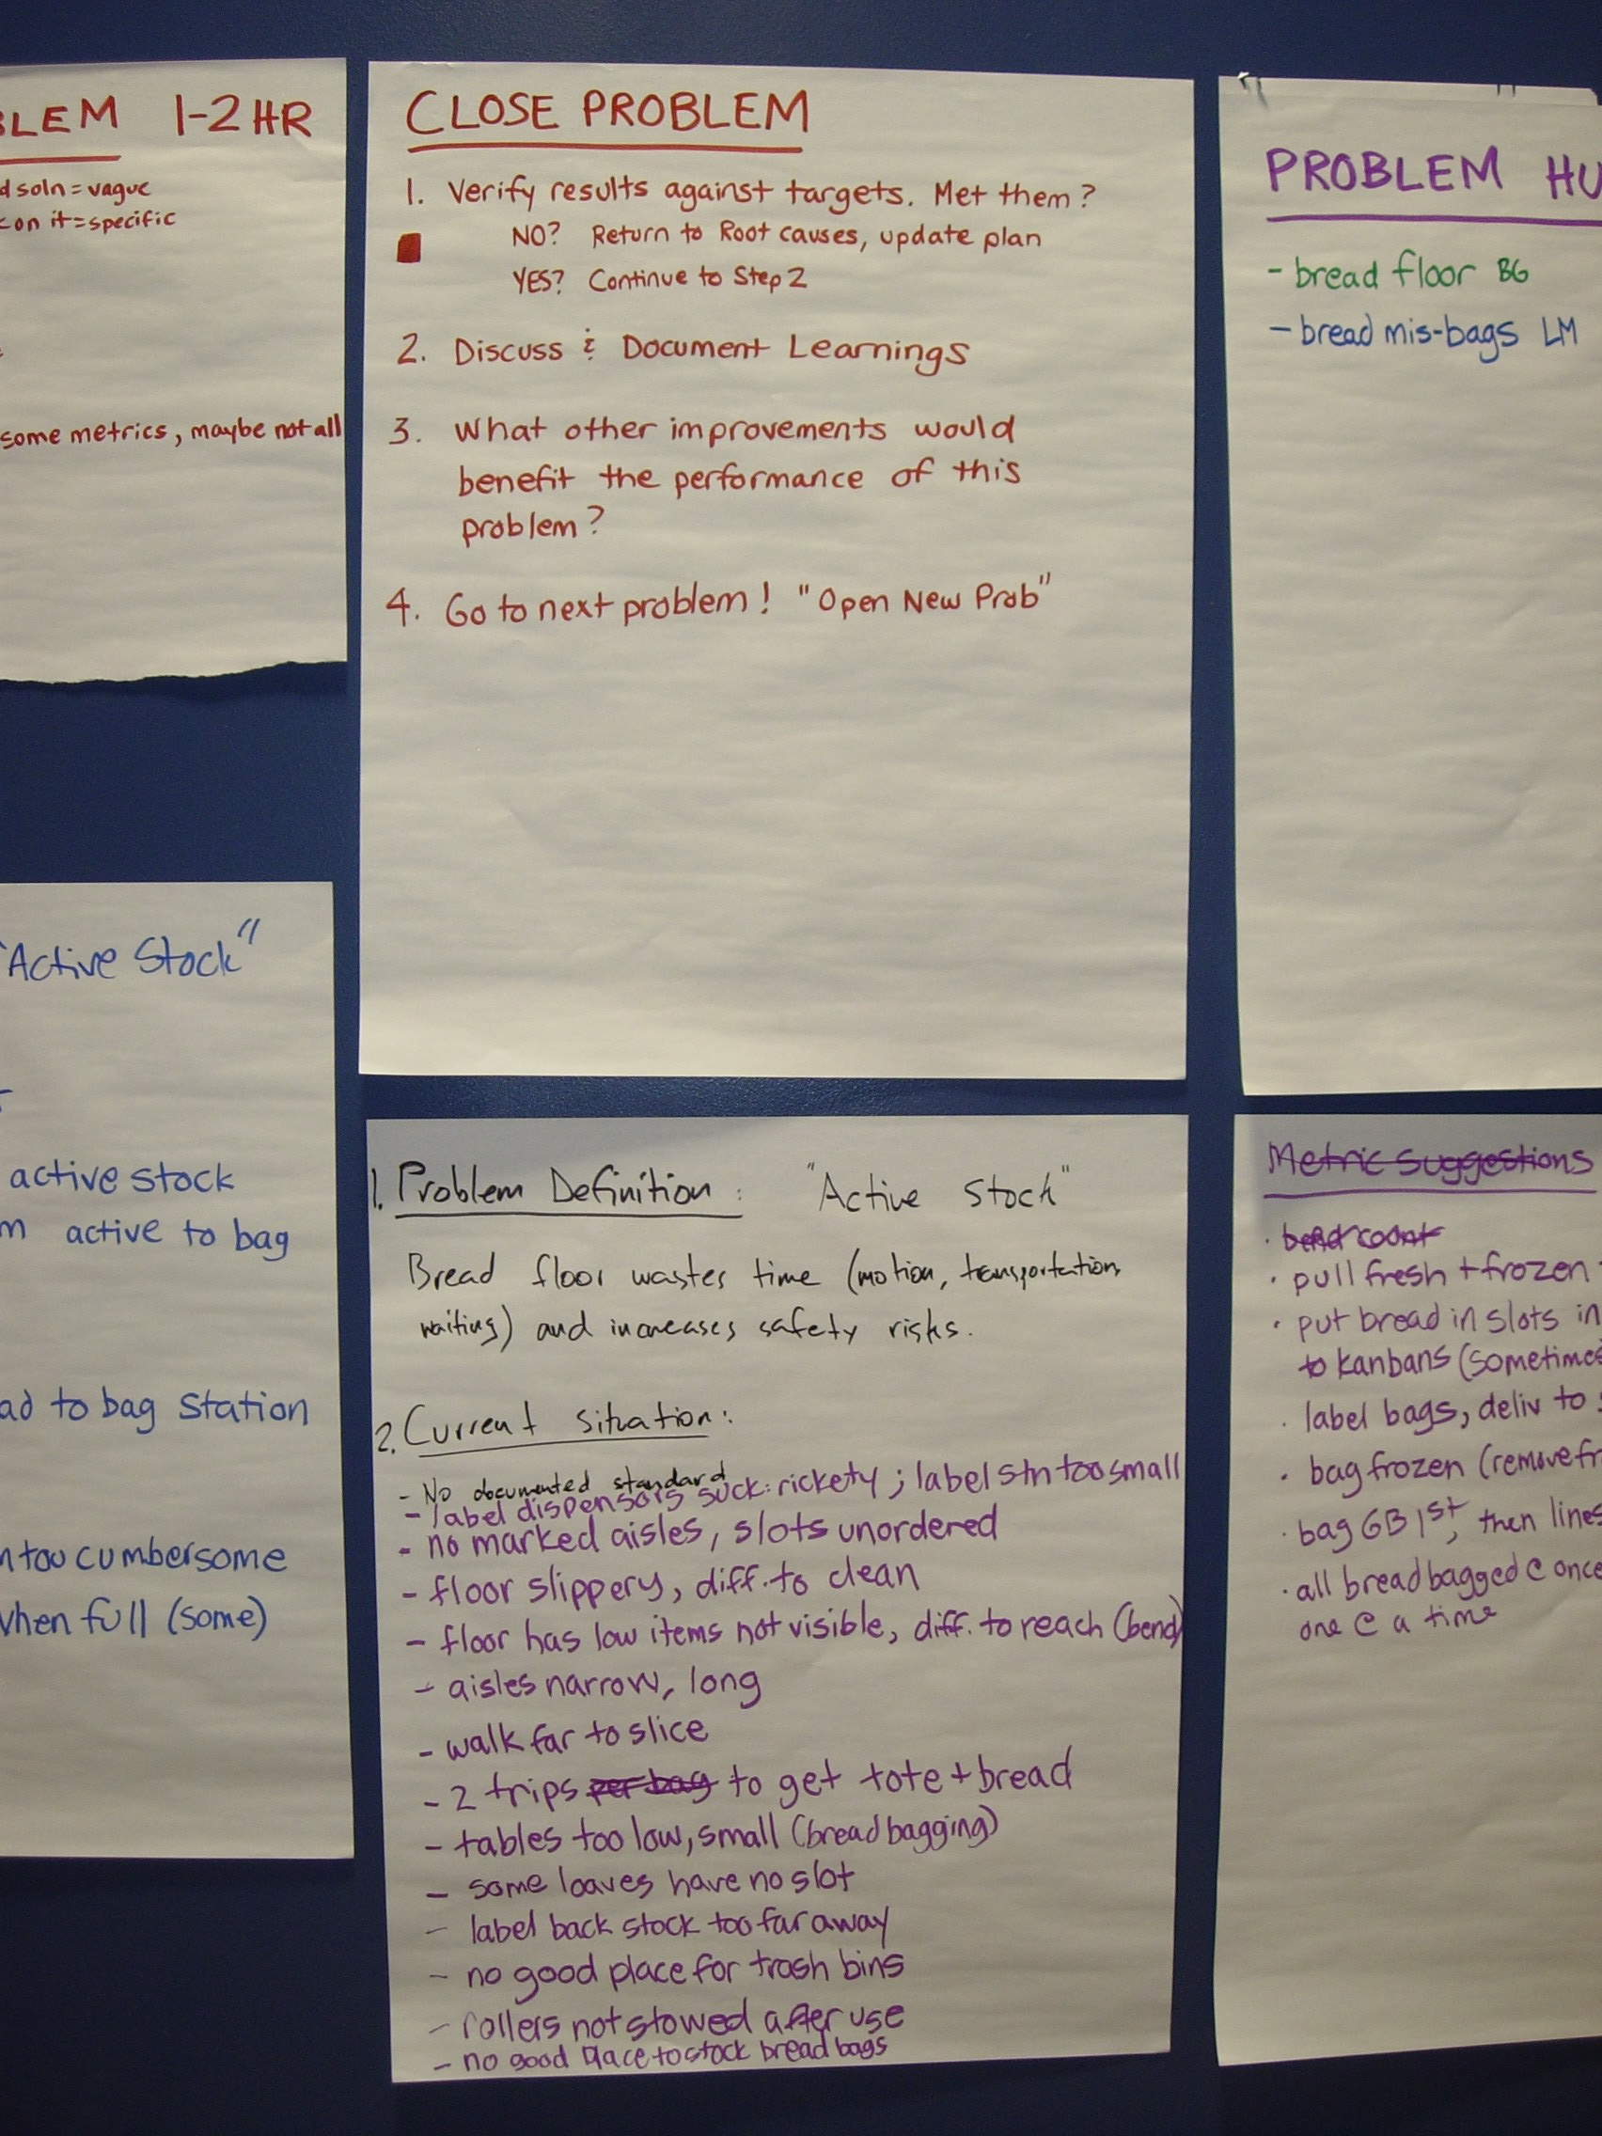
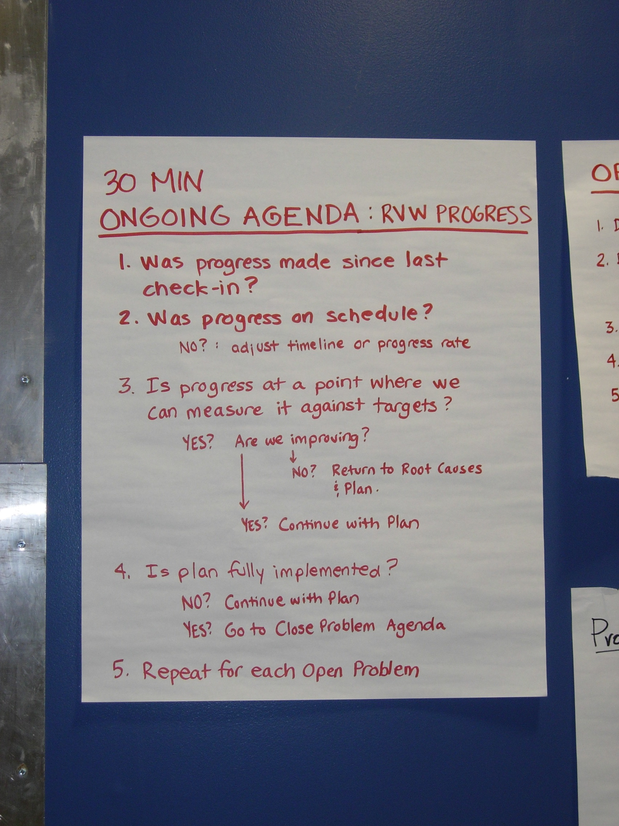
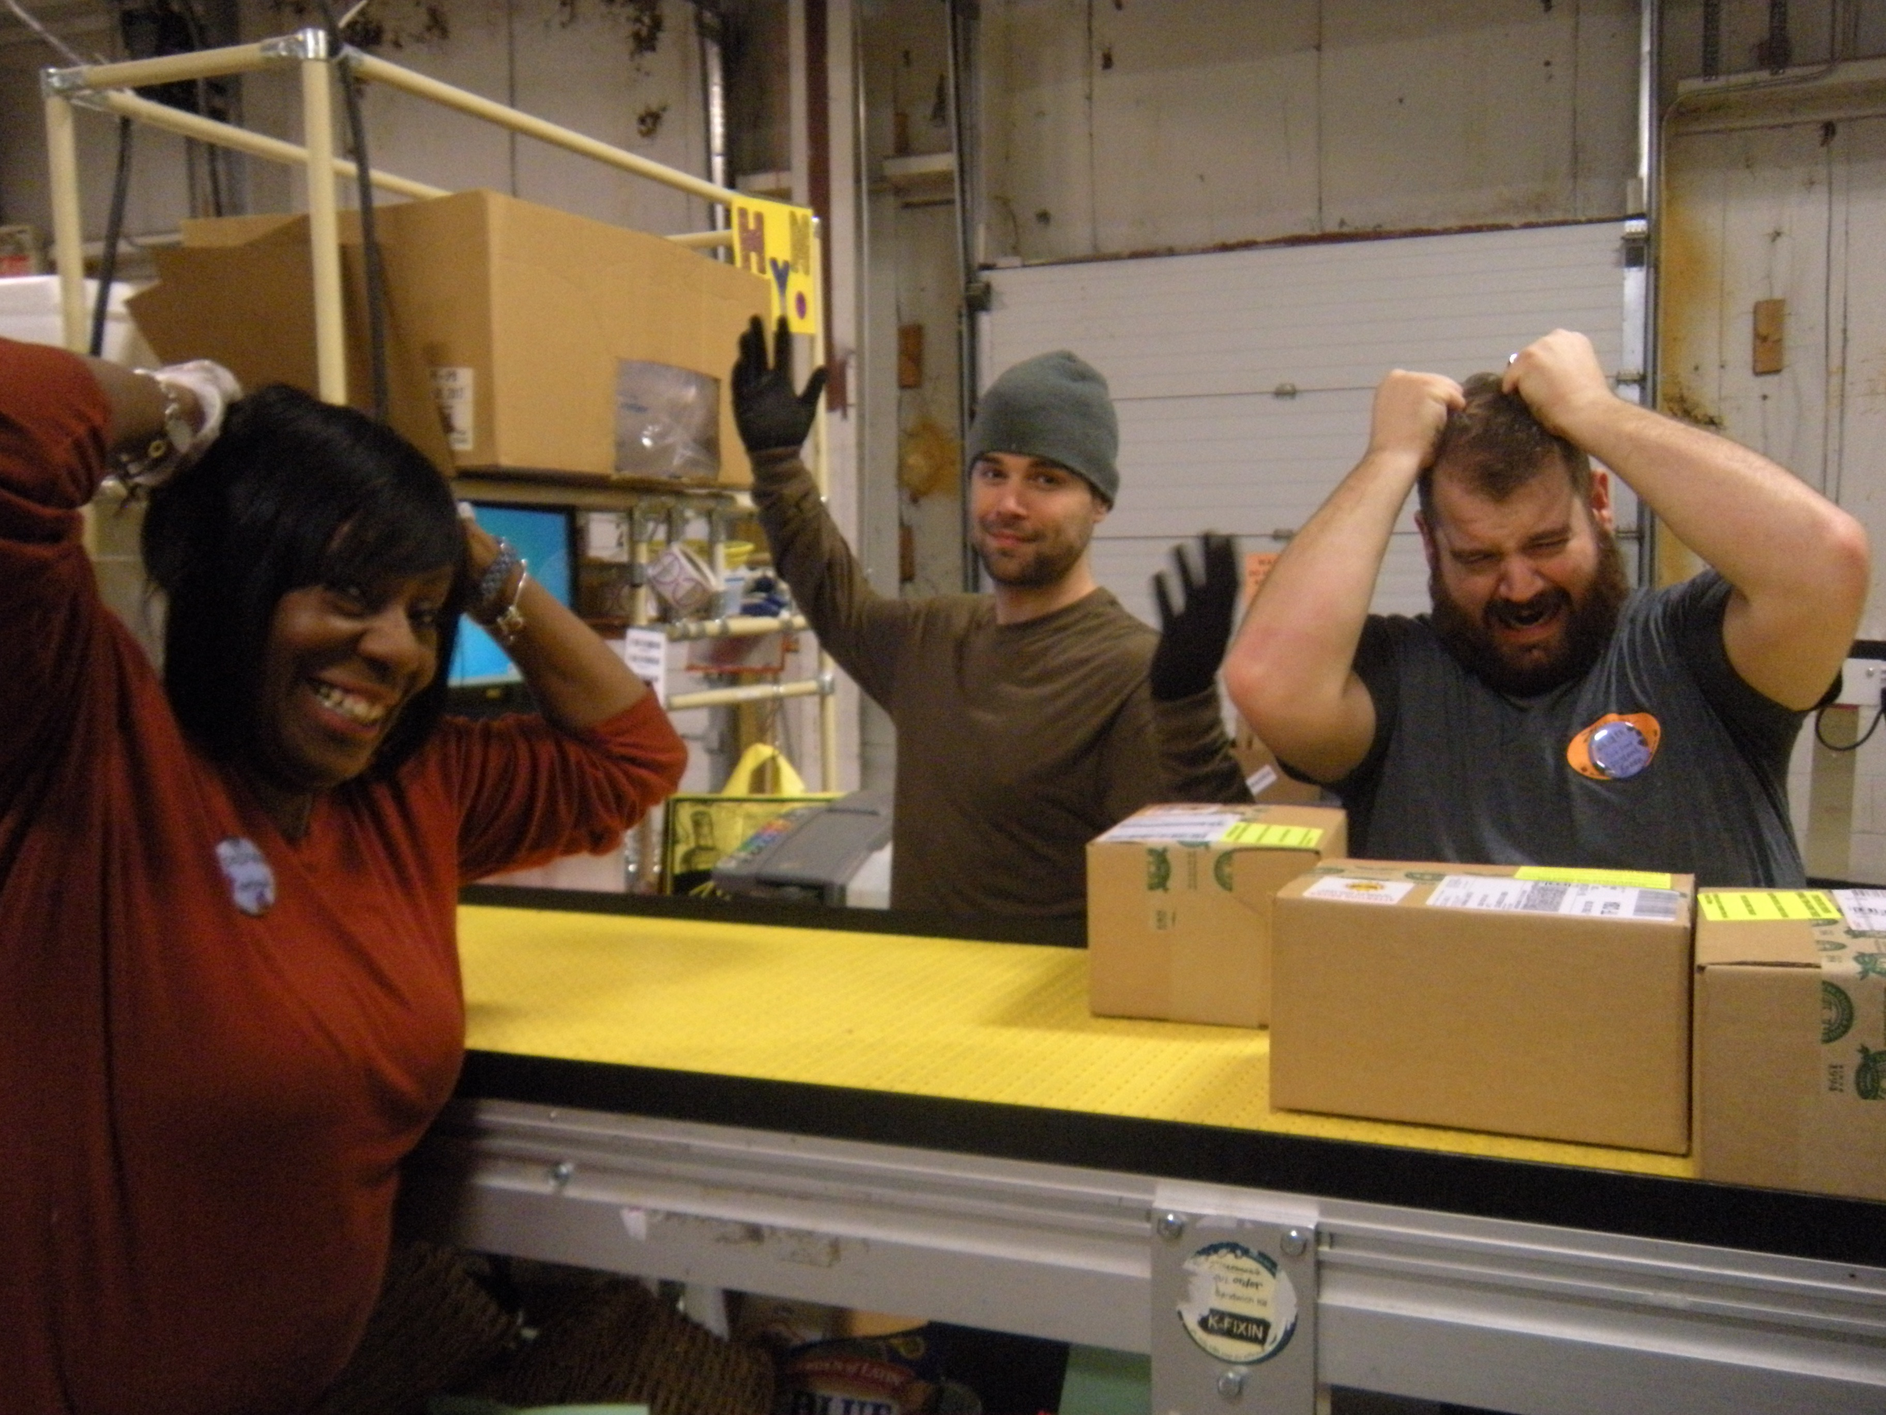
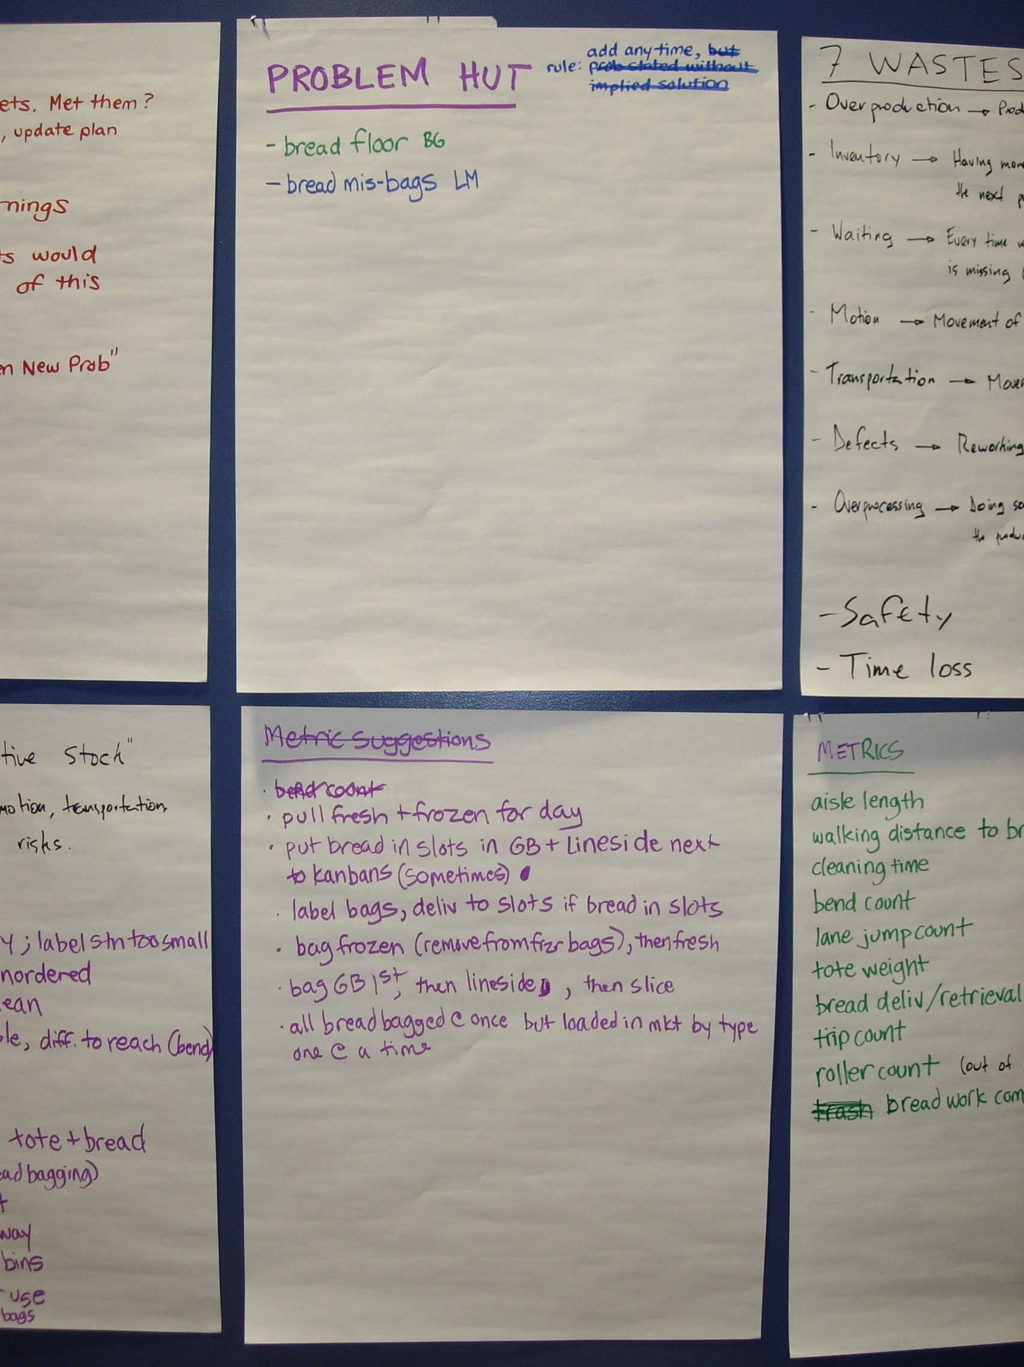
Continuous improvement history at ZMO
PDCA
Grant based CI
TBP
2004
2015
Etc.
Etc.
Etc.
Etc.
Used mostly by top management (who tried to push others to use it)
No appeal to front liners
No ownership
Grueling experience
Never took hold
Process
BETTY BRAIN PHOTO

Slide 8
These approaches are very similar… different flavors of PDCA
PDCA
Grant based CI
TBP
Toyota Kata
2004
2016
20+
People Problem
Learning
Use new process
What’s going on?

Slide 9
BEFORE
People preferred to have their teeth pulled than participate in continuous improvement
NOW
We don’t have enough experienced Coaches for all the people who want to participate
20+
People Problem
Learning
Use new process
Why such a significant and sudden change?

Slide 10
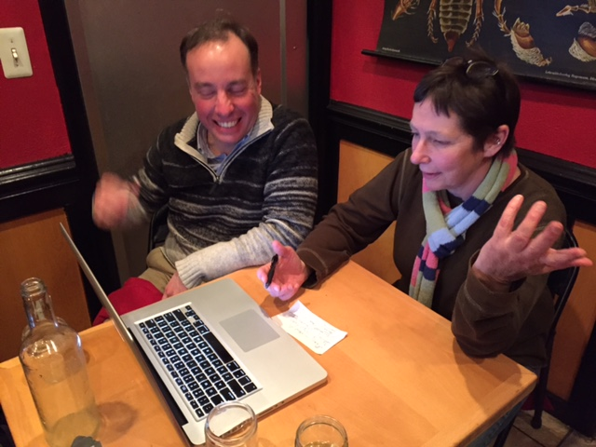
Why does Toyota Kata work?
?
?
Let’s ask the people involved!

Slide 11
What got you interested in kata?
Eric – I like the idea of improving a process and moving it forward.
Diego – You get to think and use your brain!
Emma – I like problem solving… and this process has visuals that show progress clearly. Besides, fewer OOMs means less work for me.
Tess – I’m naturally organized, so TK seems logical... it’s common sense. I like being involved, and with this I can control changes and see progress. It’s very visual. It allows me to talk on the same level to anyone in the organization.
Kelly – I like fixing things and I’m detailed oriented, but I frequently don’t know where to start. The kata gives me a clear process and direction.
John – It directly impacts the work at my station… reduces workload. I have freedom to make changes. It seems to fit well with my background.

Slide 12
What got you interested in kata?
like
improving
Eric – I like the idea of improving a process and moving it forward.
Diego – You get to think and use your brain!
Emma – I like problem solving… and this process has visuals that show progress clearly. Besides, fewer OOMs means less work for me.
Tess – I’m naturally organized, so TK seems logical... it’s common sense. I like being involved, and with this I can control changes and see progress. It’s very visual. It allows me to talk on the same level to anyone in the organization.
Kelly – I like fixing things and I’m detailed oriented, but I frequently don’t know where to start. The kata gives me a clear process and direction.
think and use your brain
like problem solving
visuals
show
progress
less work for me
naturally organized
logical
common sense
like being involved
can control changes
see
progress
visual
allows me to talk on the same level to
anyone in the organization
like fixing things
detailed oriented
clear process
direction
Personal fit
Process appeal
Perceived rewards

Slide 13
Kata is different
What’s the next target condition?
Provides direction
What’s the direction?
Logical
What’s the current condition?
Clear process
Visual
I get to think and use my brain
What obstacles are in the way?
Learning
&
Improvement
Motivation
Can see progress
What’s the
next experiment?
Freedom to make changes
Reduces
my workload
What did we learn?
What do we expect?
Can control changes

Slide 14
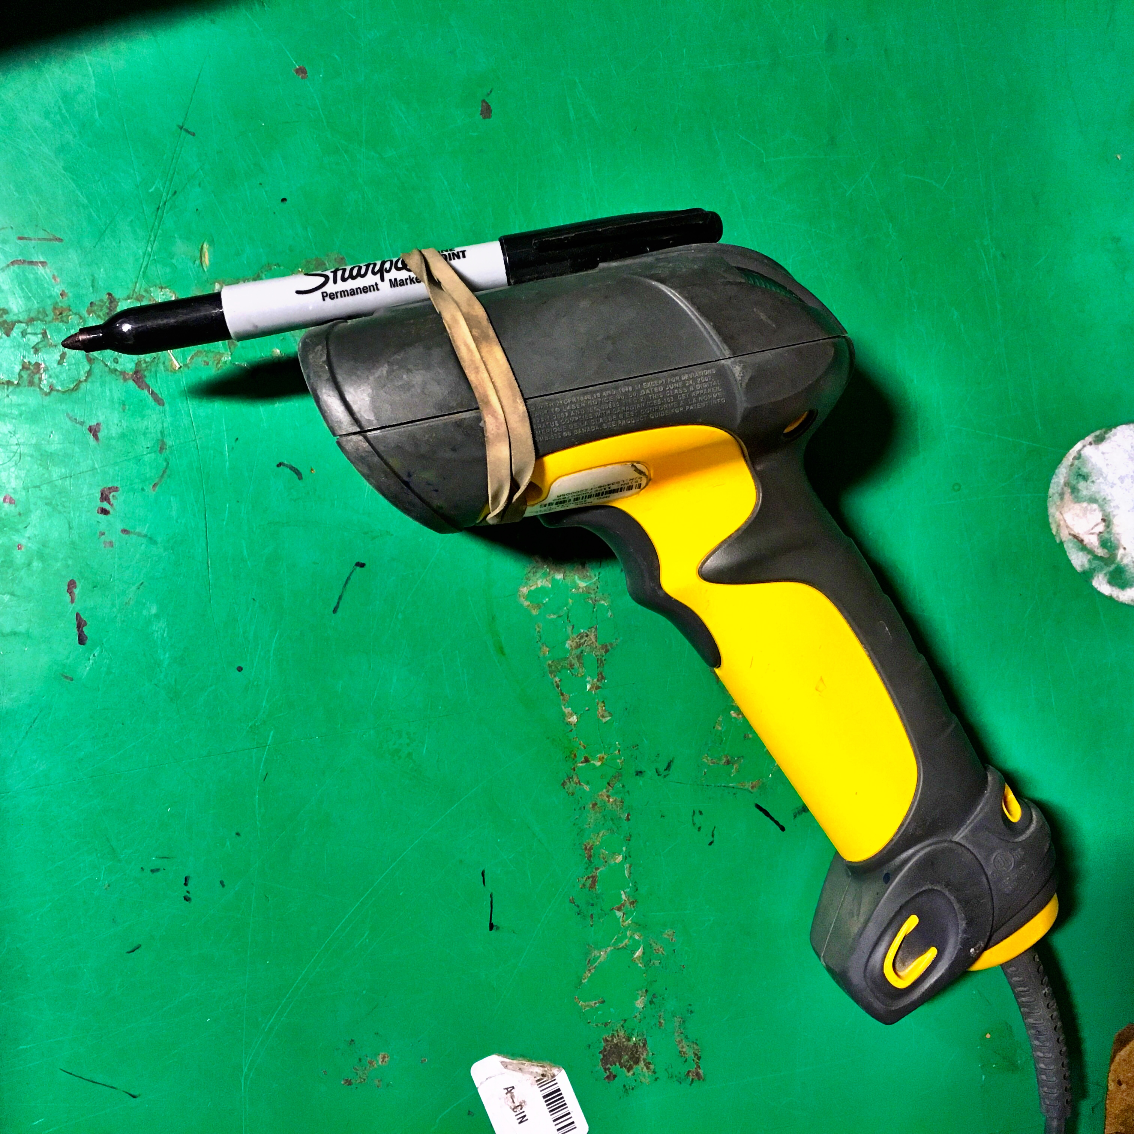
K.T.S.
Target Cond
The devil is in the details!
It’s easy to get started… and keep going
It encourages us to try new things since It’s ok to make mistakes!
Improvement and coaching kata:
Focus on doing and trying things out
Use experimentation as the way to make progress
Result in constant learning
Require taking small steps
Provide a regular pattern of activities for improvement
Have detailed tools for each step
Use a visual summary of progress and results
Go see and go do… don’t stay at the desk!
Sitting at a desk photo then photo of ppl trying new things
Develops knowledge and makes work interesting
Develops our neural pathways for continuous improvement
It’s easier and reduces risk

Slide 15
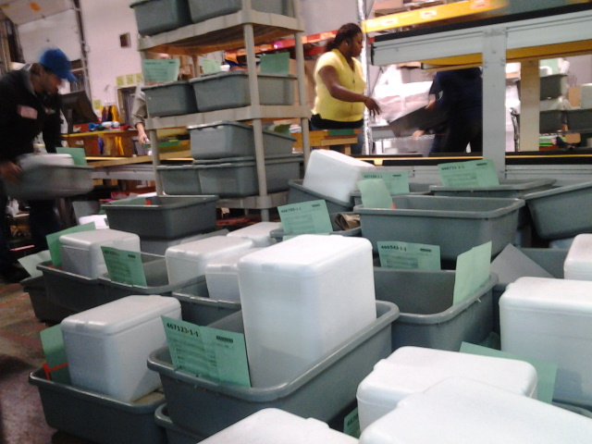
2013: 36.00%
2014: 03.44%
2015: 03.04%
What’s the next target condition?
Propose a change and it’s effect
What’s the current condition?
What’s the direction?
Run an experiment
Get involved
VIRTUOUS CIRCLE OF LEARNING
VIRTUOUS CIRCLE OF MOTIVATION
Receive quick feedback
What obstacles are in the way?
Track progress
What’s the
next experiment?
What did we learn?
Achieve
target condition
Learn
(This will be visual)
Dec 2013 OOM(out of market) 36%: entire ship day in mistakes and ran out of totes for orders
Challenge was 4% OOM for the month of December 2014
Result for Dec 2014 was 3.44% OOM for month of Dec.
Target condition was 3% outta markets daily
Result 4.1% OOM's daily in December 2014

Slide 16
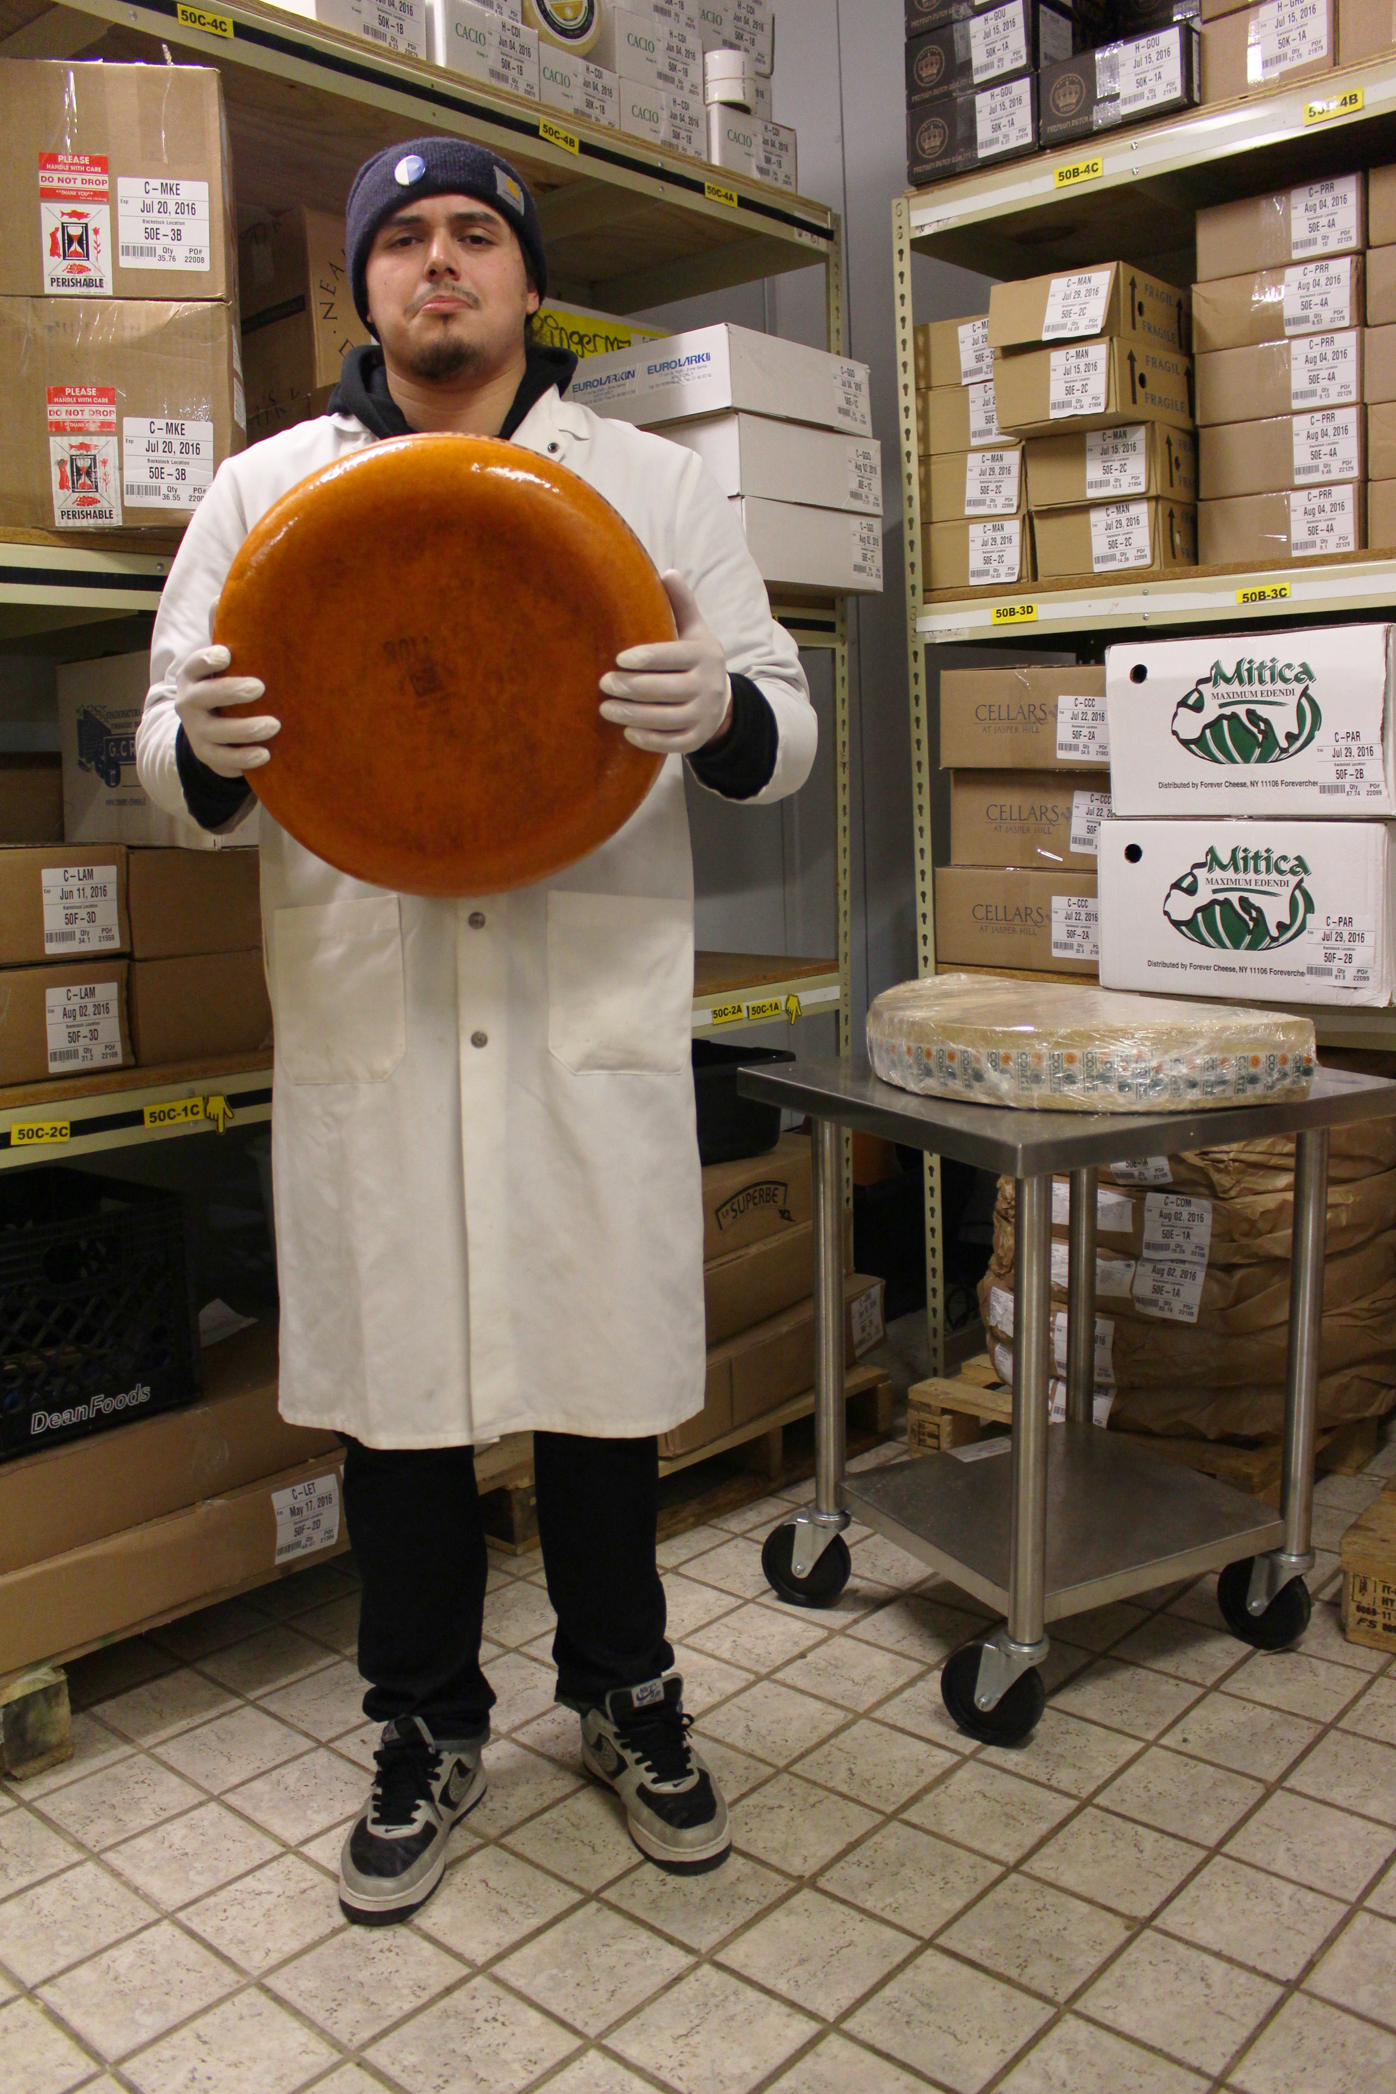
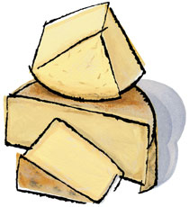
Cheese waste record high of 339.15 lbs.
Resulting in lost sales of $3,452.47.
Since starting cheese kata, we’ve reduced gouda waste by 65%... and sustained it.

Slide 17
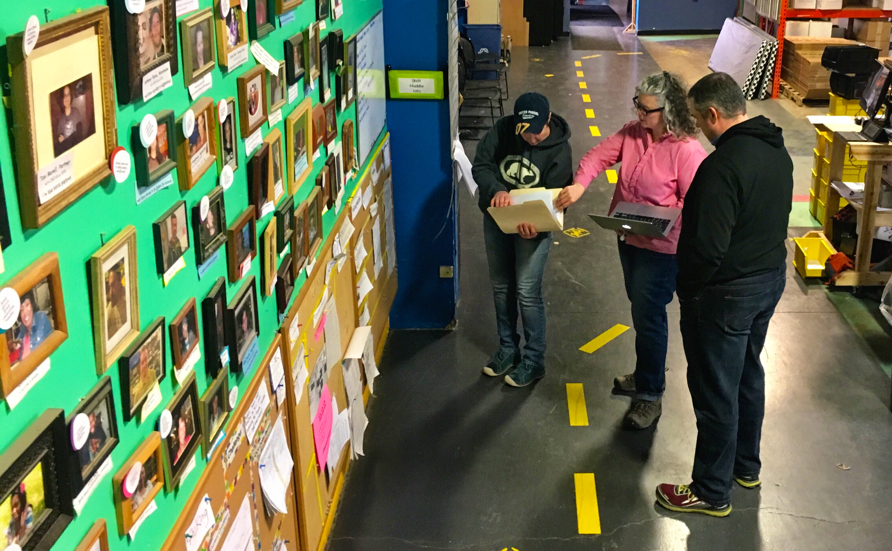
There are many, but the focus now is on two
Challenge #1:
Continue to
expand kata activities
Develop coaches and coaches in training
Continue work with Dr. Liker’s engineering students at U of M
8 active kata
These are now the coaches

Slide 18
Challenge #2
Maintain momentum throughout the year
Hibernation mode? Change from involuntary to voluntary…
Before and after the peak nothing happens…

Slide 19
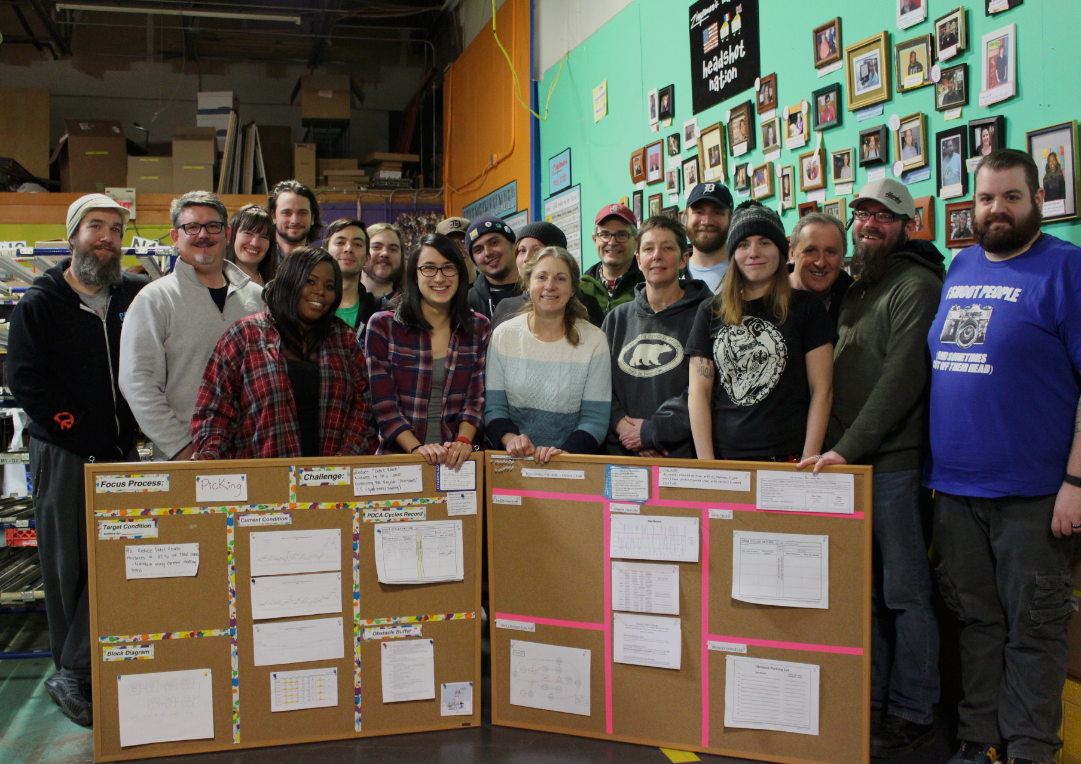
Kata works!
Develops People + Develops Knowledge
Develops people
Develops knowledge
Like most other continuous improvement methodologies
Perhaps more importantly…
Ignites people to try things out
Keeps crew continuously improving
Gives crew ownership

Slide 20
Questions?
Email us at:
Lottakata@zingermans.com
Hungry?
Zingermans.com
TK creates culture
Involvement did a 180 at Zingerman’s Mail Order
We’re continue to expand new Kata activities into departments
Starting to help teach the TK to the rest of the ZCOB

