Slide 1
Business Engagement in Lean: Through participant centered learning
MLC 7th Annual Conference
Break out session

Slide 2
Bem-vindo!
Bienvenido!
Welcome!
Bienvenue!
Willkommen!
Benvenuto!
Notes:
Say: Before you get too comfortable in your seat, we are going to practice getting comfortable with change. Say goodbye to your table mates and get ready to move to a new table.
Do: Have the participants count off based on the number of tables in the room. Assign a number for each table and ask them to move to their new table. Invite the participants to complete a name tent. Optional to have them include the number of years they’ve been exposed to BPI, Lean Six Sigma, or Process Improvement on the back side of their name tent.

Slide 3
Introduction & Expectations
Class Discussion
Class Rules & Wall Walk
Notes:
Do: Perform a wall walk around the room to show the rules, agenda, parking lot, expectations, scope/objectives, and plus/delta (to be performed at the end of day 1). Explain how sticky notes will be removed from the agenda as topics are covered each day and how the parking lot will hold questions from the class to be addressed at a later time that week.
Talking Points:
(Click) Start & end on time – we value your time and want you to ensure you don’t miss any training material. If you need to step out for a meeting, please notify your instructors (instructor note – a participant can only miss 1-2 topics and they must be made up during breaks or after class)
(Click) Limit use of phones & laptops – we ask you to be present in the class, if you need to answer an email or phone call, please do so during the break or step out
(Click) Keep an open mind – be open to new ideas and methodologies that may be different from how you’ve done things before
(Click) One conversation at a time – we don’t want you to miss any material and you may have a good question that others can benefit from hearing
(Click) Value all inputs – there are no bad ideas or questions
(Click) Stay positive
(Click) Have fun!

Slide 4
Introduction & Expectations
Learning Partner Discussion
Introductions & Expectations
Notes:
Say: Before we get started, we will do an activity to get to know each other.
Do: Have the entire class form a circle. Every other person turns to their right. Announce that they are now facing their “learning partner” to be used throughout the course. Instruct them to spend the next 5-10 minutes getting to know each other and be prepared to introduce their partner to the class. During the introduction include one thing they would like to take away from the session today
Suggestions for topics of discussion:
Your name
Your current role
Professional background
Exposure to Process Excellence, Lean Six Sigma or Quality Programs during the past
Expectations for this training
One fun fact about you
Do: Have each person introduce their learning partner. For larger sessions have the learning partners introduce each other to the table group and de breif on the expectations of the classmates.
Do: Have the participants return to their tables. Debrief on the activity

Slide 5
Session Objectives
After this session you will be able to:
Understand how participant centered learning can support “Achieving the True North: Lead- Engage-Accelerate-Now”
Understand the difference between participant centered learning and traditional training styles.
Practice participant centered learning techniques.
Notes:
Do: Show PowerPoint Slide and introduce the course objectives, tying them back to the class expectations captured on the wall.
Talking Points: When you leave this class, you should be able to:
Understand the benefits of participant centered learning
Understand how to apply simulations and different activity types to your lean training
Practice participant centered learning.
Do: Ask for a volunteer from each table (who has traveled the furthest to attend the course) to come to the front and get participant guides for their table. Explain to the class that they will be using this guide throughout the session and flip through the sections with them briefly (including the Reflection section, Simulation and Appendix).
Say: You will notice that I have given those in this class the instructor guide to empahsize the amount of standardization that can be achieved with your practitioners. With all Lean engagement it’s important that you and your team (if you have one) are sending the same general message.

Slide 6
Background
Table Discussion
Past training: What has worked and what hasn’t?
Notes:
Do: have the tables think about a time when they were both a participant in a recent training and when they have given a training on continuous improvement on lean, what worked well and what didn’t work so well?

Slide 7
Background
Class Discussion
What is participant centered learning?
Notes:
Talking Points:
Participant centered learning is a “Pull” style of learning where as much as possible the class participants pull from the instructor what they need. They learn by watching, doing, discussing.
There is an emphasis on application to the participants real work life so it makes the information more meaningful to them, which means they will retain more.
It keeps the participants engaged due to the variety and mixture of activity, discussions, etc. so they can keep focused on the key points

Slide 8
Participant Centered Learning
Teachback
Participant centered learning techniques
Notes:
Say: In your book, you will find the different types of participant learning activities: I will divide you into teams to complete a teachback exercise. You will each be assigned a group of activities and will create a visual to teach the concept back to your teammates. Feel free to use flip chart, your participant guide, markers, sticky notes, and be as creative as you can.
Do: Split the class into groups of 3+ people. Assign each person a group of categories (no one can have the same, and everyone needs to select a category). Give them 10 minutes to complete their teach-back, and 10 minutes for all to teach the material back to their team.

Slide 9
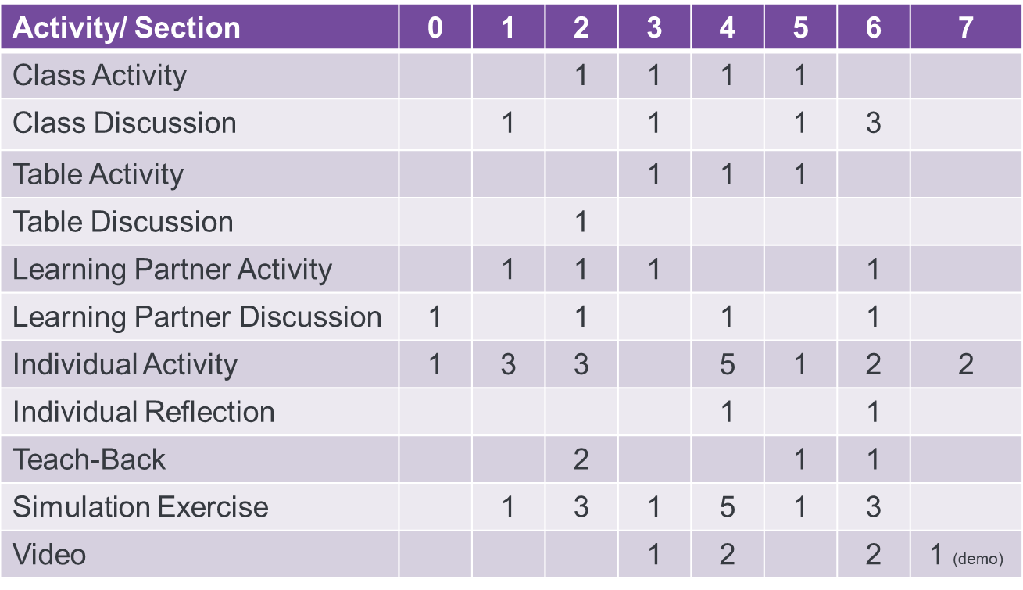
Participant Centered Learning – Debrief
How is this different then the traditional training approach?
How can PowerPoint help you with these techniques?
How much of training should be by telling, showing, and doing?
10% Tell / 20% Show / 70% Do
Notes:
Talking points:
This is a sample spread of training activities, discussions etc. that was used in a 3 day course. It’s important to have a good mix of the “Do’s” for different personality types in your training.
This took a lot more preparation and self discipline on the training side. Often you will find yourself adding more of one type of activity because that is what YOU prefer, but remember in Lean we always ask who is the customer, and in this class your customers will all value different learning types.
It’s important to focus on not what you want to teach the class, but more importantly what they need to take away.

Slide 10
Simulation Round 1
01
Simulation Exercise
Learning by doing
Notes:
Do: Run the simulation round 1 with several groups
Debrief with P & L and pain points

Slide 11
Toolbox and Concepts
Individual Reflection
What’s in your Lean toolbox?
Notes:
Explain the purpose of the simulation and showing a broken process.
-examples of lean tools you could teach, flow principles, customer value, takt time, by self discovery.

Slide 12
Toolbox and Concepts – Debrief
DMAIC
Flow
Value Stream Mapping
5s
Customer Value
Waste
Standard Work
Pull
Team Dynamics
Data Collection
Gemba Walks
Notes:
Explain the purpose of the simulation and showing a broken process.
-examples of lean tools you could teach, flow principles, customer value, takt time, by self discovery.

Slide 13
Simulation Round 2
01
Simulation Exercise
Learning by doing
Notes:
Do: Run the simulation round 1 with several groups
Debrief with P & L and pain points

Slide 14
Session Objectives
After this session you will be able to:
Understand how participant centered learning can support “Achieving the True North: Lead- Engage-Accelerate-Now”.
Understand the difference between participant centered learning and traditional training styles.
Practice participant centered learning techniques.
Notes:
Do: Show PowerPoint Slide and introduce the course objectives, tying them back to the class expectations captured on the wall.
Talking Points: When you leave this class, you should be able to:
Understand the benefits of participant centered learning
Understand how to apply simulations and different activity types to your lean training
Practice participant centered learning.
Do: Ask for a volunteer from each table (who has traveled the furthest to attend the course) to come to the front and get participant guides for their table. Explain to the class that they will be using this guide throughout the session and flip through the sections with them briefly (including the Reflection section, Simulation and Appendix).
Say: You will notice that I have given those in this class the instructor guide to empahsize the amount of standardization that can be achieved with your practitioners. With all Lean engagement it’s important that you and your team (if you have one) are sending the same general message.

Slide 15
Session Closing
01
Class Closure Activity
Ball Toss
Notes:
Do: Complete a closure activity. Have the class stand in a circle around the classroom (or outside if available). Start with a ball in the center of the circle and share one take away you had. Instruct the class to pass the ball to a classmate and share a key takeaway (a tool, a tip/trick, etc.) that they learned in the course. Pass the ball to a student and continue the exercise until everyone has spoken.
Note: For larger classes do this at each individual table. Can also be a round table discussion.

