Slide 1
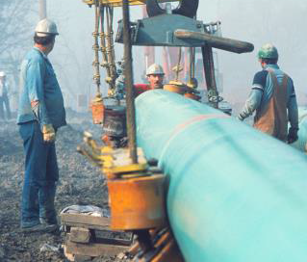
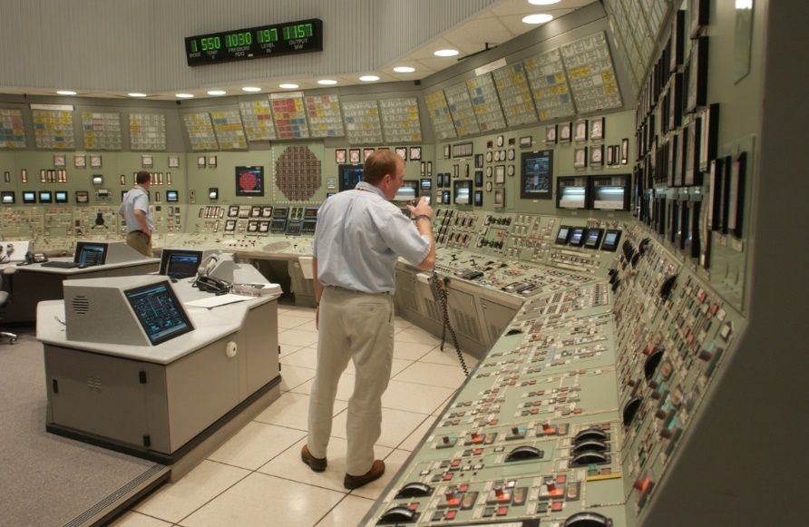
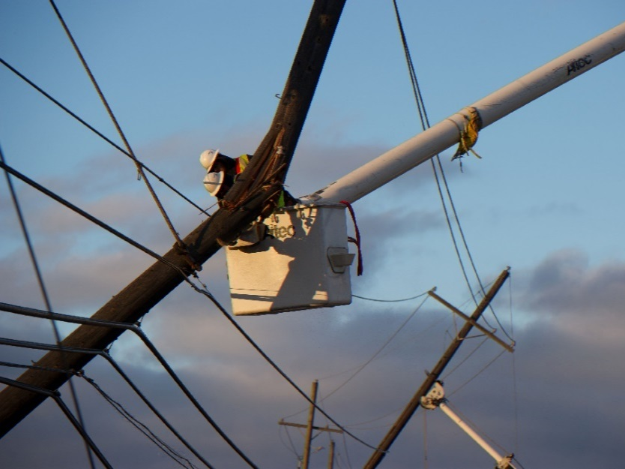
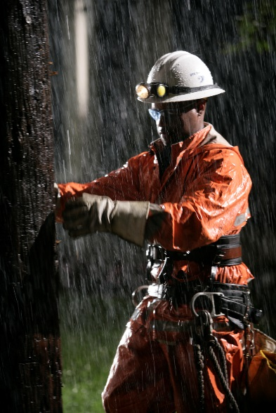
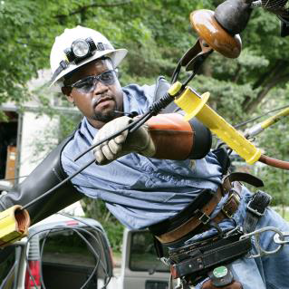
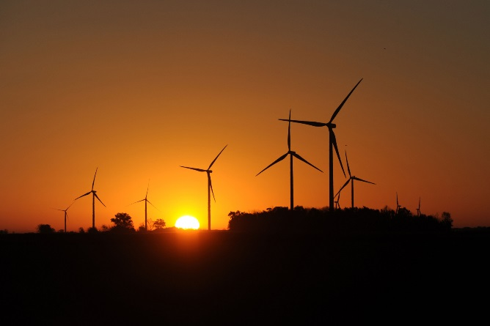
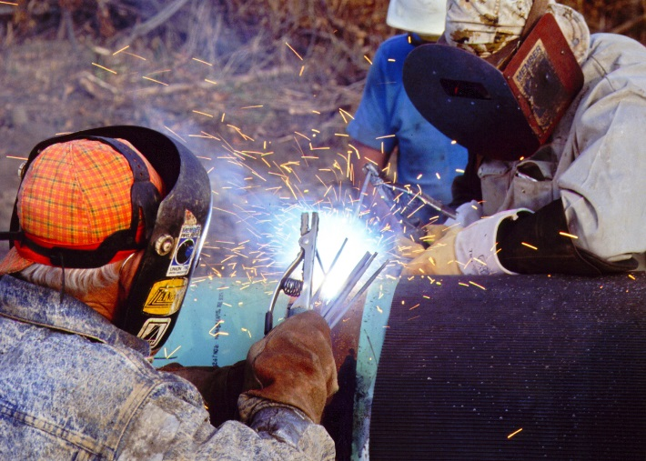
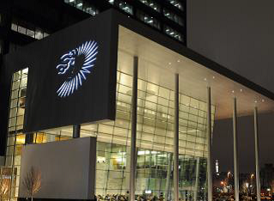
Continuous Improvement Journey
Robert Richard – Senior VP Major Enterprise Projects
August 3rd, 2017
1

Slide 2
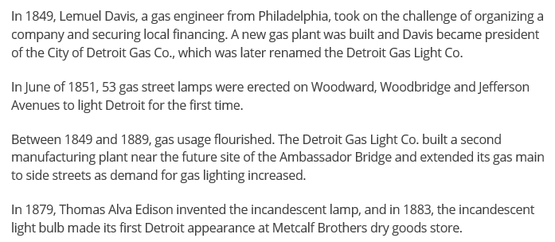
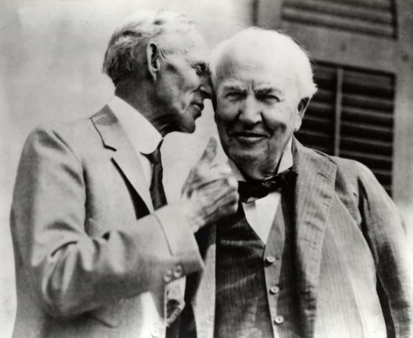
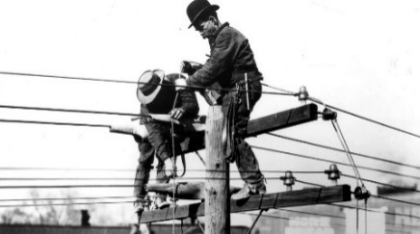
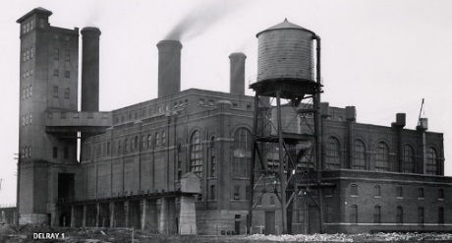
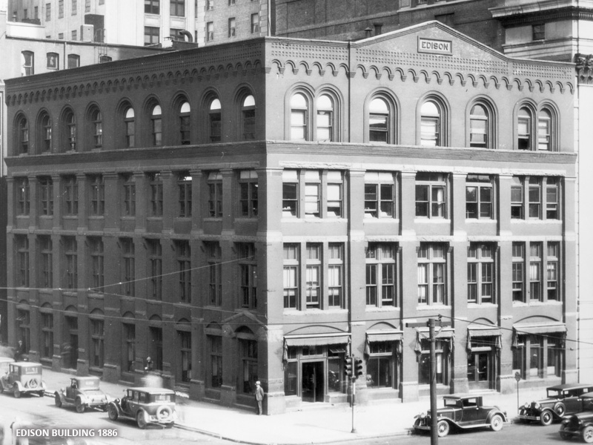
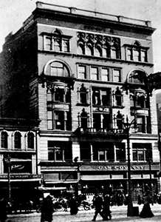
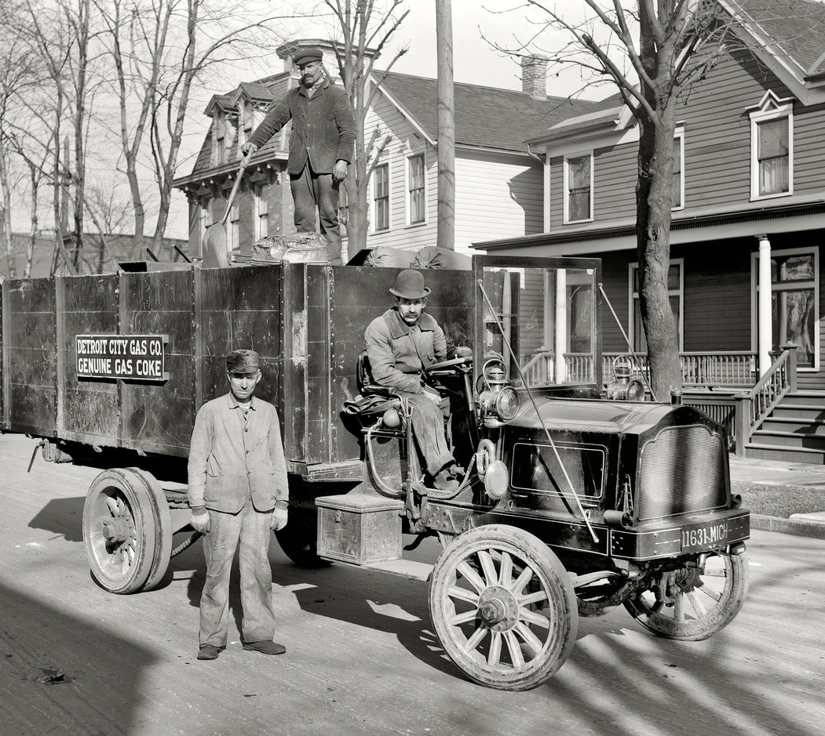
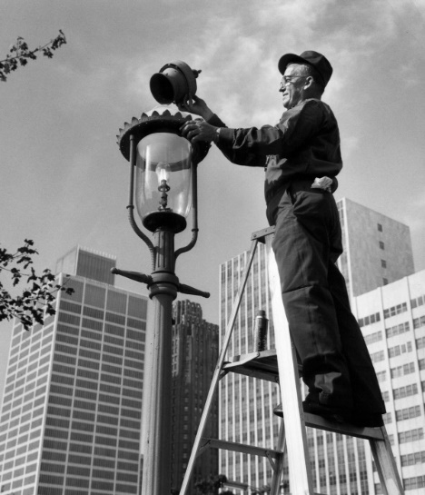
OUR HERITAGE
BUILT ON A FOUNDATION OF PUTTING MANUFACTURING FIRST.
OUR COMPANY HERITAGE
2
Notes:
DTE has a long and proud history that includes visionaries like Thomas Edison and Henry Ford, who was an early engineer who went on to design some car…I think it was Model A or something.
Explain that we have been on the NYSE for 100 years, a proud accomplishment where only a small number of companies remain. With this long history, comes an engrained culture that hasn’t always been easy to move nor has always seen the need to continuously improve.

Slide 3
WHO WE ARE TODAY
3
Notes:
DTE Energy’s aspiration is to be the best operated utility in North America and a force for growth and prosperity in the communities where we live and serve. We are well underway to achieving that aspiration as noted above….
Earnings are record high
Volunteerism within the DNA of our employees
Focused on renewable energy
Located in over 15 states
Customer focused leader
Working to continuously improve our daily work

Slide 4
DTE ELECTRIC
Notes:
Intro to our largest Business Unit, DTE Electric

Slide 5
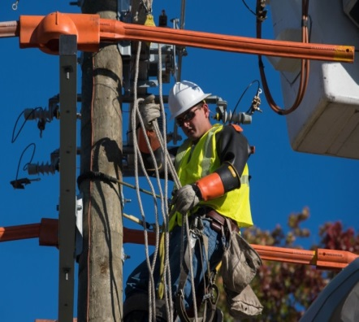
GENERATION AND DISTRIBUTION INFRASTRUCTURE UPGRADES
12th largest US electric utility, generating over 11,000 MW, with 2.2 million customers
New generation
Retire 60% of coal fleet; replacing with clean energy
Distribution infrastructure
Move electric reliability to 1st quartile
Maintenance and other projects
Productivity and efficiency improvements to reduce costs
Notes:
DTE Electric is dedicated to the improvement of their system reliability by efficiently prioritizing infrastructure investments to increase customer satisfaction. The idea is to increase customer affordability through investment planning and cost controls.
$1 billion capital increase every 4 years until 2026.
This is how we are going to get there…..
Reduce coal electric generation and utilize combine cycle natural gas assets
Our distribution system to focus on Asset health (reduction of corrective maintenance), Tree trimming, Outages (reduce outages and complaints)
How do we get there? As you see in blue we are going to leverage CI tools and methodologies to optimize processes geared at enhancing productivity

Slide 6
REPLACING COAL FIRED GENERATION
12,200 square kilometers service territory centered around Detroit
Notes:
You may have seen our recent announcement to reduce our carbon emissions by 80 by 2050. To achieve this goal, we’re transforming our generation fleet and retiring several of our coal plants, with cleaner burning gas combined cycle units as well as wind and solar generation.

Slide 7
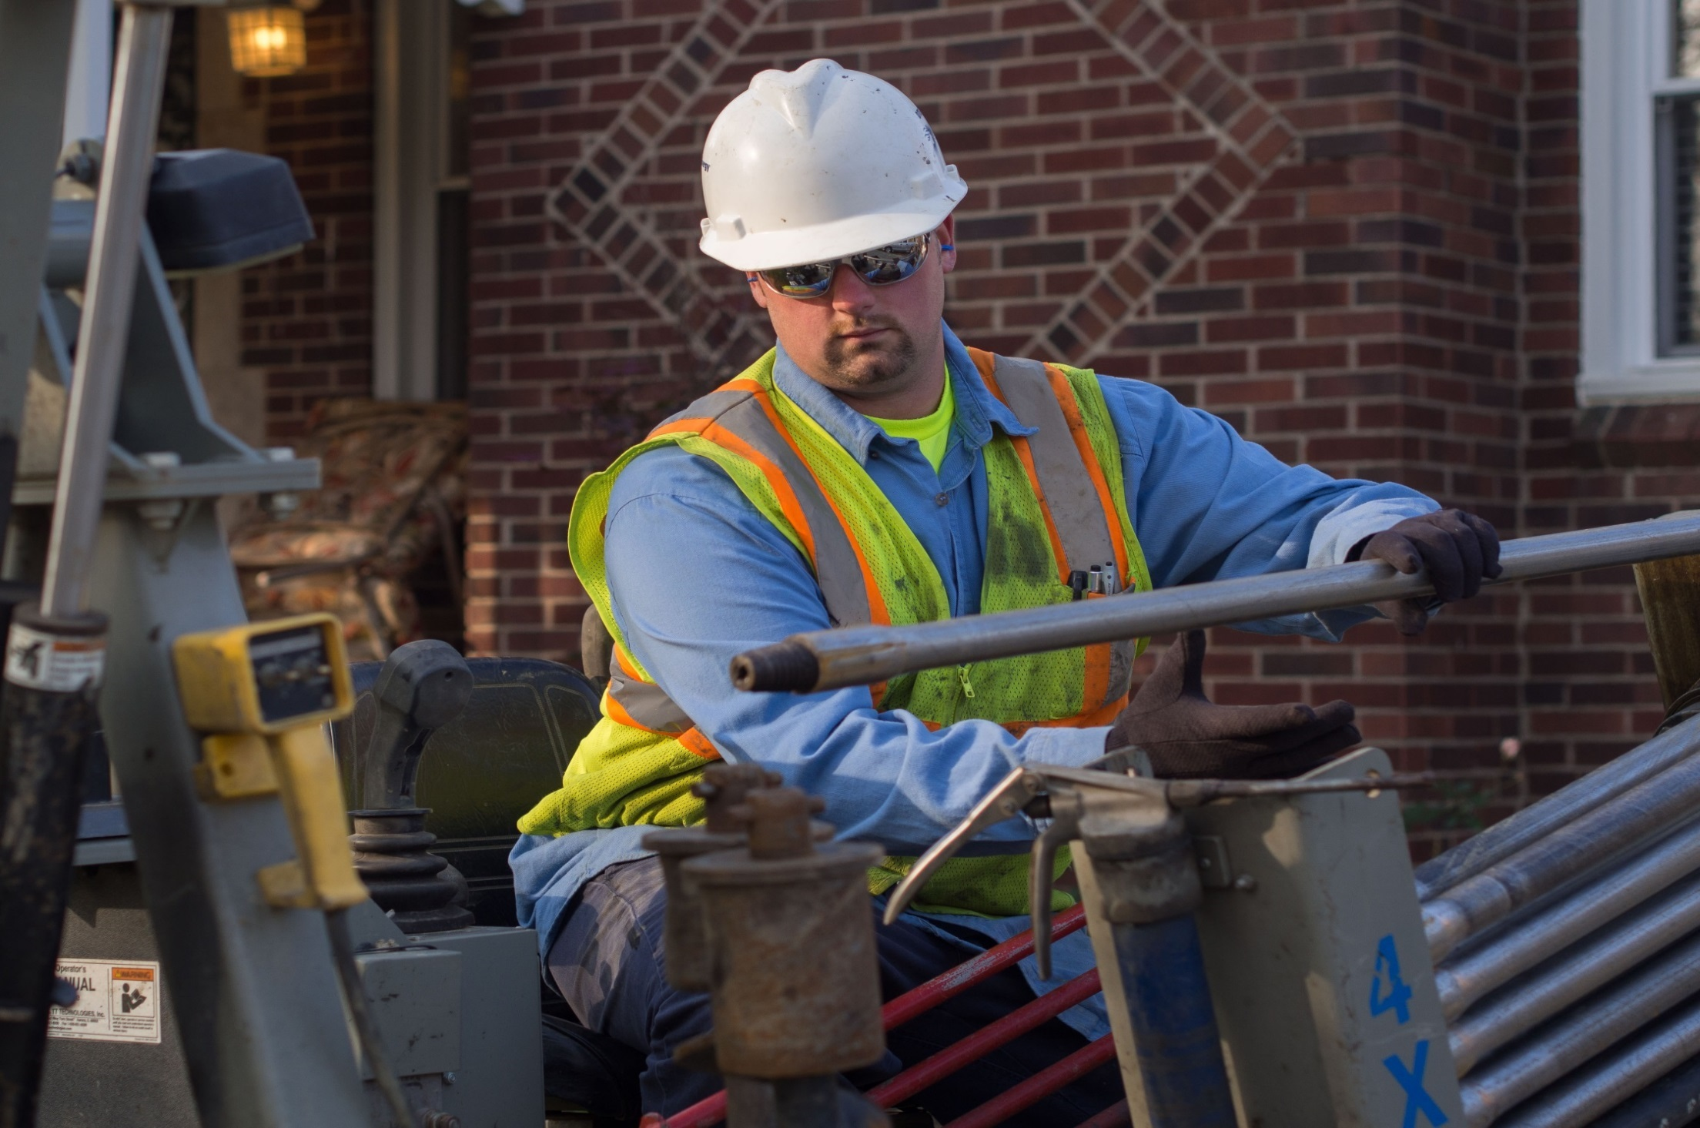
DTE GAS
Notes:
Our second largest Business unit is DTE Gas

Slide 8
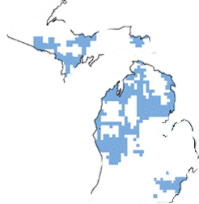
IMPROVED SERVICE TO CUSTOMERS OVER THE NEXT 10 YEARS
10th largest US natural gas utility with 1.2 million customers
Base infrastructure
Transmission, compression, distribution, storage
Infrastructure renewal
Strengthen gas infrastructure by reducing planned main replacement cycle by half
NEXUS related compression
Notes:
Turning now to our Gas business,
…the renewal of aging infrastructure is the dominant theme here as well.
You can see that our gas utility is entering a period of significant capital investment to better serve our customers and renew our aging infrastructure.
Over the next 5 years we expect to invest $1.8 billion in our gas utility, which is about a 30% increase over the prior 5 years
This increased investment is being driven by a few things:
.We will be strengthening and renewing our gas infrastructure by accelerating the replacement of our aging cast-iron and unprotected steel pipe shown here in yellow
We will also be adding the compression needed to move gas delivered from the NEXUS pipeline shown in green.

Slide 9
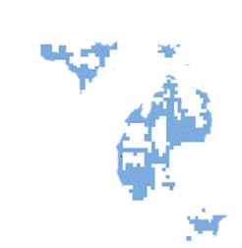
REPLACING AGING INFRASTRUCTURE
23,500 square kilometers service territory - ~$1.4 billion in revenue, $4.3 billion in assets
Notes:
As mentioned in the prior slide, our gas organization is focused on 3 main items:
Main replacement- Retiring and/or abandoning of poor/unprotected main and replacing with mainly highly effective plastic pipe
Pipeline integrity- Enhancing our gas infrastructure to control the flow of gas
Meter Move Out- Utilizing automated meter technology to reduce manual processes

Slide 10
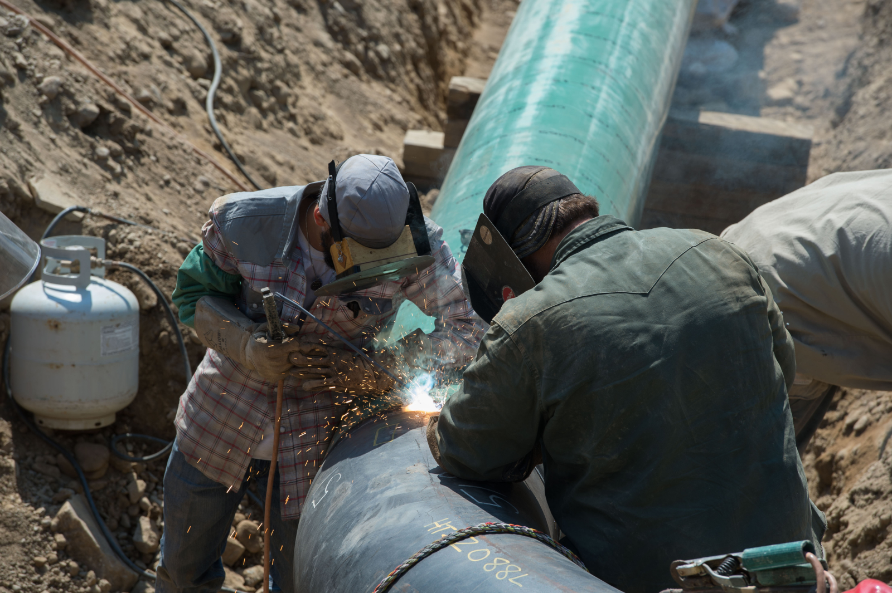
DTE GAS STORAGE AND PIPELINES (GSP)
Notes:
One of more significant non-regulated business is what we call GSP, Gas Storage and Pipelines

Slide 11
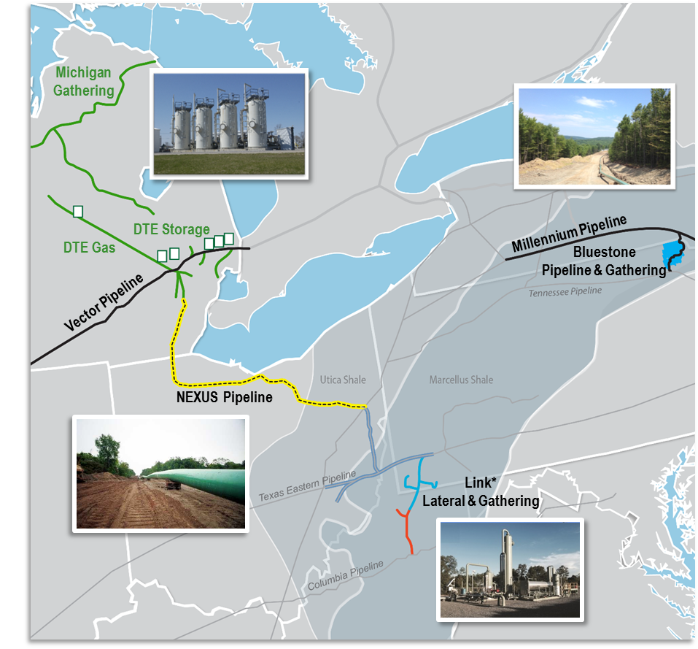
GSP ASSET PORTFOLIO
6th largest owner / operator of gas storage in North America
Growth Platforms
Purposefully located in the best geology in North America
Bluestone Pipeline & Gathering
Millennium Pipeline
NEXUS Pipeline
Link* Lateral & Gathering
Michigan Assets
Strategically located between Chicago and Dawn trading hubs
Vector Pipeline
Storage
Gathering
Notes:
The GSP portfolio has rapidly expanded over the past few years with interest in major pipelines like Millennium, Vector and Nexus that transport gas from wells throughout the Northeast. Also with the rise in Gas availability throughout the Marcellus and Utica Shale areas, DTE recently made a large acquisition that will allow us to expand out capability further into the South.

Slide 12
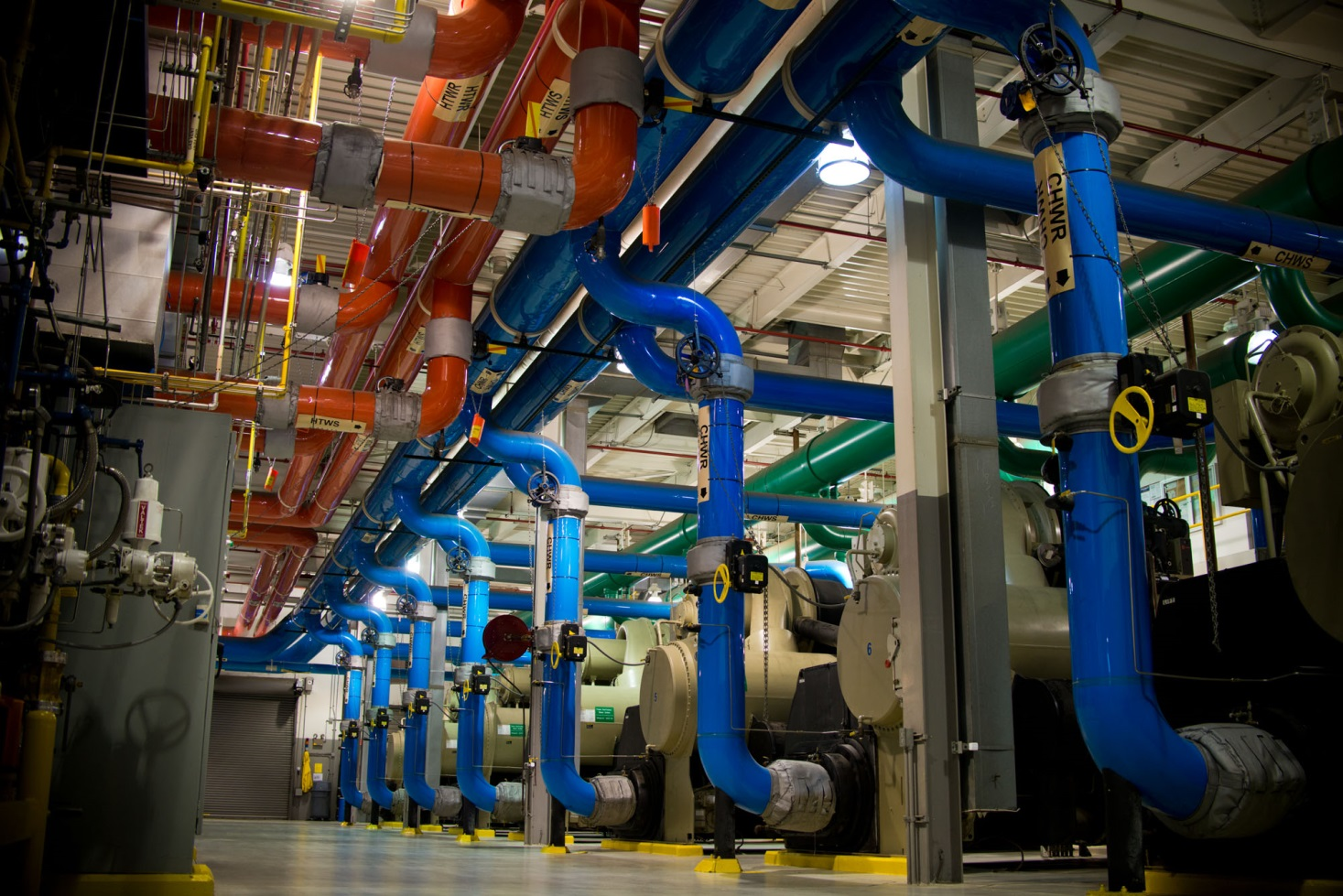
POWER & INDUSTRIAL PROJECTS (P&I)
Notes:
Another major non-regulated business is Power & Industrial

Slide 13
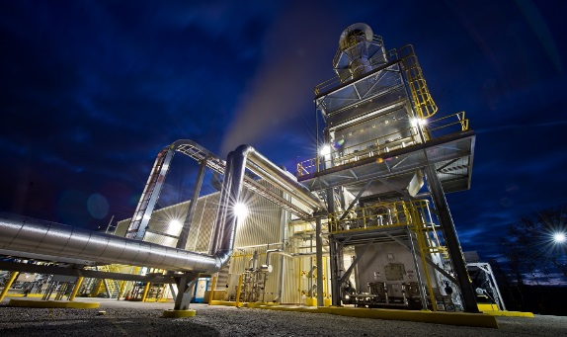
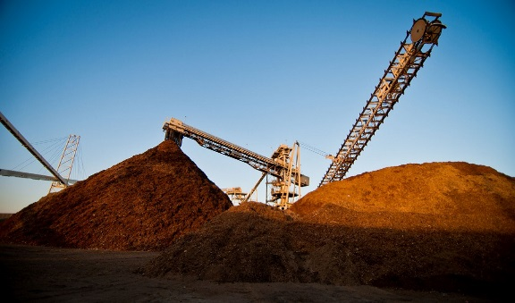
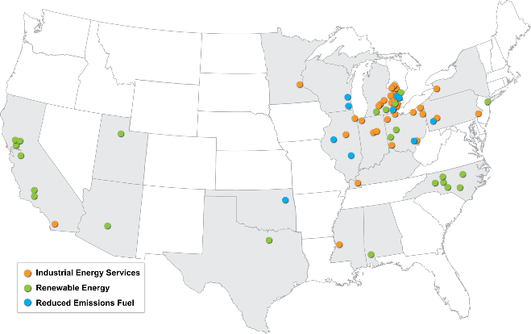
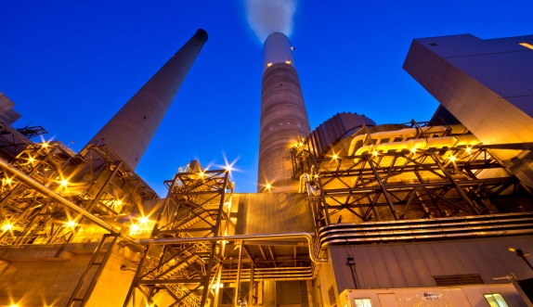
P&I OPERATES THREE DISTINCT BUSINESS LINES
DTE operates 58 locations within 18+ states across the US
On-site utility services for industrial and commercial customers
Coke and pulverized coal for steel customers
Industrial Energy Services
Renewable Energy
Wood-fired power plants
Convert landfill gas to energy
Projects to reduce emissions from coal-fired plants
Utility contracted
Reduced Emissions Fuel (REF)
Notes:
This business reaches way beyond our Michigan borders to offer Energy Management services to a wide range of commercial sites (give some examples). P & I also operates several BioMass plants in the West that burn renewable fuel such as Fruit Pits and various wood materials. Additionally, we also operate facilities at landfills were the methane gas is captured and used and renewable fuel.

Slide 14
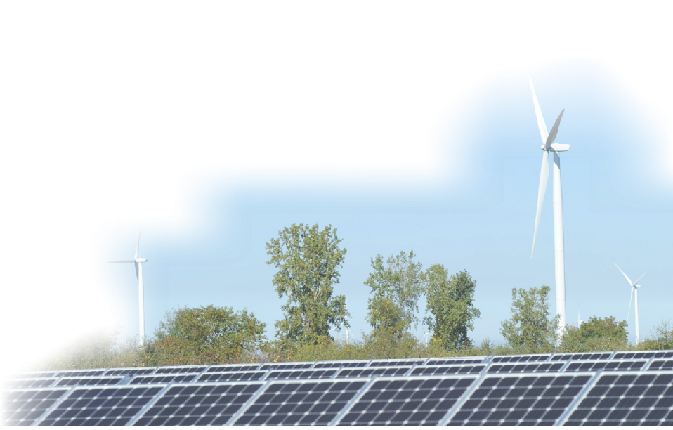
DTE INVESTMENTS WILL DRIVE INCREASED AFFORDABILITY
Design detailed roadmap for the transformation of our business that ties near-term work to long-term success providing 30% - 40% cost reductions over the next decade
Apply continuous improvement
Use innovative technology to fundamentally improve customer experiences and achieve productivity gains
Make infrastructure investments in new generation and reliability while maintaining customer affordability
Notes:
Our focused efforts discussed previously are providing 30-40% cost reductions by doing the following:
Utilizing continuous improvement tools and methodologies to drive out waste in our processes
Leveraging new innovative tools to achieve productivity gains
Continued efforts in new generation and reliability
This is all being performed to drive positive customer experiences

Slide 15
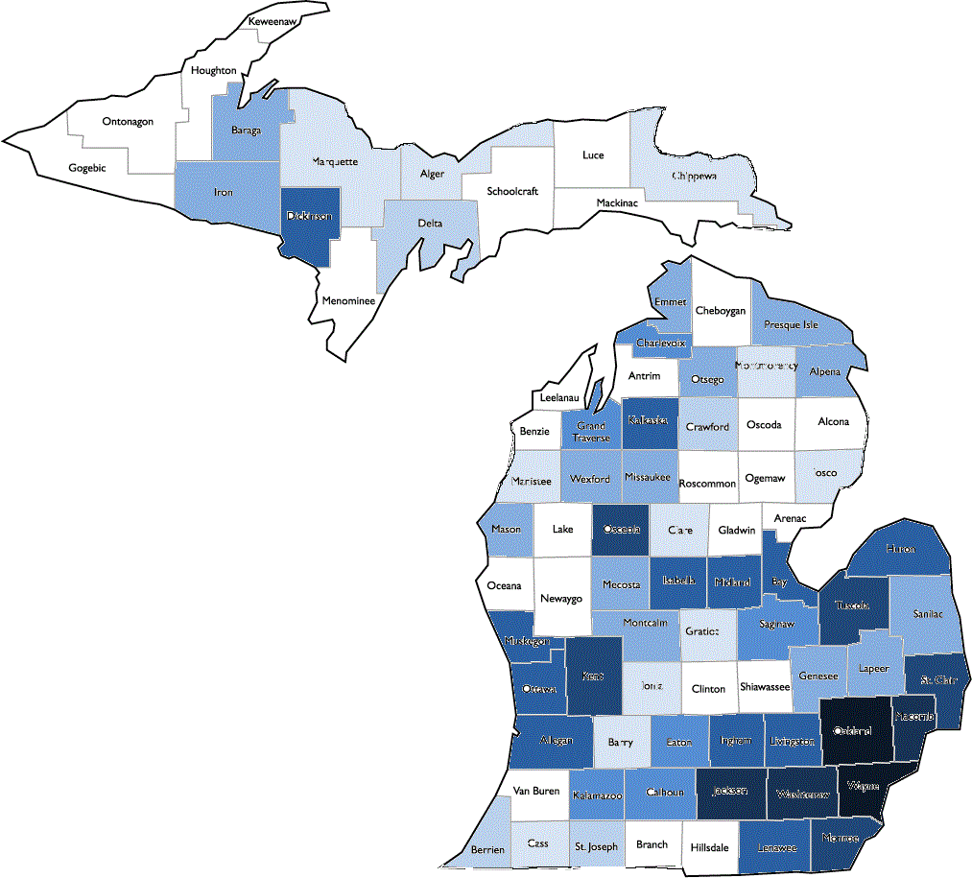
SIGNIFICANT INVESTMENTS WITH MICHIGAN-BASED SUPPLIERS
Michigan-Based Supplier Spend
(Millions)
Our Michigan spend helped create and support 13,000 jobs
$5 billion committed over the next 5 years
Notes:
DTE Energy is one of the original seven leaders of this initiative. Administered through an alliance with the Michigan Economic Development Corporation and Business Leaders for Michigan. Pure Michigan Business Connect is a multi- billion dollar public-private initiative connecting buyers to suppliers of Michigan goods and services. Through the business-to-business network, Michigan companies are encourage to increase their procurement within the state.
DTE has implemented key strategies to continue to grow our MI spend, including:
A requirement of at least two Michigan suppliers on all new contracts available to bid
An establishment of internal Michigan spend targets to drive ownership
A commitment to work existing and new suppliers to physically locate in Michigan
A commitment to negotiate with existing suppliers to use Tier 2 Michigan suppliers and Michigan labor
In addition to supporting local suppliers, we particularly recognize the importance of cultivating business relationships with Detroit based and certified diversity suppliers.

Slide 16
DTE ENERGY’S OPERATING SYSTEM
Notes:
Use this slide to Segway from WHO we are, to HOW we plan to accomplish our goals and affordability for our customers. This slide along with the other is the beginning of the CI discussion.

Slide 17
BEST OPERATED AND FORCE FOR GROWTH
Notes:
As you see our aspiration….. is an interconnection of best operated and force for growth and prosperity. How do we effectively do this…. Continuous Improvement

Slide 18
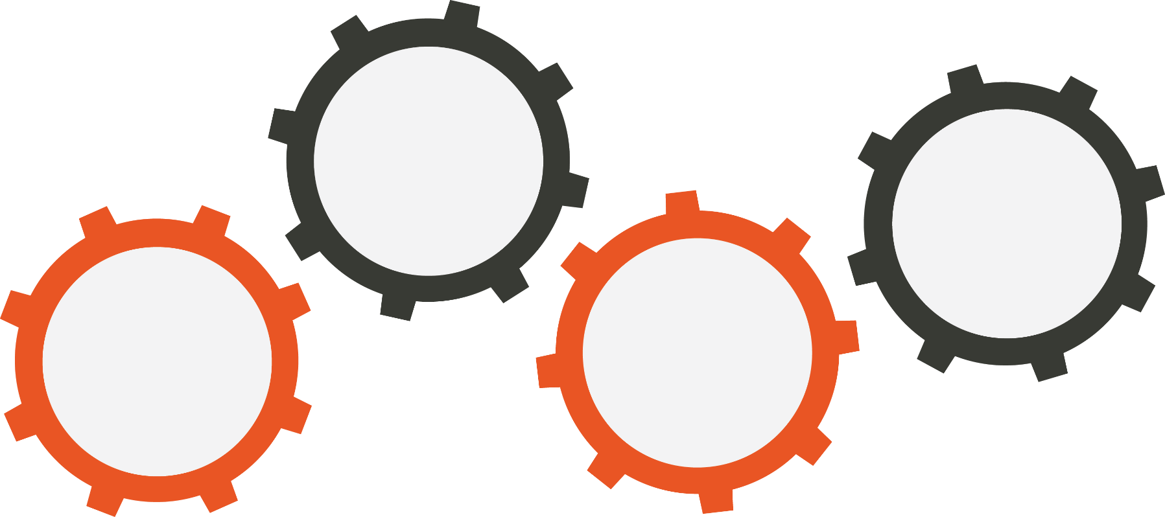
THE EARLY DAYS OF CONTINUOUS IMPROVEMENT
“Under Michigan's Electric Customer Choice Program, the generation and supply of power is now open to competitive suppliers”
- Michigan Public Service Commission
Merger of Michcon & Detroit Edison drives further need for cost synergies
Fear of Load Loss
Kick-Starts CI
Demo Projects
2000
Six
Sigma
2004
Operating
System
Framework
2002
Kaizen
1998
Project focus
to “prove” the
value of CI
Executive with GE experience initiates our use of BB CI Resources
18
Notes:
To give you an little history about our CI Journey, while our company has always be one of innovation, it was essentially kick-started in the last 90’s do the introduction of Choice and the fear of loss of electric load. This jump start and subsequent years followed a more typical approach to CI implementation where tools were added over the years and CI was a function of what a handful of skilled people did, but not everyone.

Slide 19
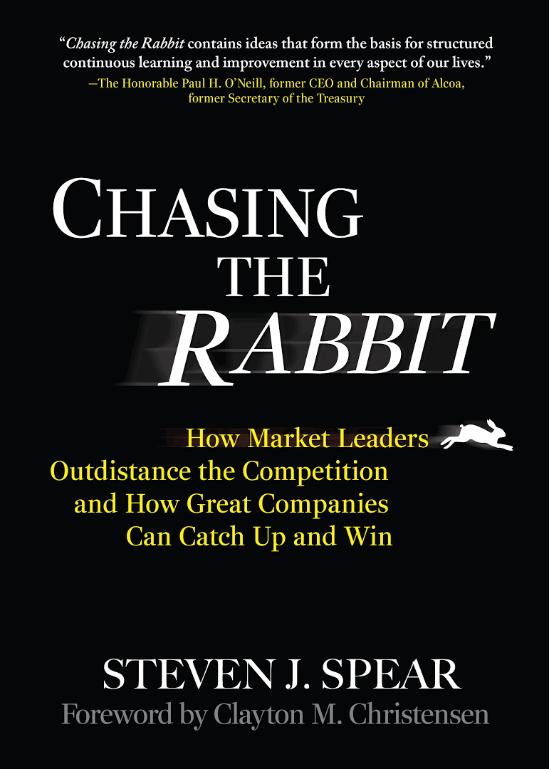
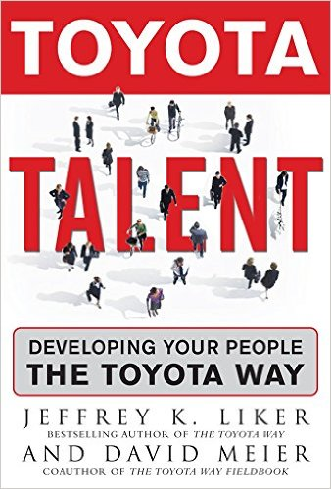
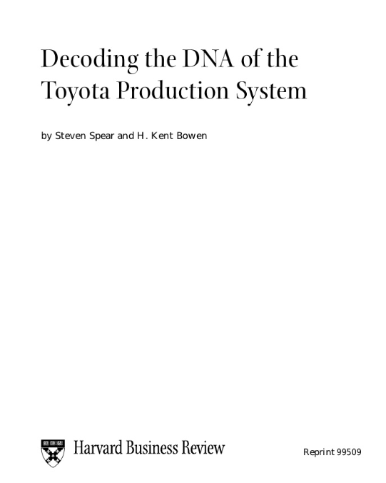
FOLLOWING TOYOTA’S APPROACH
It’s about developing peoples capabilities to SEE and SOLVE PROBLEMS
19
Notes:
While our approach was getting results, our leaders wanted more that just cost savings, we wanted a way to transform our culture where everyone could participate in seeing and solving problems. It was at this time that we took a step back and took a couple of pages from Toyota, who has also struggling to help it’s suppliers understand the Toyota Way. Steven Spear, an MIT researcher, published a book called Chasing the Rabbit (based on his landmark work and HBR artcle called Decoding the DNA of Toyota) that help to decode their approach.

Slide 20
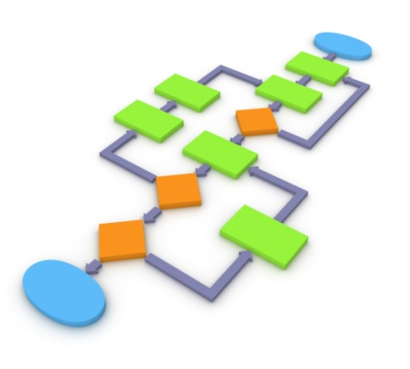
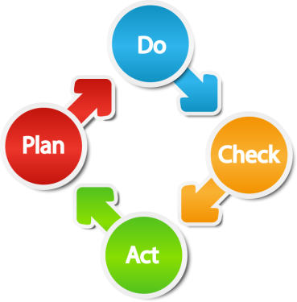
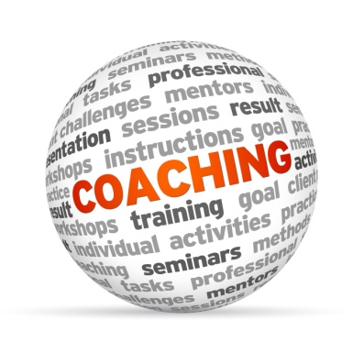
CONTINUOUS IMPROVEMENT AS A CAPABILITY
This approach started in 2008 with our Senior Leaders attending a 5 day workshop to understand the capabilities and the value of solving MANY SMALL PROBLEMS that can lead to LARGE IMPROVEMENTS.
Process Design
Design work to see problems
Problem Solving
Solve problems systematically
Knowledge Sharing
Share improvement across enterprise
Coaching
Expect leaders to teach and develop teams
20
Notes:
In his book, Spear reframed Toyota’s approach, to building employee capacities in four areas. Explain the four capabilities here and that the most important one is the last, where Leaders are the ones to develop these capabilities in there people.

Slide 21
HOW WE GOT RESULTS BECAME EVEN MORE IMPORANT
The creation of the CI MATURITY MODEL and ASSESSMENT came in as a way for leader to know if results were being achieved in a way consistent with our desired CI culture.
Develop a current state view of the entity
Develop plans to drive use
Monitor progress and provide coaching
Benefits:
Accountability
Bread crumbing leaders toward the culture we want
Consistent and unbiased viewpoint of enterprises progress
Challenges:
Numbers game
Feeling of gotcha
Transparency
21
Notes:
As we started to develop the skills and capabilities to see and solve problems, we also needed to use CI itself to know if we were getting better at the approach and where we may have spots that needed additional assistance, so what we call the CI Maturity Model, was created. This is our method of inspection to help leaders in the company understand their current state of “maturity” and then with assistance, help them to develop a plan to move their capabilities forward, focused on real business results.

Slide 22
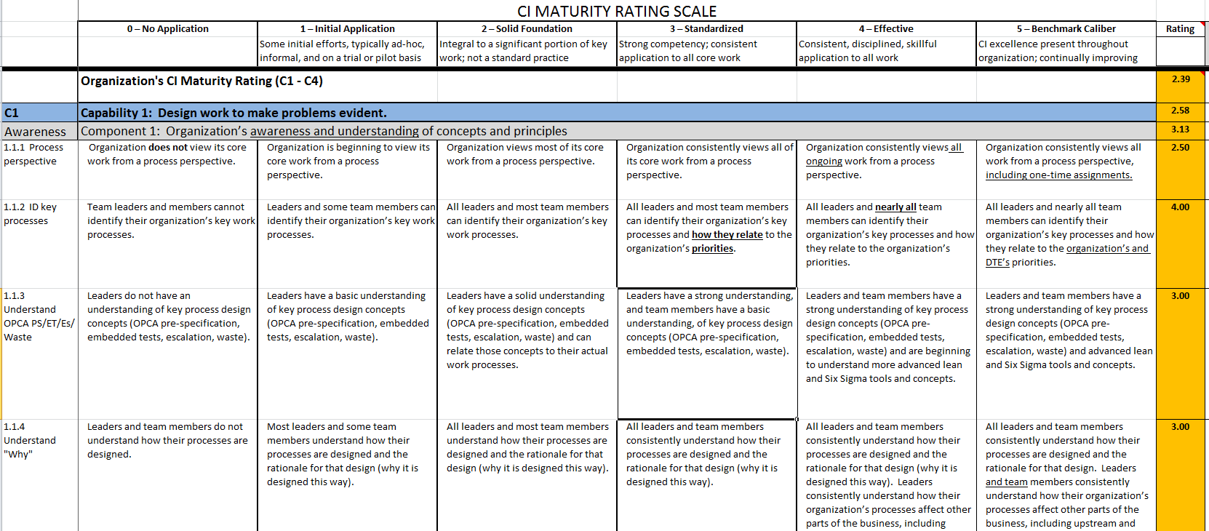
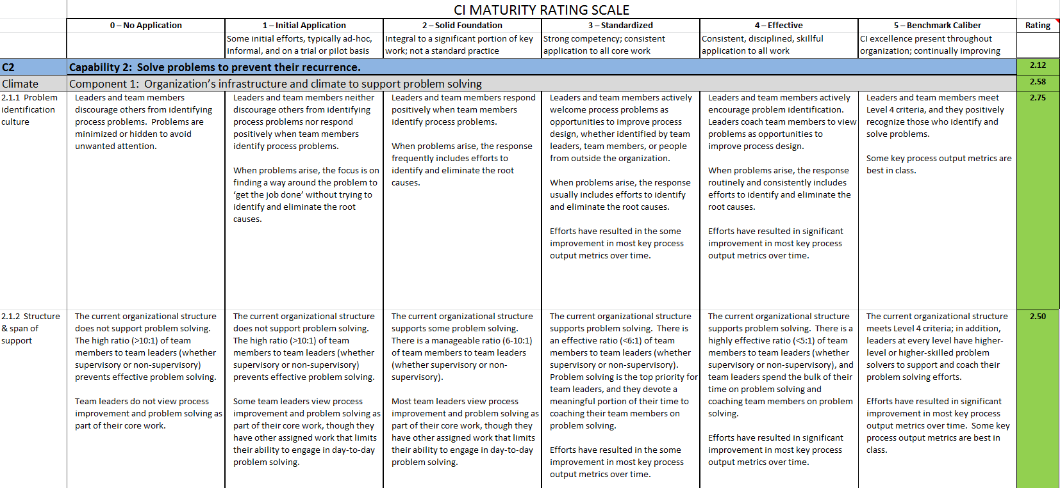
CIMM ASSESSMENT CREATED THE NEEDED TENSION
Rate 45 CI attributes on a 5-point scale
Self-assessed annually; rated by independent internal group every 2 years
Results used to drive CI development plans, which integrate into business priority plans
22
Notes:
While not all leaders appreciated the extra oversight and help, it did create the needed tension to help leaders understand that HOW we get results, is as important as the results themselves. To sustain the culture we wanted, we needed everyone focused on understanding waste, seeing problems and knowing how to go about solving them in a robust way. What surfaced early on was that our people didn’t have the training and knowledge to do this a robust way…...Segway to the next slide on Training.

Slide 23
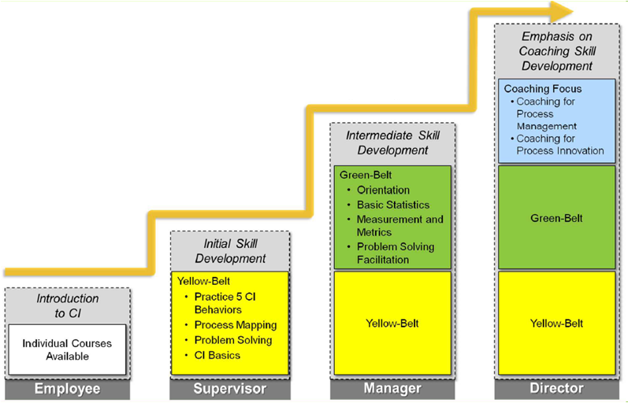
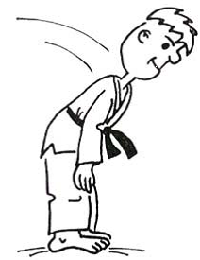
CI TRAINING AS A FOUNDATION
Training employees on our CI approach has evolved over the years based on gaps surfaced during our CI Maturity Assessments
Get up and fight
you cowardly
problems
OUR SHIFT FROM BB TO LEAN
LEVELS OF TRAINING BY POSITIONS
White Belt +
Individual Classes
23
Notes:
Our hierarchy of training looks like this. Over the years we’ve evolved our curriculum to ensure that our people have the right knowledge at the right level to help them apply CI to our most demanding processes and problems. While we use the titles of “Belts” most of our curriculum is DTE specific and targeted at leaders so that they then can develop their own people to see and solve problems.

Slide 24
CI BECOMES A VALUE
24
Notes:
With our CI foundational capability taking shape, our CEO, Gerry Anderson, witnessing what could be accomplished from our people when practicing CI in a meaningful way, he embedded this practice into our set of company values adding “We believe that improvement is our daily responsibility, …. and know those we serve have the right to expect that from us”. As time progressed, 8 other foundational capabilities were identified that many follow the same approach as our CI Capability, where a framework is established, training, support and assessment. I’ll take more about our Project Management capability shortly.

Slide 25
DELIBERATE PRACTICE - SHOP FLOOR MANAGEMENT
While CI events were happening on a regular basis, to really get good at anything takes “deliberate practice”, under the guidance of a coach.
DAILY CI
TEAM
HUDDLES
EPISODIC CI
SWARM
EVENTS
25
Notes:
Have any of you read the book by Malcom Gladwell called OUTLIERS? In his book he talks about what “deliberate practice” is. It’s not going to the golf range and hitting balls, its much more intentionally. It’s working a specific part of your swing, with a goal in mind, measurement and under the guidance of the coach. He states to really get good at anything you need to deliberately practice for 10,000 hours. That seems daunting! Well we starting make some parallels to our CI capability and asked ourselves, what do we want our people to be GOOD AT and how do we want them to practice everyday?
From this we established 5 behaviors that we want our employee to do over and over again, as a way to build capability, and under the guidance of their leader. These are:
Huddle with your employees – around the process that they perform every day.
Ask them (not tell them) questions – about how the process is performing (good and bad) to surface where we can do better tomorrow
Go and See the problems are identified – to understand the current condition first hand
Now start to problem solve – using the scientific method to prevent recurrence
and finally, Change the Process Design – to reflect the changes. This step is most important as it’s how we embed our learning for others to benefit from it.

Slide 26
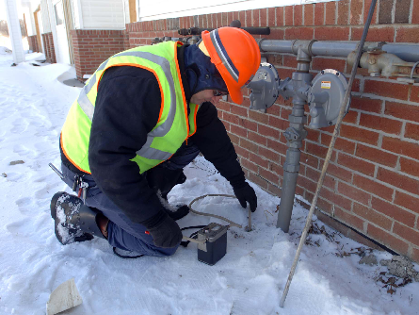
WE ARE WHAT WE REPEATEDLY DO
INCORPORATE
IMPROVEMENTS
REVIEW PERFORMANCE
Execute the Process
1
5
ENGAGE THE TEAM
EXPERIMENT
GO AND SEE THE FACTS
2
4
3
26
Notes:
It’s this cycle, that we continue to work at and as problems occur in our ability to learn and practices these behaviors, we countermeasure them and then test for improvement. Just think about the power of 10,000 employees, surfacing and solving just a few problems, 365 days a year. That a tremendous force that can really make change happen for the better.

Slide 27
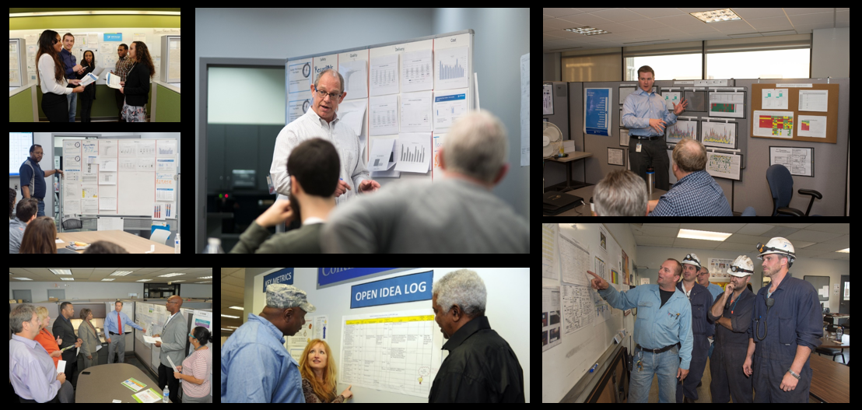
EVERYDAY, EMPLOYEES MEET IN HUDDLES
27
Notes:
Here’s a short video that highlights what I’ve been talking about.
** This just a transition slide to introduce the video. Once you click to the next slide the video will start automatically. **

Slide 28
CI Analysis Video here
EVERYDAY, EMPLOYEES MEET IN HUDDLES
28

Slide 29
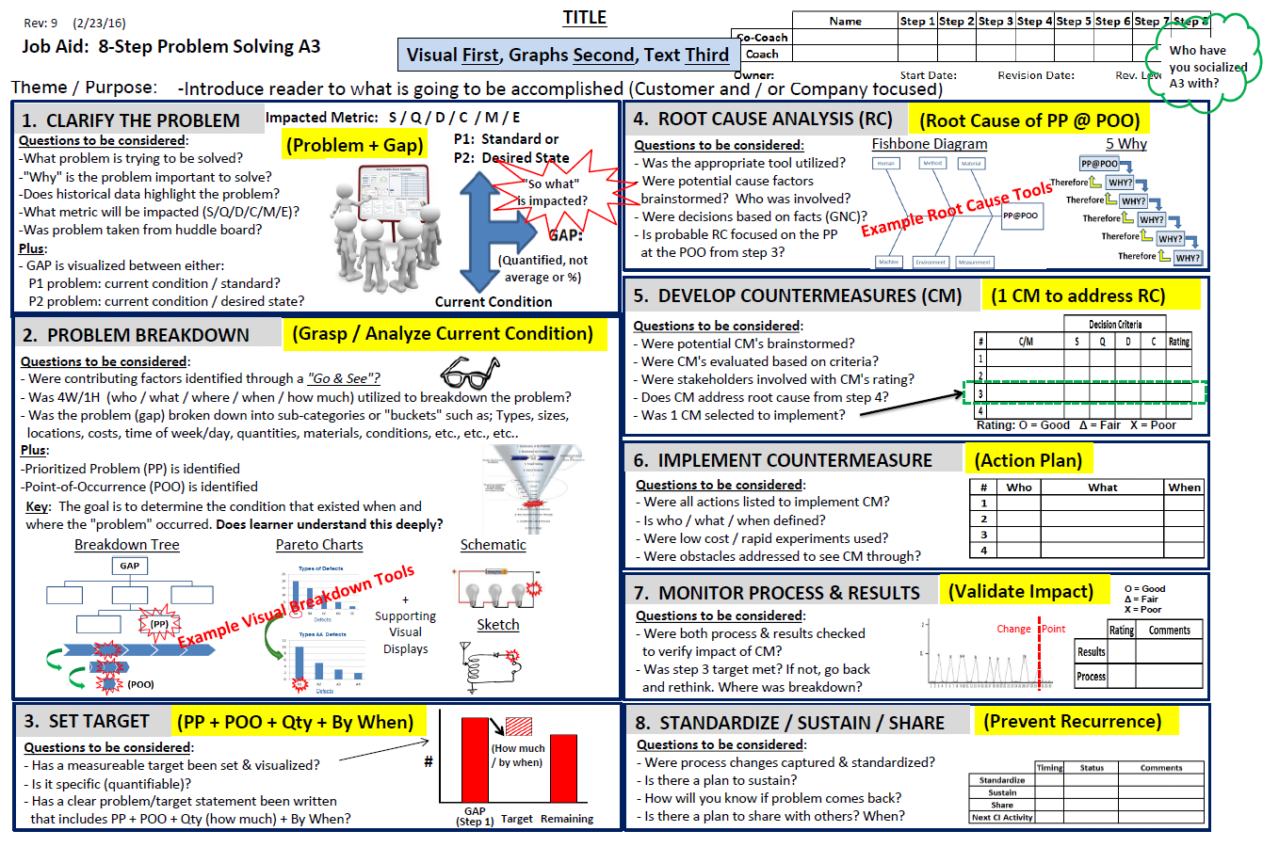
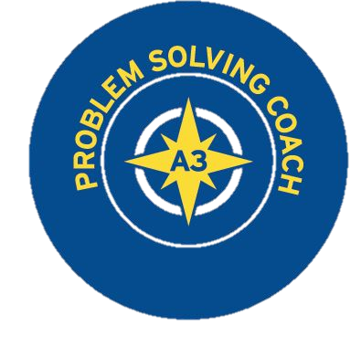
BUILDING A STRONG PROBLEM SOLVING CULTURE
SCIENTIFIC METHOD AND A3 THINKINIG
29
Notes:
One area that I’m particularly proud of is our focus on building a strong problem solving capability. I once heard a leader say, “we don’t have any problems”. That tells you that they really don’t understand their process and may not be listening to their people. We admit we have problems everyday and that our processes can get better. It’s this acknowledgement that allows us to move to the next step to then focus on HOW we go about solving problems. We categorize problems into small, medium and large where most can be broken down into smaller problems to then solve. We leverage the A3 approach and have made great strides in helping learners rethink how to break problems down, go after the root cause and then test to confirm if the countermeasures worked. This is slow process of helping people one by one, but it’s a journey worth taking.

Slide 30
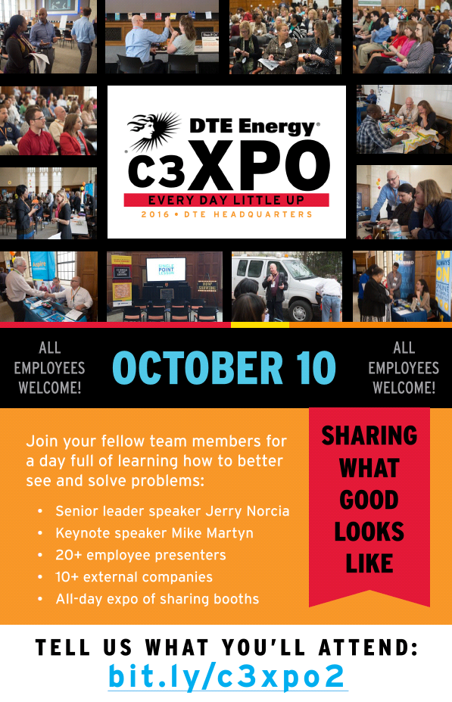
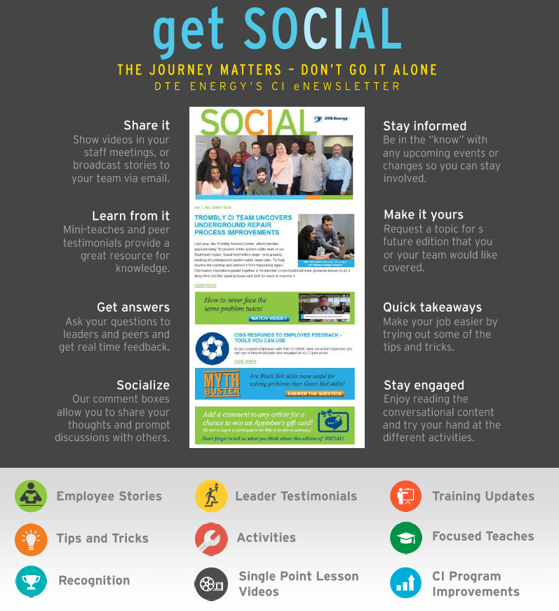
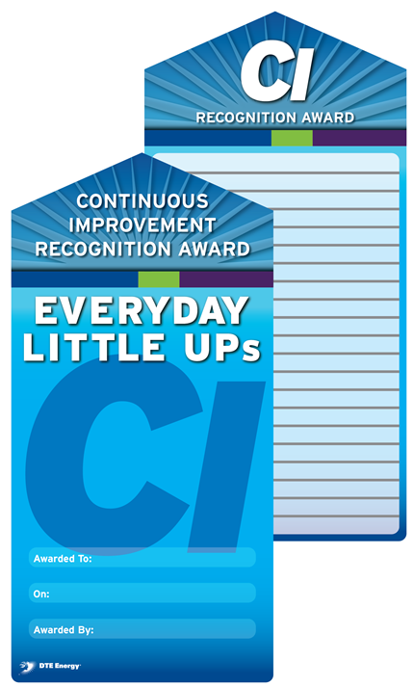
RECOGNIZE WHAT YOU WANT TO SEE MORE OF
CI SHARING EVENTS
MONTHLY CI NEWSLETTER
CI LITTLE UPS
AWARD
DTE NEWSLETTERS, SOCIAL, LITTLE UPS, C3XPO
30
Notes:
We’ve also learned along the way that you need to recognize what you want to see more of, thus we’ve developed ways to share what Great CI Looks like, highlight where employees are using CI to make a improvements for our customers and in our processes.

Slide 31
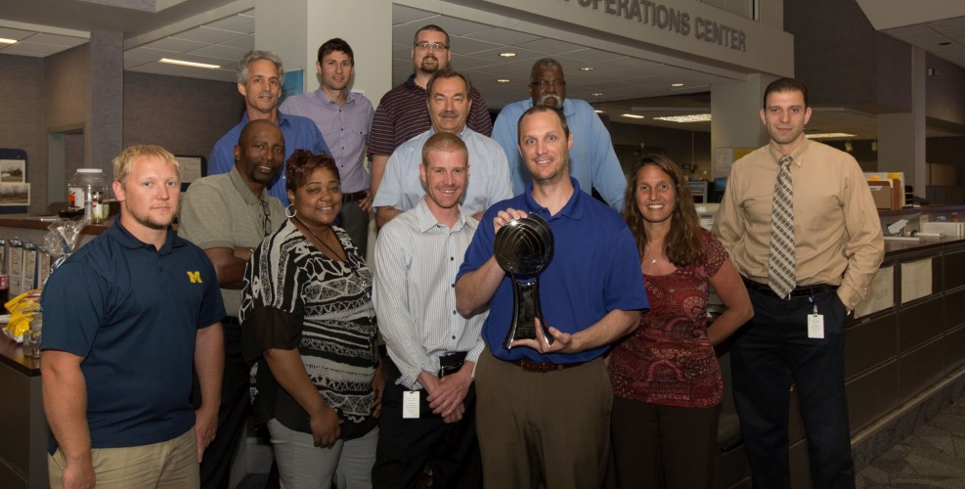
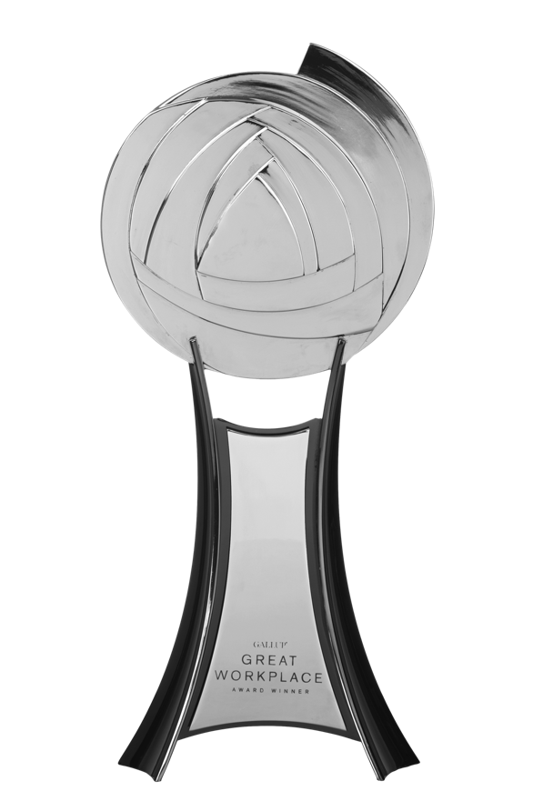
AN ENGAGED WORKFORCE HELPS ACHIEVE OUR GOALS
Winner of 5 consecutive
Gallup Great Workplace Awards
(2012, 2013, 2014, 2015, 2016)
31
Notes:
In turn our employees are telling us that we’re building a place where our they feel empowered to make change happen and enjoy coming to work every day. And this engagement and focus on CI is translating into value for our customers…

Slide 32
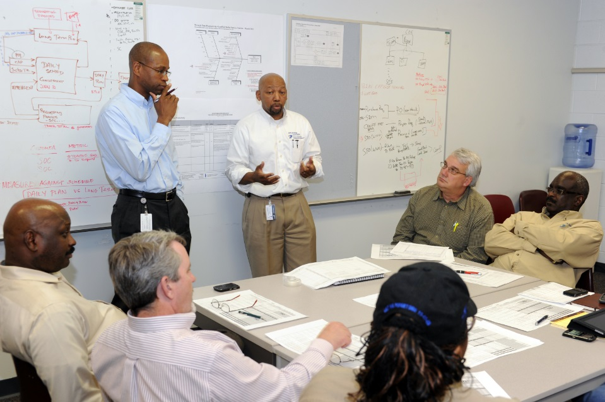
KEEPING COSTS LOW IS ONE WAY WE LIVE OUR CI VALUE
Daily focus on problem solving
Metrics drive progress
Scorecards monitor success
Employees have input into making their work and DTE a better place
2008 to 2016 Change in O&M Costs
Electric Peers
82%
DTE Electric -3%
Average 34%
Gas Peers
92%
DTE Gas -5%
Average 22%
32
Notes:
… where are costs are some of the lowest in the industry and this translates into lower utility rates for our customers.

Slide 33
DTE CI JOURNEY LESSONS LEARNED? TOO MANY TO LIST!
Make it about Culture and Not a program
Moving a culture isn’t fast or easy, so patience is important
Culture is what you repeatedly do, so be specific with what you want them to do
Top leadership involvement (doing and saying) is key as well as consistency in management transition
It’s a balancing act between savings, robustness and employee engagement – you need them all
Assessments create eustress, but at a cost
You cannot share and communicate your successes enough
Keep CI fun and go light on the language
33
Notes:
So in summary, we’ve learned a lot over the years and we’re committed continuing our CI Journey toward becoming the Best Operated Company in North America and a Force for Growth in the Communities where we live and serve. I touch on many of these and would be happy to answer any of your questions. Thank You!
Click to the next slide to then answer questions.

Slide 34
34

